Slide 1
UI Design Template
Bryan Woo
Version 0.1
2017. 12. 20

Slide 2
Screen Layouts

Slide 3
8-points Grid System

Slide 4
Layout Grid System – 4 column grid
Column : 4 cols
Gutter Width : 16 points
Margin Width : 16 points

Slide 5
Layout Grid System – 6 column grid
Column : 6 cols
Gutter Width : 8 points
Margin Width : 16 points

Slide 6
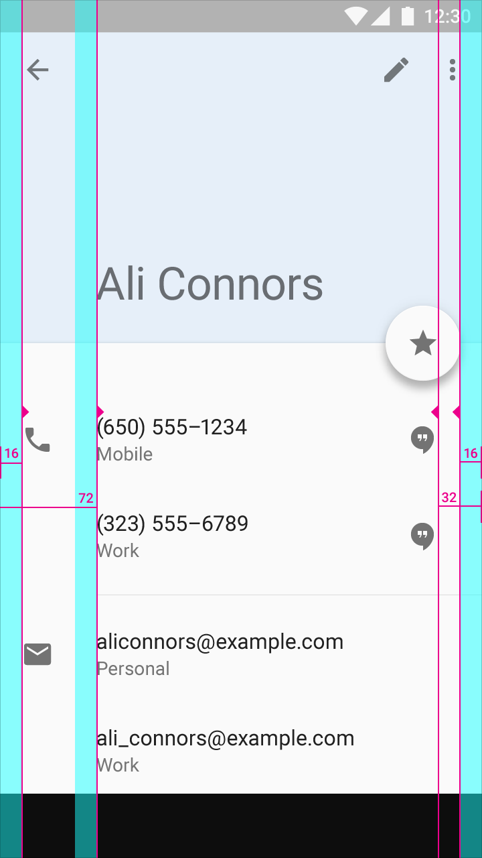
Layout Grid System – 6 column grid

Slide 7
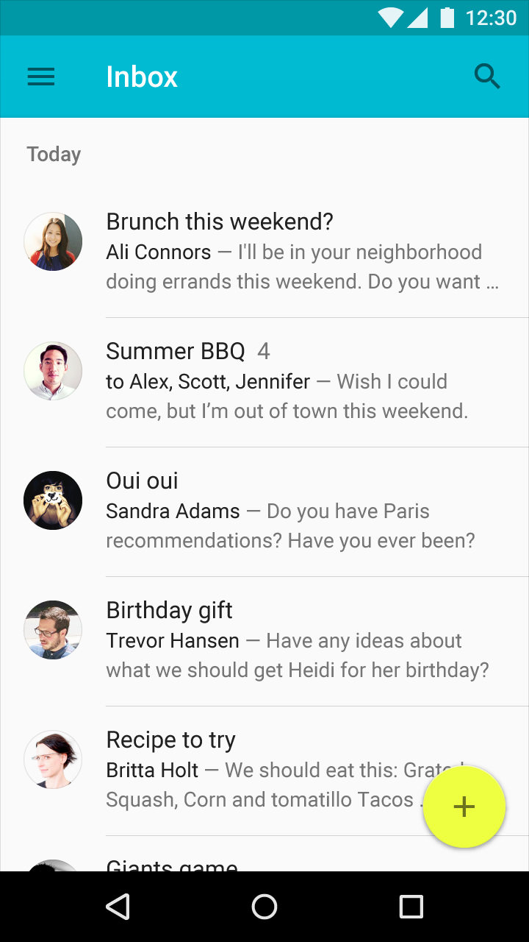
Google Inbox Screen

Slide 8
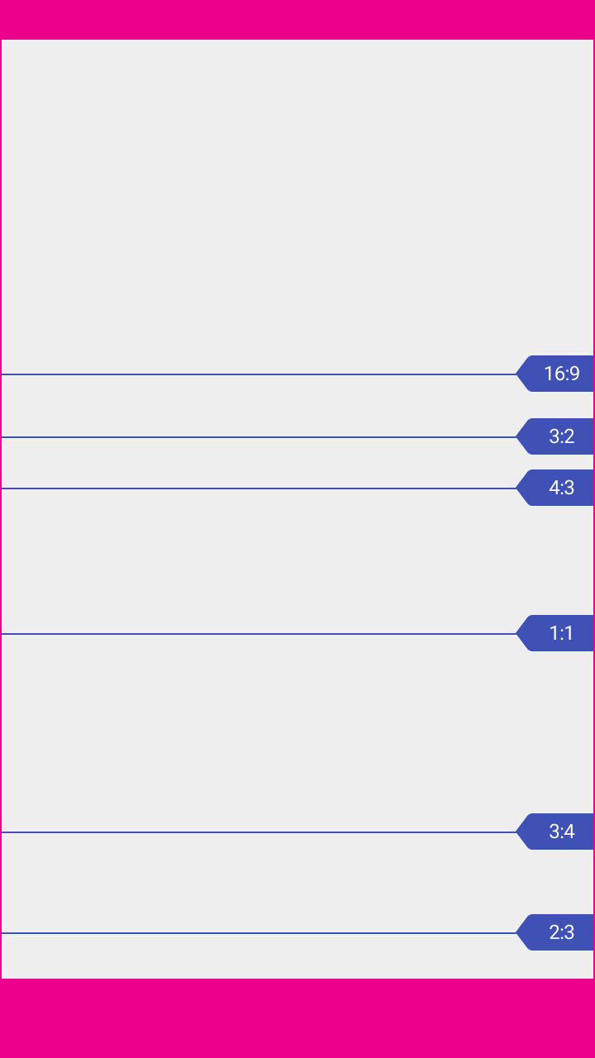
Screen Ratio (Google Material Design)

