Slide 1
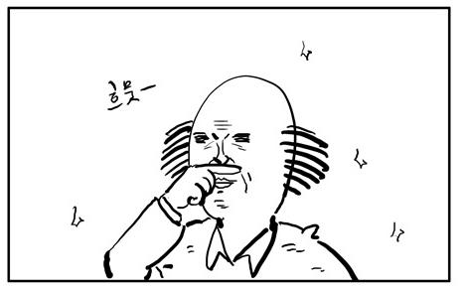
청춘사업 MUST GO ON

Slide 2
추진 배경 요약
Have no time to hangout with one and only 소영 (네가 너무 바쁨)
매 월, 정기 만남의 날 만들어 강제회동 집행
Coffee & chill is good but some other AAActivity would be much better and fun
만약 AAActivity의 컨텐츠가 좋다면, invite friends and others, have more fun!

Slide 3
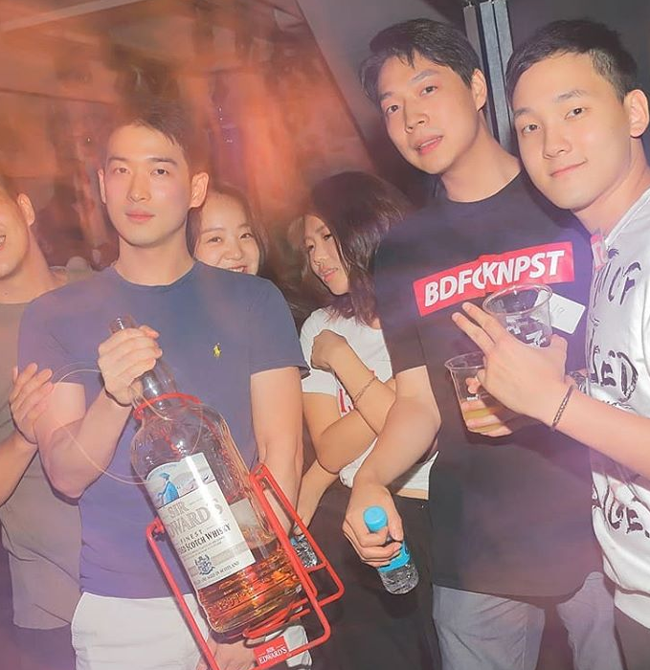
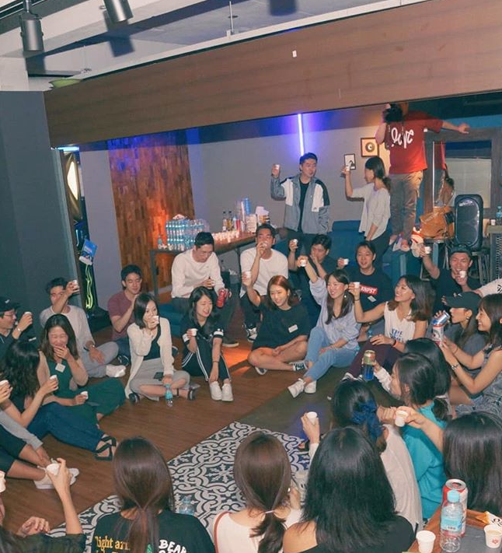
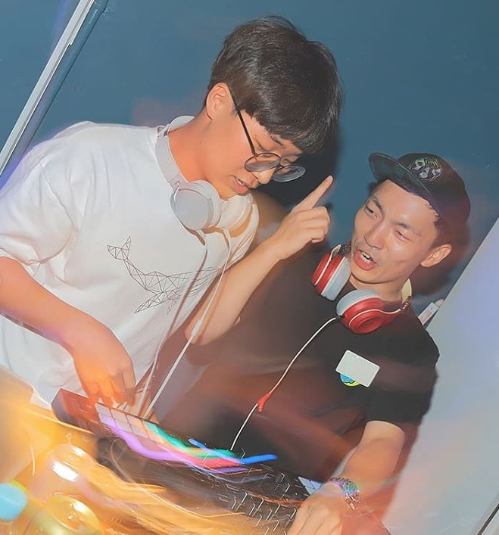
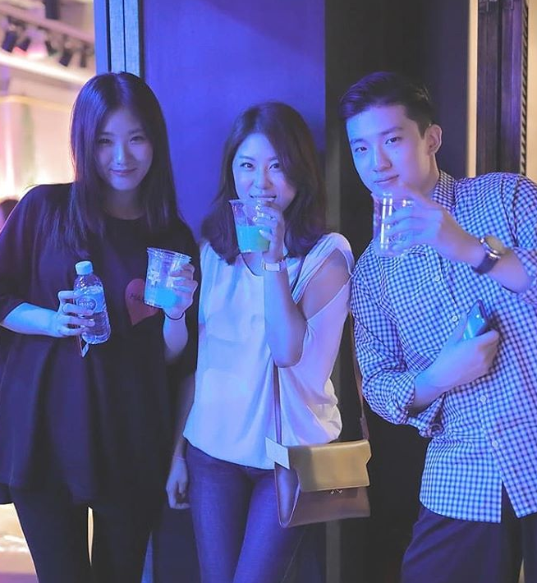
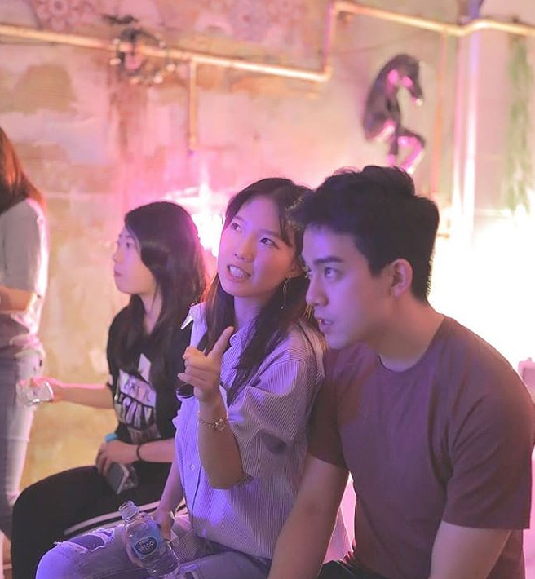
SO WE DID
나태한 15:15

Slide 4
나태한 15:15 결과
47명 참가
47명 전원 만족
23명으로부터 “다음 파티 언제” 문의 받음
참가비 잔여 총액 기부
소영, 영훈 파티 플래너인줄 알았다는 코멘트 4건
공식 커플 한 쌍 탄생, 비공식 셋 넷? 탄생?? (추정)
사이드 프로젝트의 즐거움 인지
소영 영훈 에너지 탕진, 폐인화 및 몸살
Fun
이성 간의 케미스트리 is always interesting

Slide 5
What made 나태한 15:15 fun
A L C O H O L
LIVE MUSIC
지인
이성
컨텐츠
  ‘흥부와 놀부’ : 이로 인해 첫 만남 첫 질문이 식상하지않았음
    누구랑 오셨어요, 누구 소개로 오셨어요? 파티는 자주 참여하세요? CLICHÉ (x)
    영원한 사랑을 믿으시나요? 비핵화에 관심이 있으신가요? ; 랜덤한 질문을 통한 긴장 타파 및 유대감 형성 (o)
    결과 : 이어지는 이벤트에 어색함 없이 참여함
  각종 파트너 / 팀 게임
  상품

Slide 6
SO?
  W H A T

Slide 7
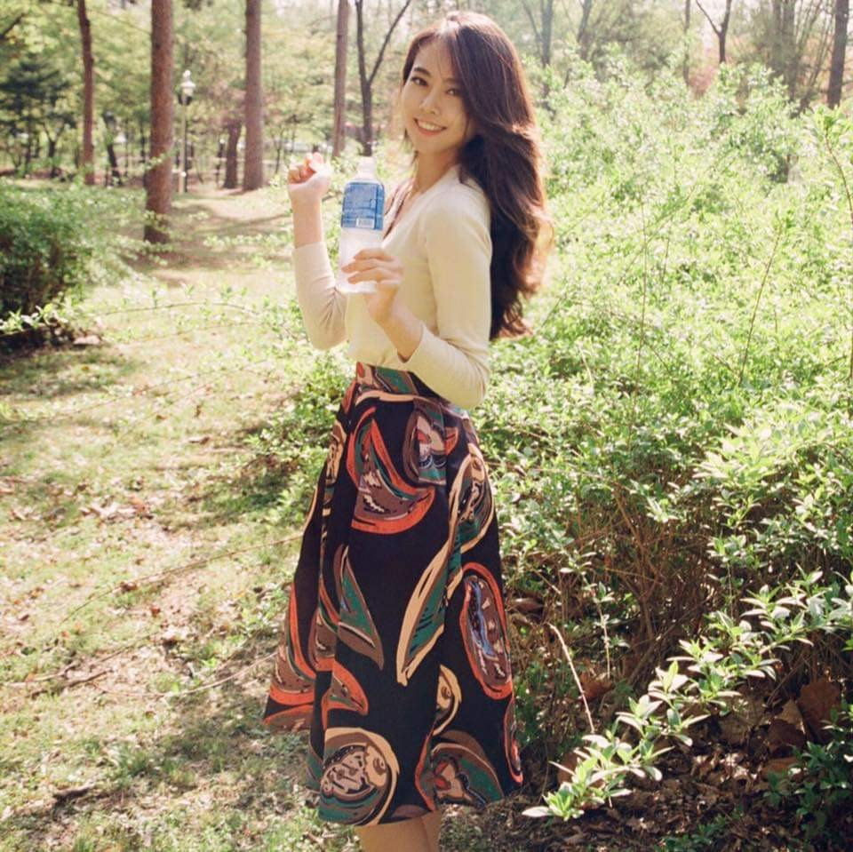

Slide 8
HARD WORKING HARD WORKING HARD WORKING HARD WORKING HARD WORKING HARD WORKING HARD WORKING HARD WORKING
HARD WORKING HARD WORKING HARD WORKING HARD WORKING HARD WORKING HARD WORKING HARD WORKING HARD WORKING
HARD WORKING HARD WORKING HARD WORKING HARD WORKING HARD WORKING HARD WORKING HARD WORKING HARD WORKING
HARD WORKING HARD WORKING HARD WORKING HARD WORKING HARD WORKING HARD WORKING HARD WORKING HARD WORKING
HARD WORKING HARD WORKING HARD WORKING HARD WORKING HARD WORKING HARD WORKING HARD WORKING HARD WORKING
HARD WORKING HARD WORKING HARD WORKING HARD WORKING HARD WORKING HARD WORKING HARD WORKING HARD WORKING
HARD WORKING HARD WORKING HARD WORKING HARD WORKING HARD WORKING HARD WORKING HARD WORKING HARD WORKING
HARD WORKING HARD WORKING HARD WORKING HARD WORKING HARD WORKING HARD WORKING HARD WORKING HARD WORKING
HARD WORKING HARD WORKING HARD WORKING HARD WORKING HARD WORKING HARD WORKING HARD WORKING HARD WORKING
HARD WORKING HARD WORKING HARD WORKING HARD WORKING HARD WORKING HARD WORKING HARD WORKING HARD WORKING
HARD WORKING HARD WORKING HARD WORKING HARD WORKING HARD WORKING HARD WORKING HARD WORKING HARD WORKING
HARD WORKING HARD WORKING HARD WORKING HARD WORKING HARD WORKING HARD WORKING HARD WORKING HARD WORKING
HARD WORKING HARD WORKING HARD WORKING HARD WORKING HARD WORKING HARD WORKING HARD WORKING HARD WORKING
HARD WORKING HARD WORKING HARD WORKING HARD WORKING HARD WORKING HARD WORKING HARD WORKING HARD WORKING
HARD WORKING HARD WORKING HARD WORKING HARD WORKING HARD WORKING HARD WORKING HARD WORKING HARD WORKING
HARD WORKING HARD WORKING HARD WORKING HARD WORKING HARD WORKING HARD WORKING HARD WORKING HARD WORKING
HARD WORKING HARD WORKING HARD WORKING HARD WORKING HARD WORKING HARD WORKING HARD WORKING HARD WORKING
HARD WORKING HARD WORKING HARD WORKING HARD WORKING HARD WORKING HARD WORKING HARD WORKING HARD WORKING
HARD WORKING HARD WORKING HARD WORKING HARD WORKING HARD WORKING HARD WORKING HARD WORKING HARD WORKING
HARD WORKING HARD WORKING HARD WORKING HARD WORKING HARD WORKING HARD WORKING HARD WORKING HARD WORKING
HARD WORKING HARD WORKING HARD WORKING HARD WORKING HARD WORKING HARD WORKING HARD WORKING HARD WORKING
HARD WORKING HARD WORKING HARD WORKING HARD WORKING HARD WORKING HARD WORKING HARD WORKING HARD WORKING
HARD WORKING HARD WORKING HARD WORKING HARD WORKING HARD WORKING HARD WORKING HARD WORKING HARD WORKING
HARD WORKING HARD WORKING HARD WORKING HARD WORKING HARD WORKING HARD WORKING HARD WORKING HARD WORKING
HARD WORKING HARD WORKING HARD WORKING HARD WORKING HARD WORKING HARD WORKING HARD WORKING HARD WORKING
HARD WORKING HARD WORKING HARD WORKING HARD WORKING HARD WORKING HARD WORKING HARD WORKING HARD WORKING
HARD WORKING HARD WORKING HARD WORKING HARD WORKING HARD WORKING HARD WORKING HARD WORKING HARD WORKING
HARD WORKING HARD WORKING HARD WORKING HARD WORKING HARD WORKING HARD WORKING HARD WORKING HARD WORKING

Slide 9

HARD WORKING HARD WORKING HARD WORKING HARD WORKING HARD WORKING HARD WORKING HARD WORKING HARD WORKING
HARD WORKING HARD WORKING HARD WORKING HARD WORKING HARD WORKING HARD WORKING HARD WORKING HARD WORKING
HARD WORKING HARD WORKING HARD WORKING HARD WORKING HARD WORKING HARD WORKING HARD WORKING HARD WORKING
HARD WORKING HARD WORKING HARD WORKING HARD WORKING HARD WORKING HARD WORKING HARD WORKING HARD WORKING
HARD WORKING HARD WORKING HARD WORKING HARD WORKING HARD WORKING HARD WORKING HARD WORKING HARD WORKING
HARD WORKING HARD WORKING HARD WORKING HARD WORKING HARD WORKING HARD WORKING HARD WORKING HARD WORKING
HARD WORKING HARD WORKING HARD WORKING HARD WORKING HARD WORKING HARD WORKING HARD WORKING HARD WORKING
HARD WORKING HARD WORKING HARD WORKING HARD WORKING HARD WORKING HARD WORKING HARD WORKING HARD WORKING
HARD WORKING HARD WORKING HARD WORKING HARD WORKING HARD WORKING HARD WORKING HARD WORKING HARD WORKING
HARD WORKING HARD WORKING HARD WORKING HARD WORKING HARD WORKING HARD WORKING HARD WORKING HARD WORKING
HARD WORKING HARD WORKING HARD WORKING HARD WORKING HARD WORKING HARD WORKING HARD WORKING HARD WORKING
HARD WORKING HARD WORKING HARD WORKING HARD WORKING HARD WORKING HARD WORKING HARD WORKING HARD WORKING
HARD WORKING HARD WORKING HARD WORKING HARD WORKING HARD WORKING HARD WORKING HARD WORKING HARD WORKING
HARD WORKING HARD WORKING HARD WORKING HARD WORKING HARD WORKING HARD WORKING HARD WORKING HARD WORKING
HARD WORKING HARD WORKING HARD WORKING HARD WORKING HARD WORKING HARD WORKING HARD WORKING HARD WORKING
HARD WORKING HARD WORKING HARD WORKING HARD WORKING HARD WORKING HARD WORKING HARD WORKING HARD WORKING
HARD WORKING HARD WORKING HARD WORKING HARD WORKING HARD WORKING HARD WORKING HARD WORKING HARD WORKING
HARD WORKING HARD WORKING HARD WORKING HARD WORKING HARD WORKING HARD WORKING HARD WORKING HARD WORKING
HARD WORKING HARD WORKING HARD WORKING HARD WORKING HARD WORKING HARD WORKING HARD WORKING HARD WORKING
HARD WORKING HARD WORKING HARD WORKING HARD WORKING HARD WORKING HARD WORKING HARD WORKING HARD WORKING
HARD WORKING HARD WORKING HARD WORKING HARD WORKING HARD WORKING HARD WORKING HARD WORKING HARD WORKING
HARD WORKING HARD WORKING HARD WORKING HARD WORKING HARD WORKING HARD WORKING HARD WORKING HARD WORKING
HARD WORKING HARD WORKING HARD WORKING HARD WORKING HARD WORKING HARD WORKING HARD WORKING HARD WORKING
HARD WORKING HARD WORKING HARD WORKING HARD WORKING HARD WORKING HARD WORKING HARD WORKING HARD WORKING
HARD WORKING HARD WORKING HARD WORKING HARD WORKING HARD WORKING HARD WORKING HARD WORKING HARD WORKING
HARD WORKING HARD WORKING HARD WORKING HARD WORKING HARD WORKING HARD WORKING HARD WORKING HARD WORKING
HARD WORKING HARD WORKING HARD WORKING HARD WORKING HARD WORKING HARD WORKING HARD WORKING HARD WORKING
HARD WORKING HARD WORKING HARD WORKING HARD WORKING HARD WORKING HARD WORKING AND THAT MAKES ME SAD

Slide 10
ㄴㄴ
동 심 파 괴

Slide 11

동 심 회 개

Slide 12
죽은 우리의 동심에 국화 꽃 한 송이
동심파괴 ㄴㄴ
잃어버린 동심 회개 ㅇㅇ
한 달에 한 번의 휴식

Slide 13
WHY 청춘사업 MUST GO ON?
맨 처음 청춘사업을 생각했던 것처럼 본 이벤트는 우리의 즐거움 그 자체가 되어야 함.
BUT WE DID PUT TOOOOOOO MUCH EFFORT on 나태한 15:15
따라서, 즐거운 ‘이벤트’가 아닌 ‘즐거움’ 자체에 초점을 맞췄으면 함.
김영훈 사견으로써, 한 달에 한 번 준비해야할 이벤트가 아닌 소영이 너에게 하루의 휴식 및 에너지를 주고 싶은 마음.
그렇다면 어떻게?
준비 최소화 ; 지난 행사에서 많은 피로감을 느꼈던 부분은 손이 많이 갔던 것들 :
  FOOD & BEVERAGE ; 이벤트 끝나고 희망자에 한해 그냥 식당을 가는게 나음 (술, 간단 안주 정도는 괜찮)

Slide 14
LIVE FORVER YOUNG!
at least once in a month

Slide 15
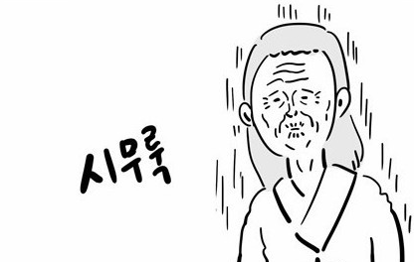
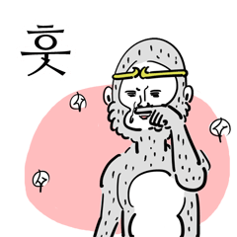
AND I REALLY WANT TO GIVE YOU A BREAK 소영

