Slide 1
AYARF Research Proposal
‘The Global Ecocide Of Korean Companies’
I note three incidents this year: LG Chem's India Bikashapatnam gas disaster(5.7), Kepco and Dosan’s overseas coal power plant investment structure decision. Korindo and Posco international’s illegal land exploitation of Indonesia Papua. Besides, there is Samsung's suppression of Vietnamese factory workers and sexual exploitation. SK’s collapse of the Laos dam in 2018.
So, the 2nd AYARF theme will be "The global ecocide, also known as ecosystem exploitation of Korea companies – Focus on chemical accident, overseas coal power plants investment, and land exploitation of palm oil farm."
Key question is that ‘Why are Korean companies notorious as villains, especially in the destruction of the global ecosystem? What is the structural cause of them?" Korean companies are making Asia as hell now.
A huge paradox is at the center of this problem. First, the stock market does not reflect the influence of ecocide. Second, ‘greenwashing’ works well in this process. Third, public financial institutions and private companies are operative together, such as project financing. Fourth, the company’s ecosystem destruction is committed to ‘double standard’. Fifth, there is a back-scratching alliance in the local corrupt government.
These are the causes. First, the corporate governance structure of Korean companies, called 'bulletproof clothing', the exclusive power of the owner. Second, the investment structure of private companies and public institutions, which evaluated only by profitability. Third, the Korean government's protection companies and connivance when the accident begins. Fourth, the lack of media awareness and be bought off. Fifth, the lack of power capacity in civil society.
The following are the alternatives I suggest. First, change corporate governance, the introduction of a joint labor-management decision system. Second, the expansion of sustainable, ESG, SRI investment and regulation policy changed. Third, the expansion of land tax and carbon tax. Fourth, the protection of the rights of indigenous peoples, the application of Georgism. Fifth, the expanded Global Green New Deal, not the National Green New Deal.
Ultimately, I’m looking forward to watching cases of exploitation by Korean companies around the world. And based on these cases, I try to make a theoretical solution, a theory that can analyze these situations critically. At the same time, I'm going to research, make it public, and active. I want to gather people in AYARF and expand my vision.
Notes:
“The Global Ecocide of korea companies” That’s my theme topic on second AYARF. I try to see ecological distruption and ecosystem exploitation on Asia, and focus on Korean enterprise’s chemical accident, overseas coal power plants investment, and land exploitation of palm oil farm. Key question is that ‘Why are Korean companies notorious as villains, especially in the destruction of the global ecosystem? What is the structural cause of them?" Korean companies are making Asia as hell now. You will see the mulititude case.

Slide 2
What is ecocide?
  Definition
    Ecocide is criminalized human activity that violates the principles of environmental justice, such as causing extensive damage or destroying ecosystems or harming the health and well-being of a species (including humans). (Wikipedia)
    …

Slide 3
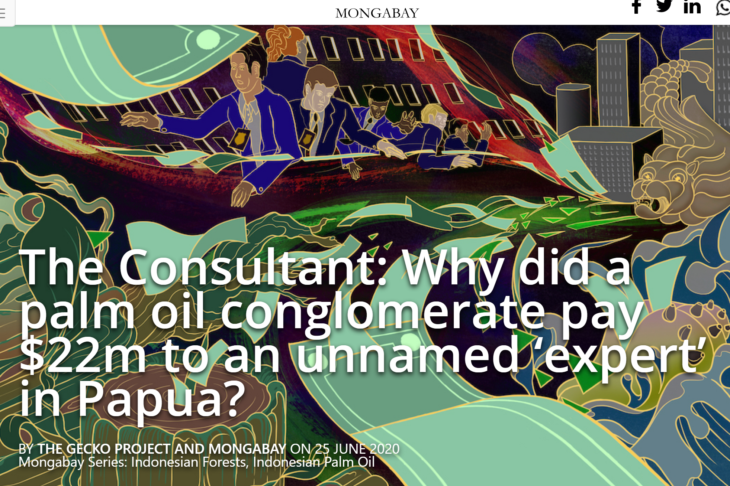
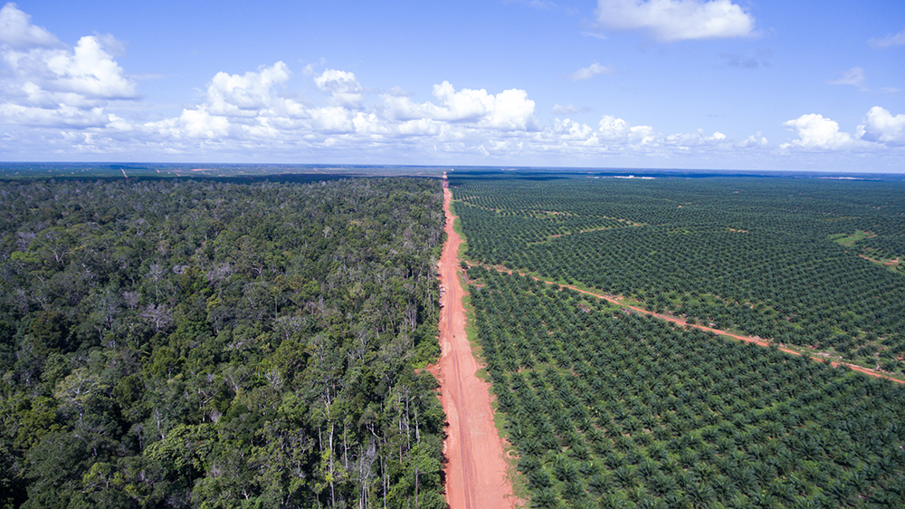
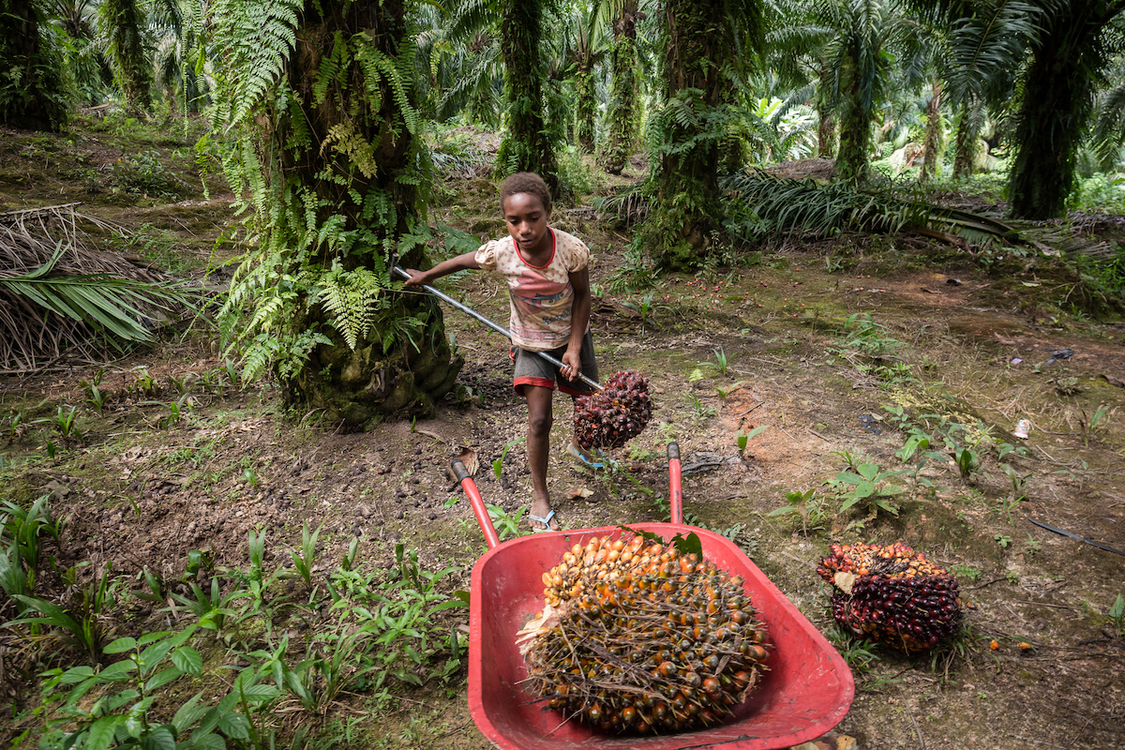
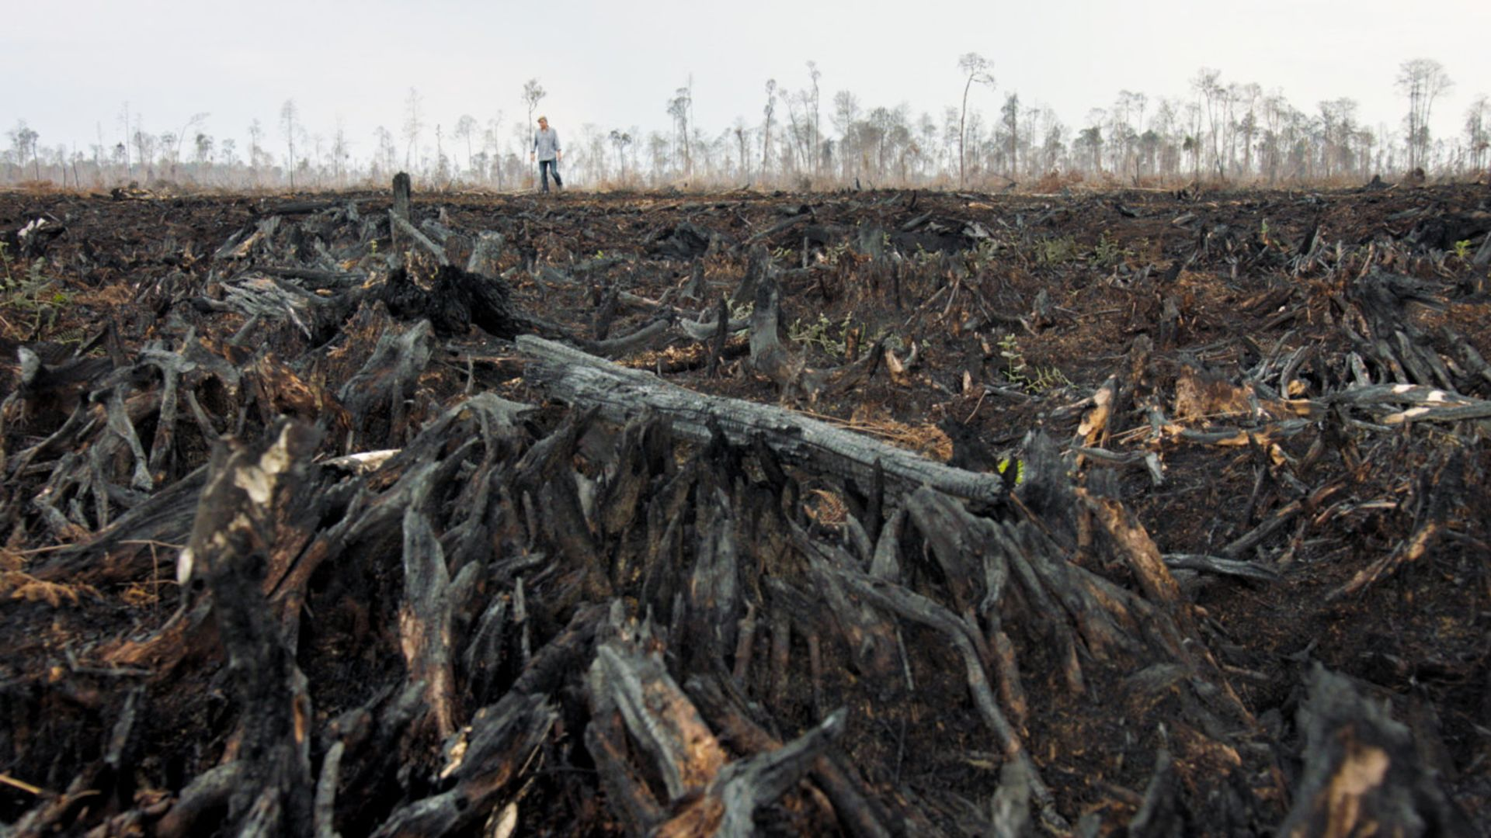
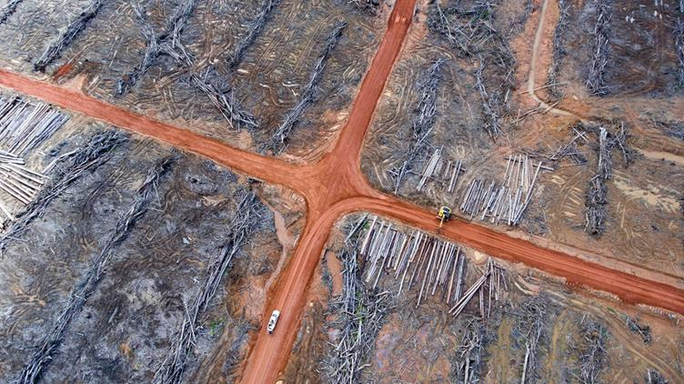
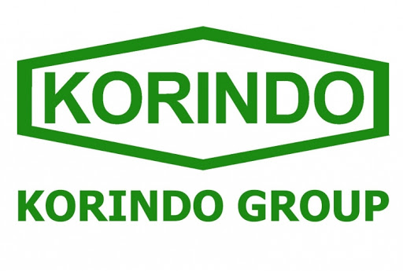


Notes:
First case, Korindo and Posco international, Samsung’s illegal land exploitation of Indonesia Papua,

Slide 4
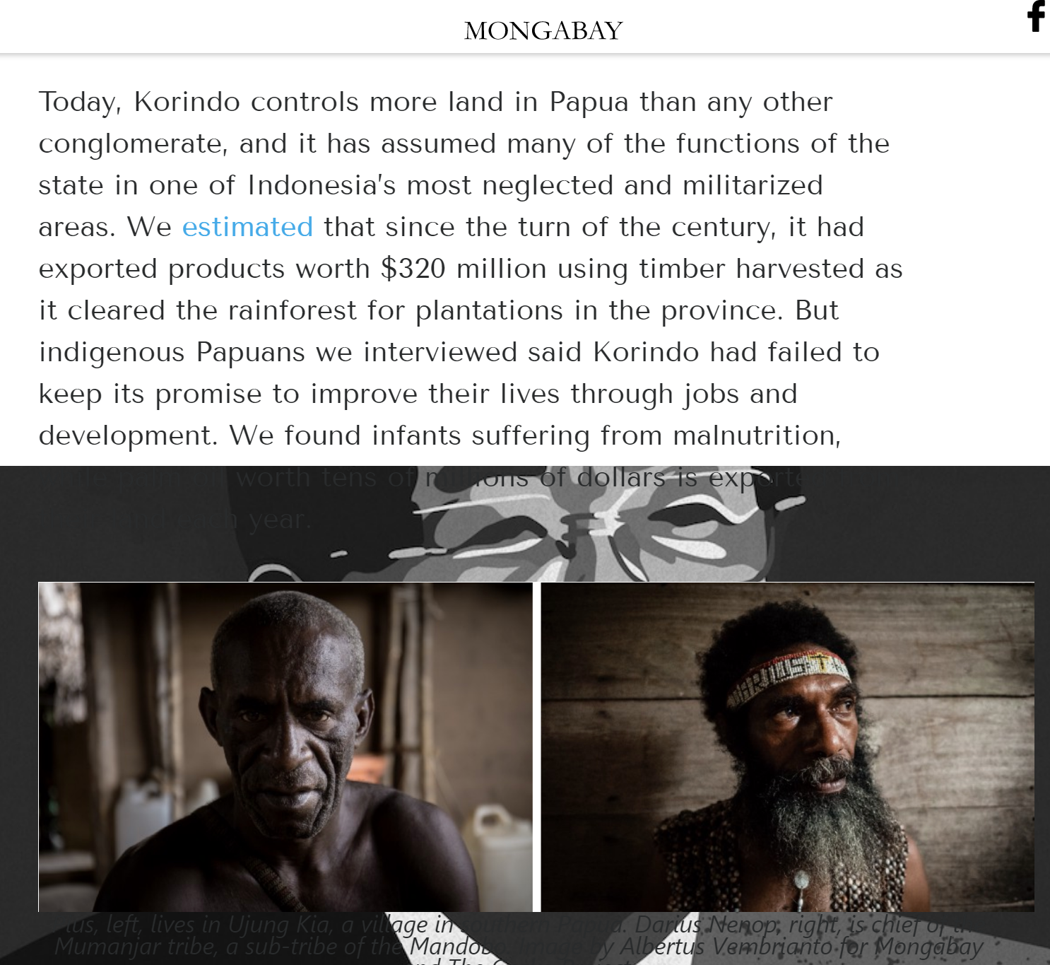
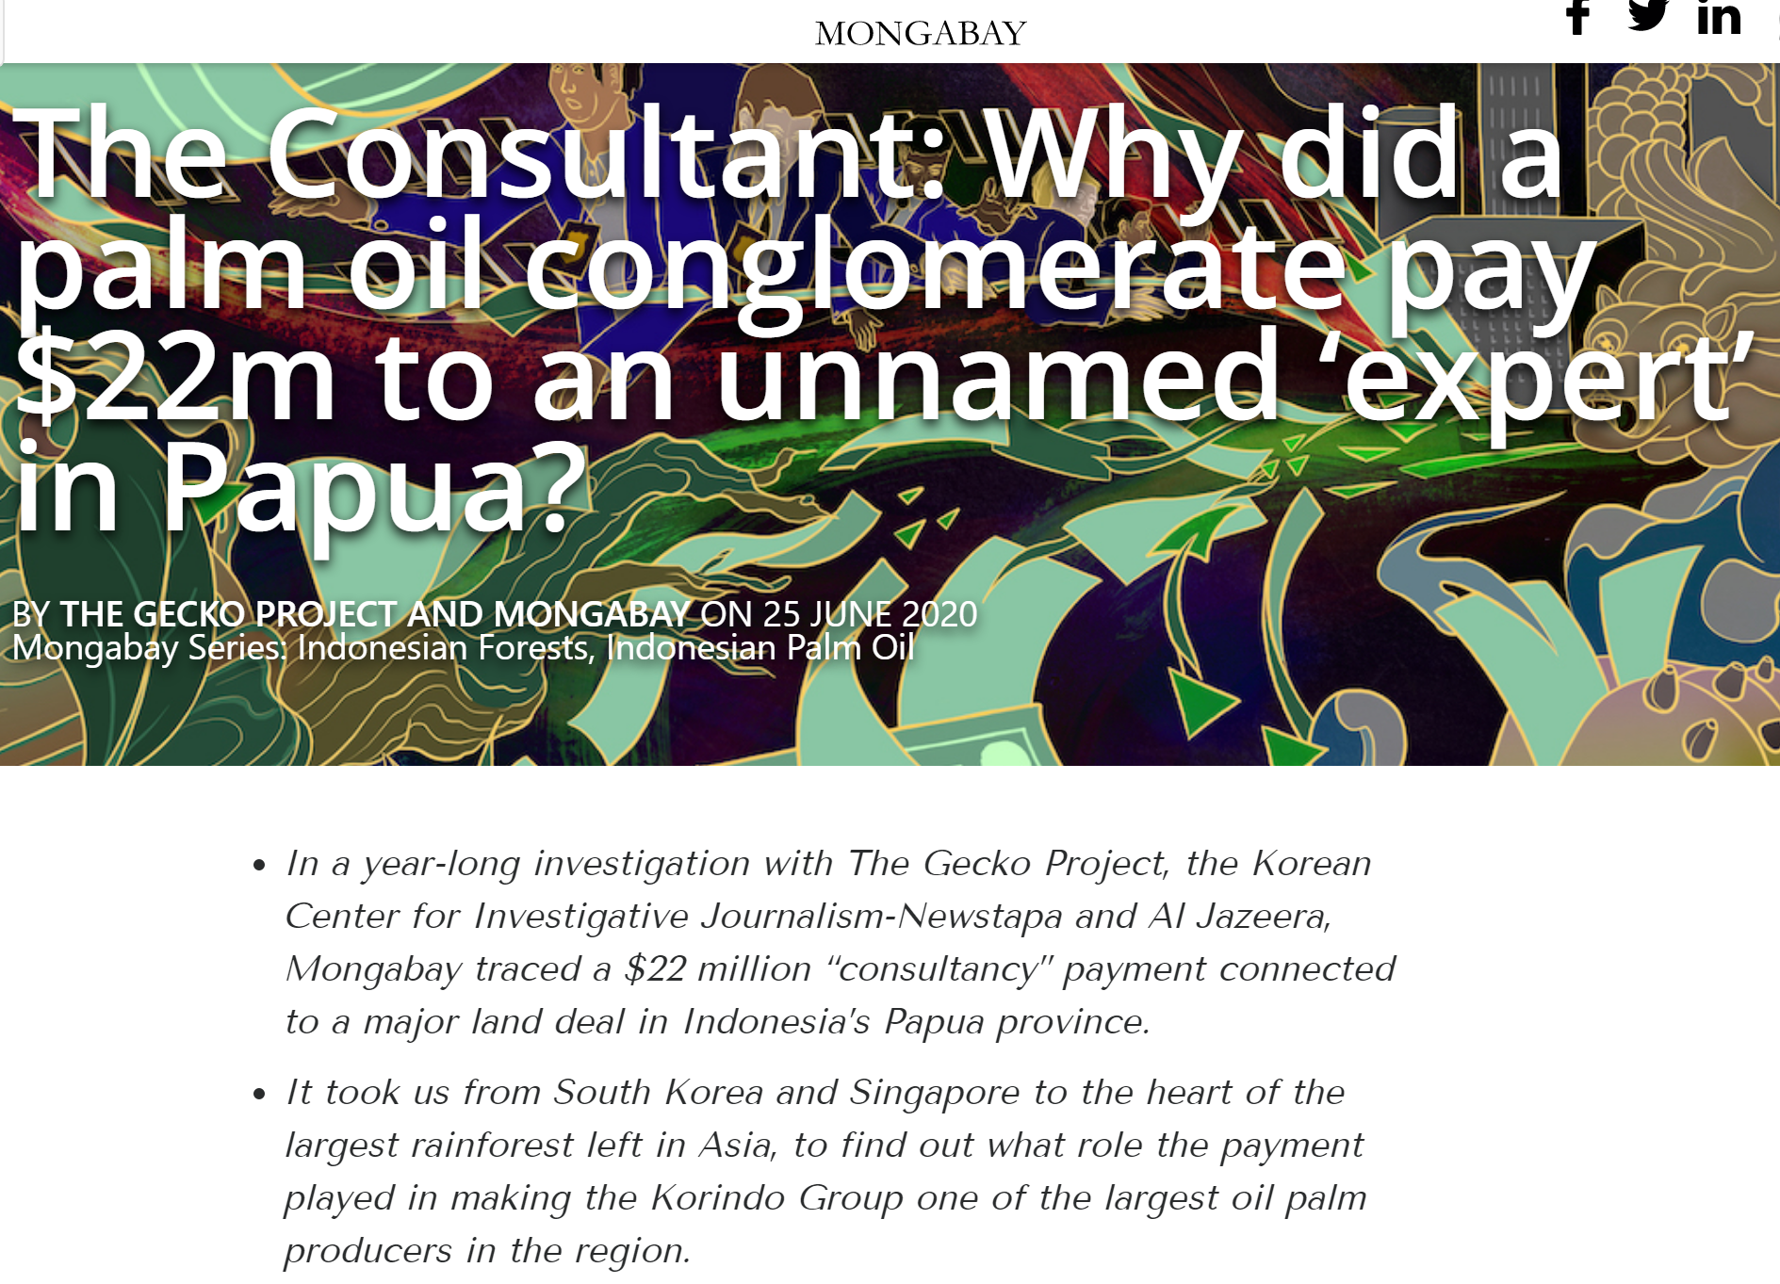

Slide 5
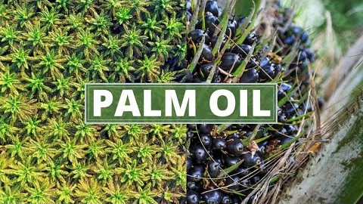

Slide 6

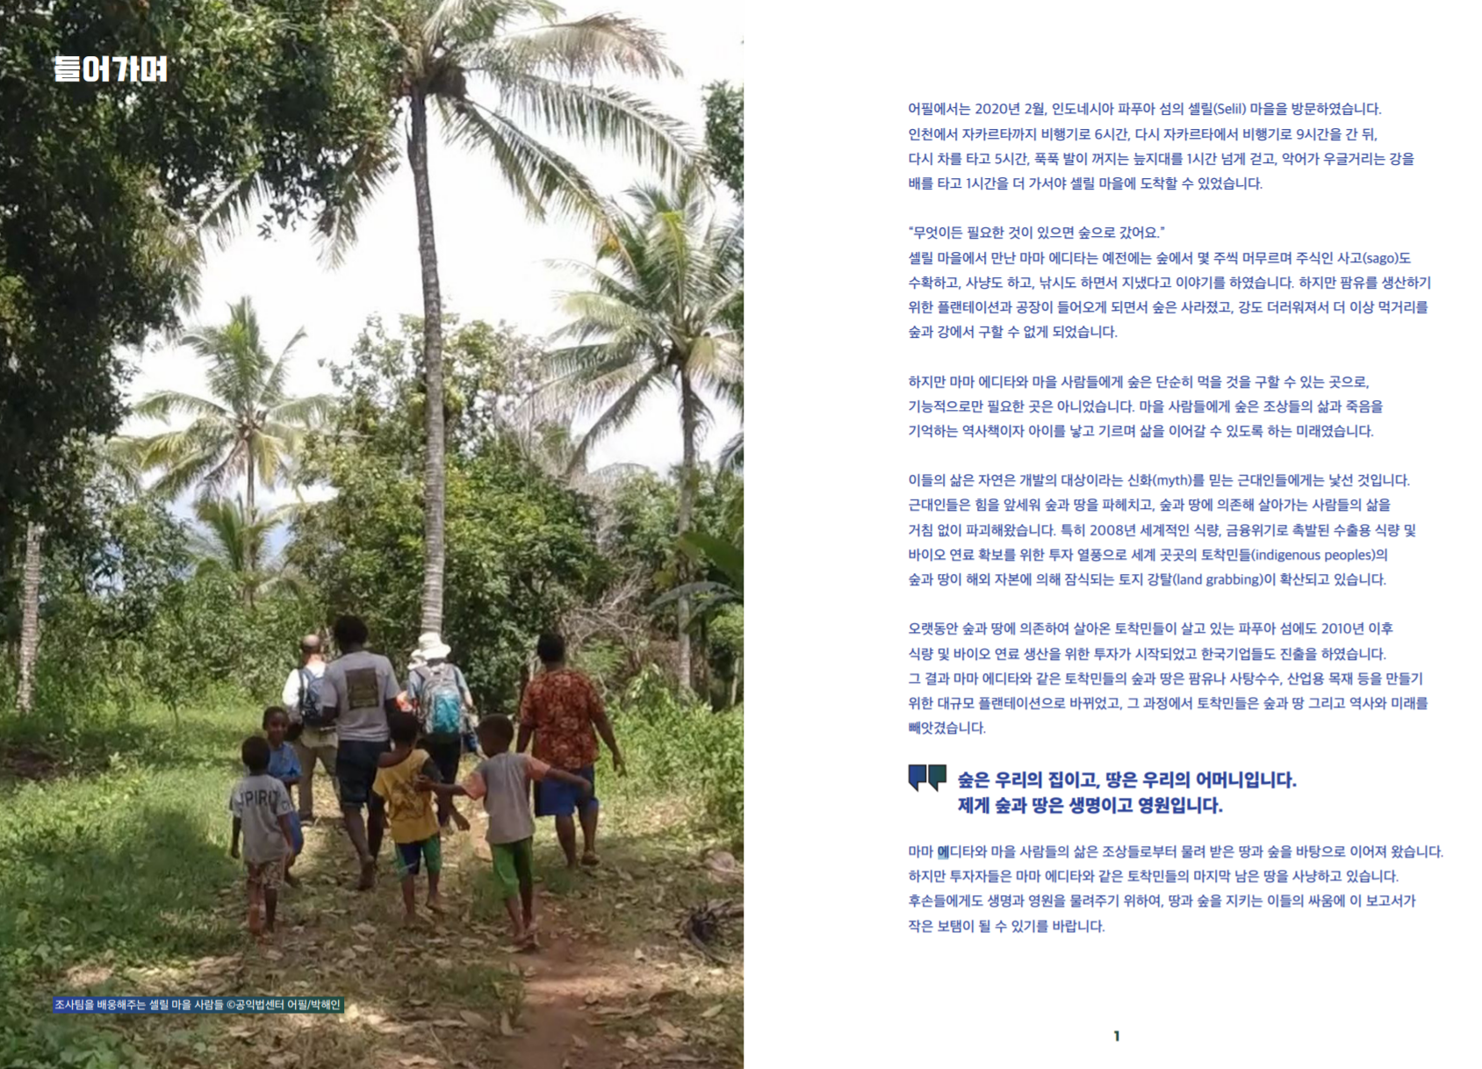
Right of Indigenous people 토착민의 권리
Last hunt
https://apil.or.kr/wp-content/uploads/2020/08/%e1%84%86%e1%85%a1%e1%84%8c%e1%85%b5%e1%84%86%e1%85%a1%e1%86%a8%e1%84%89%e1%85%a1%e1%84%82%e1%85%a3%e1%86%bc.pdf

Slide 7
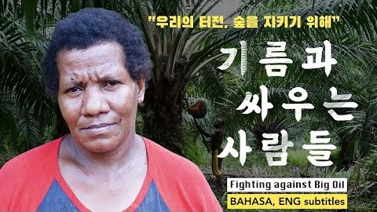

Slide 8
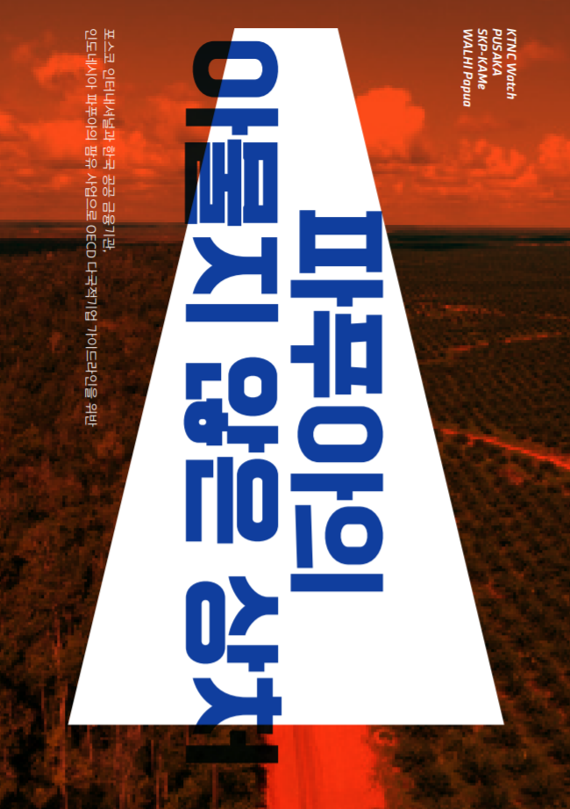
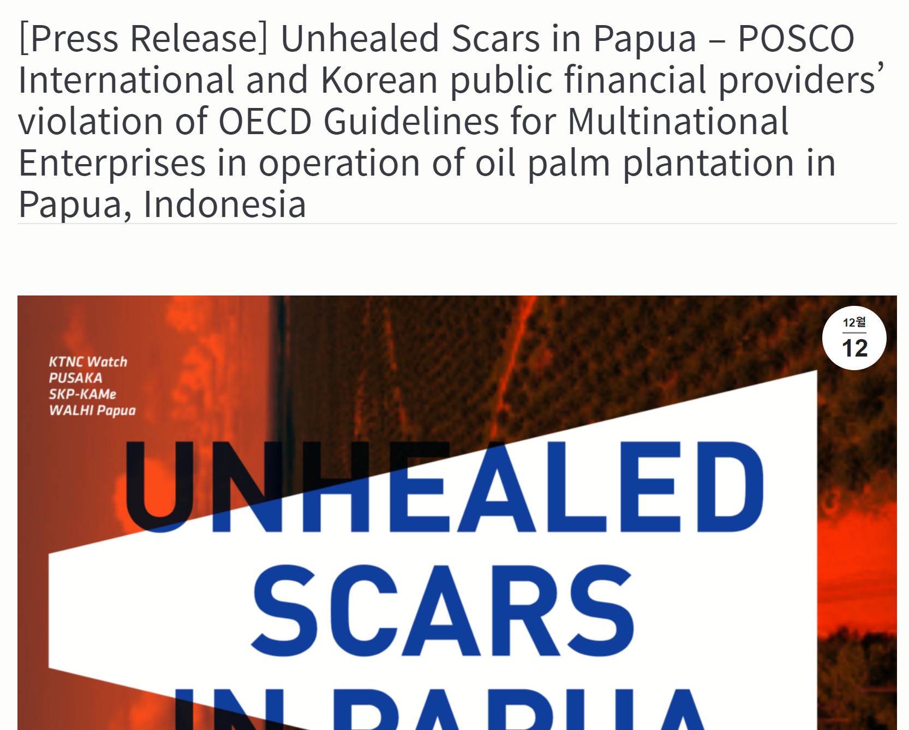

Slide 9
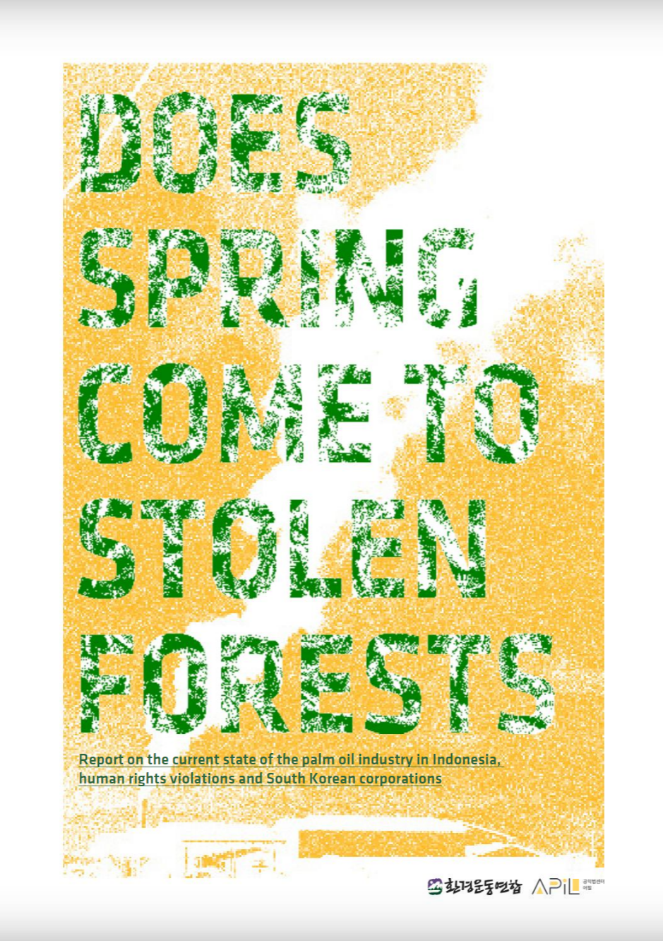
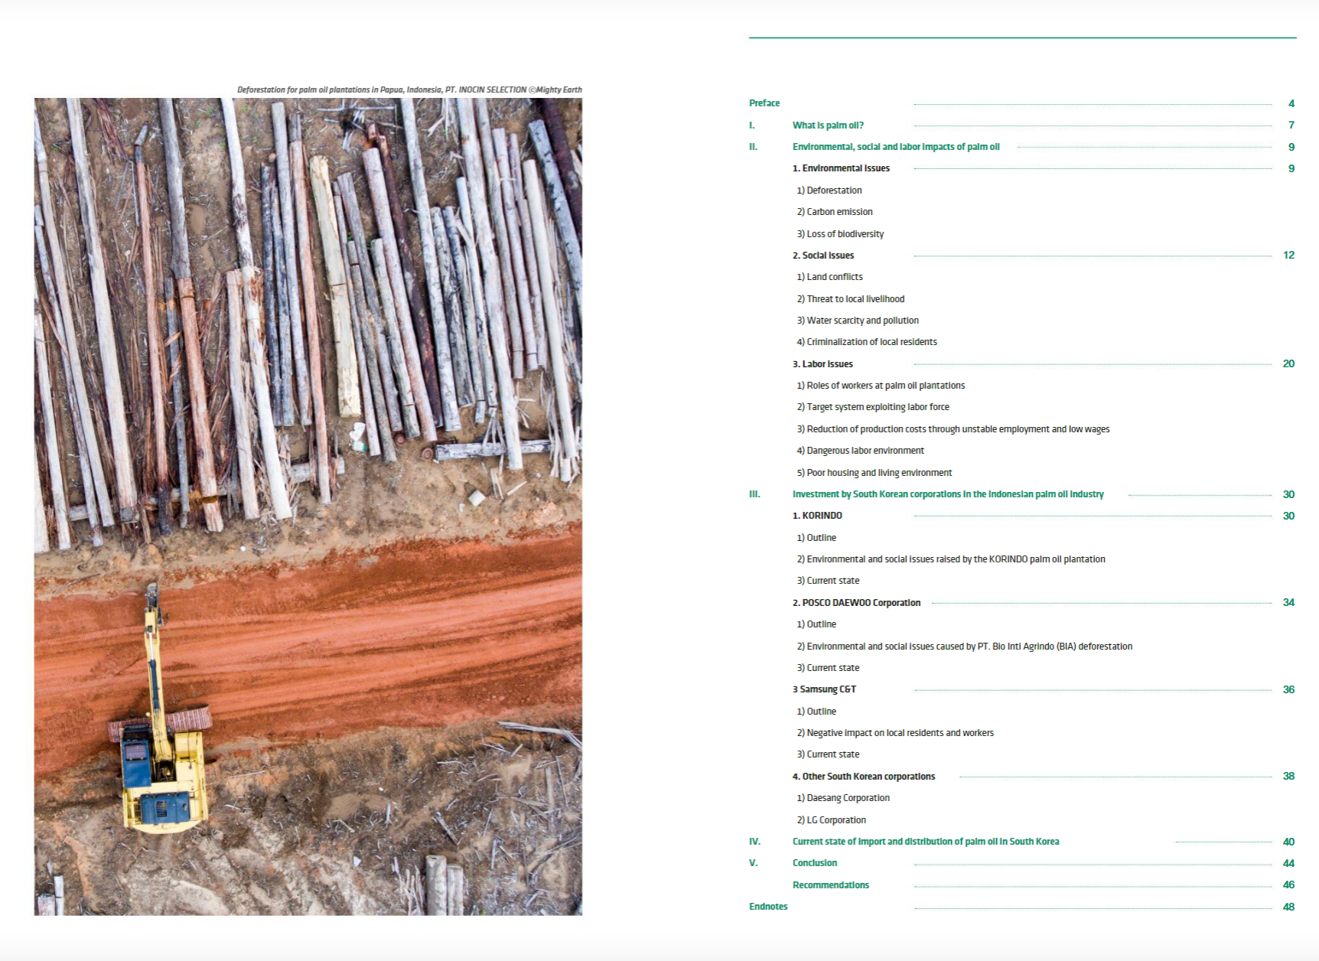

Slide 10
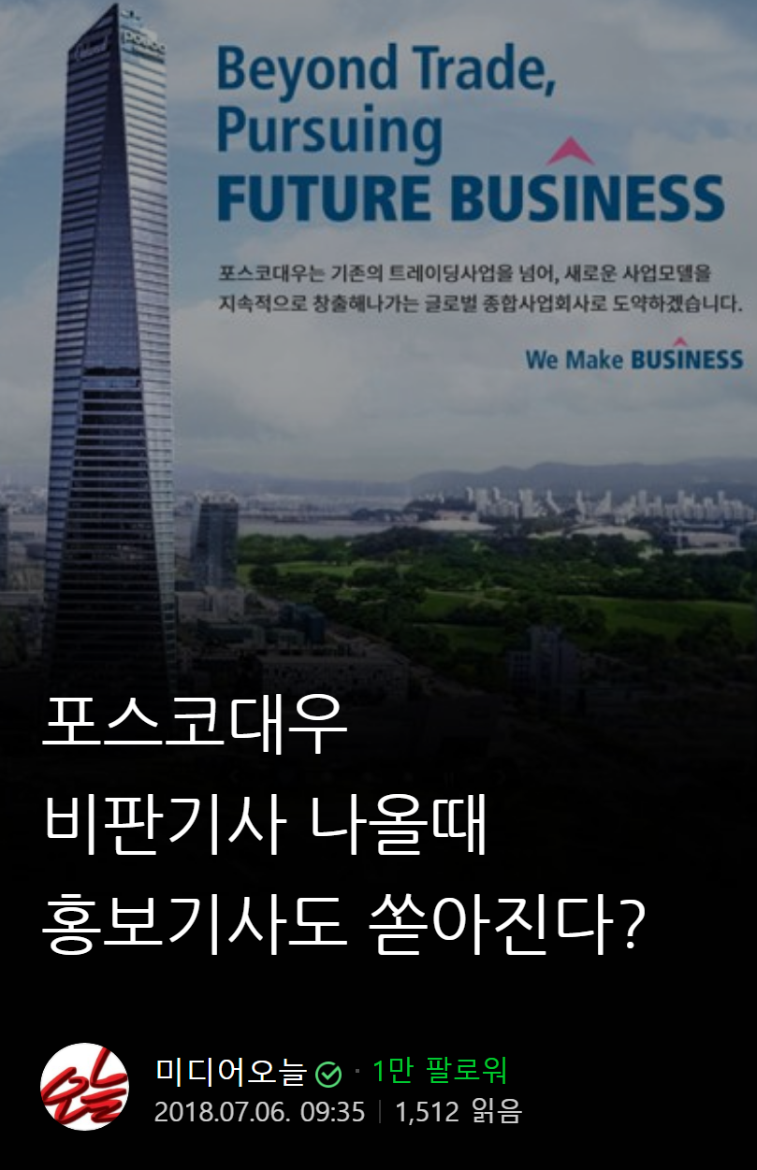
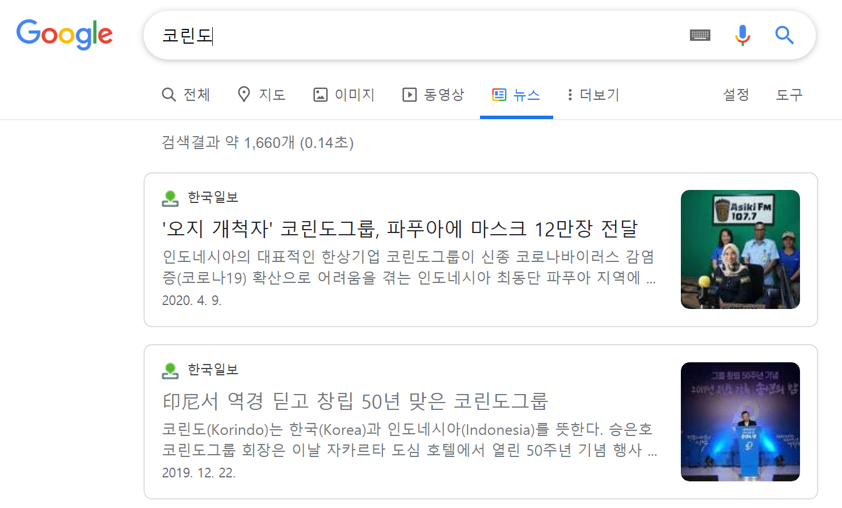
Green Washing

Slide 11
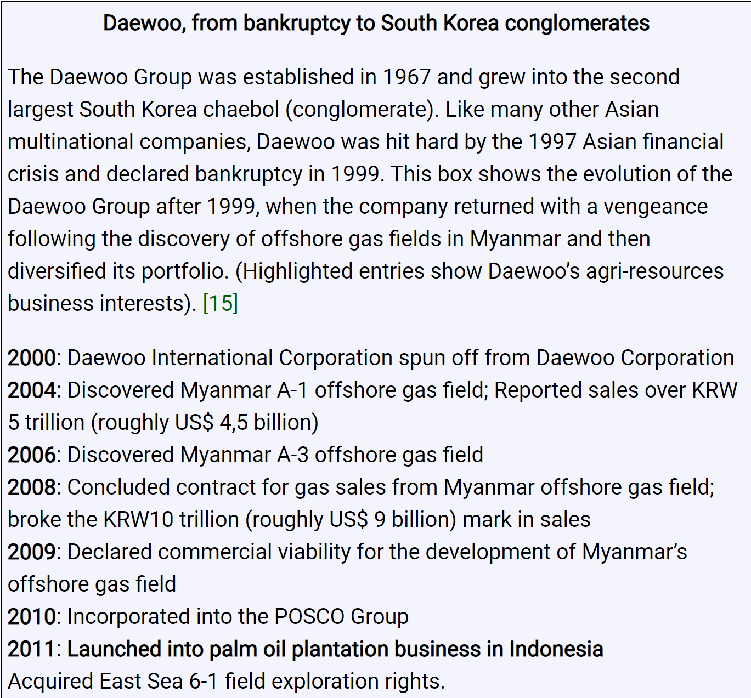
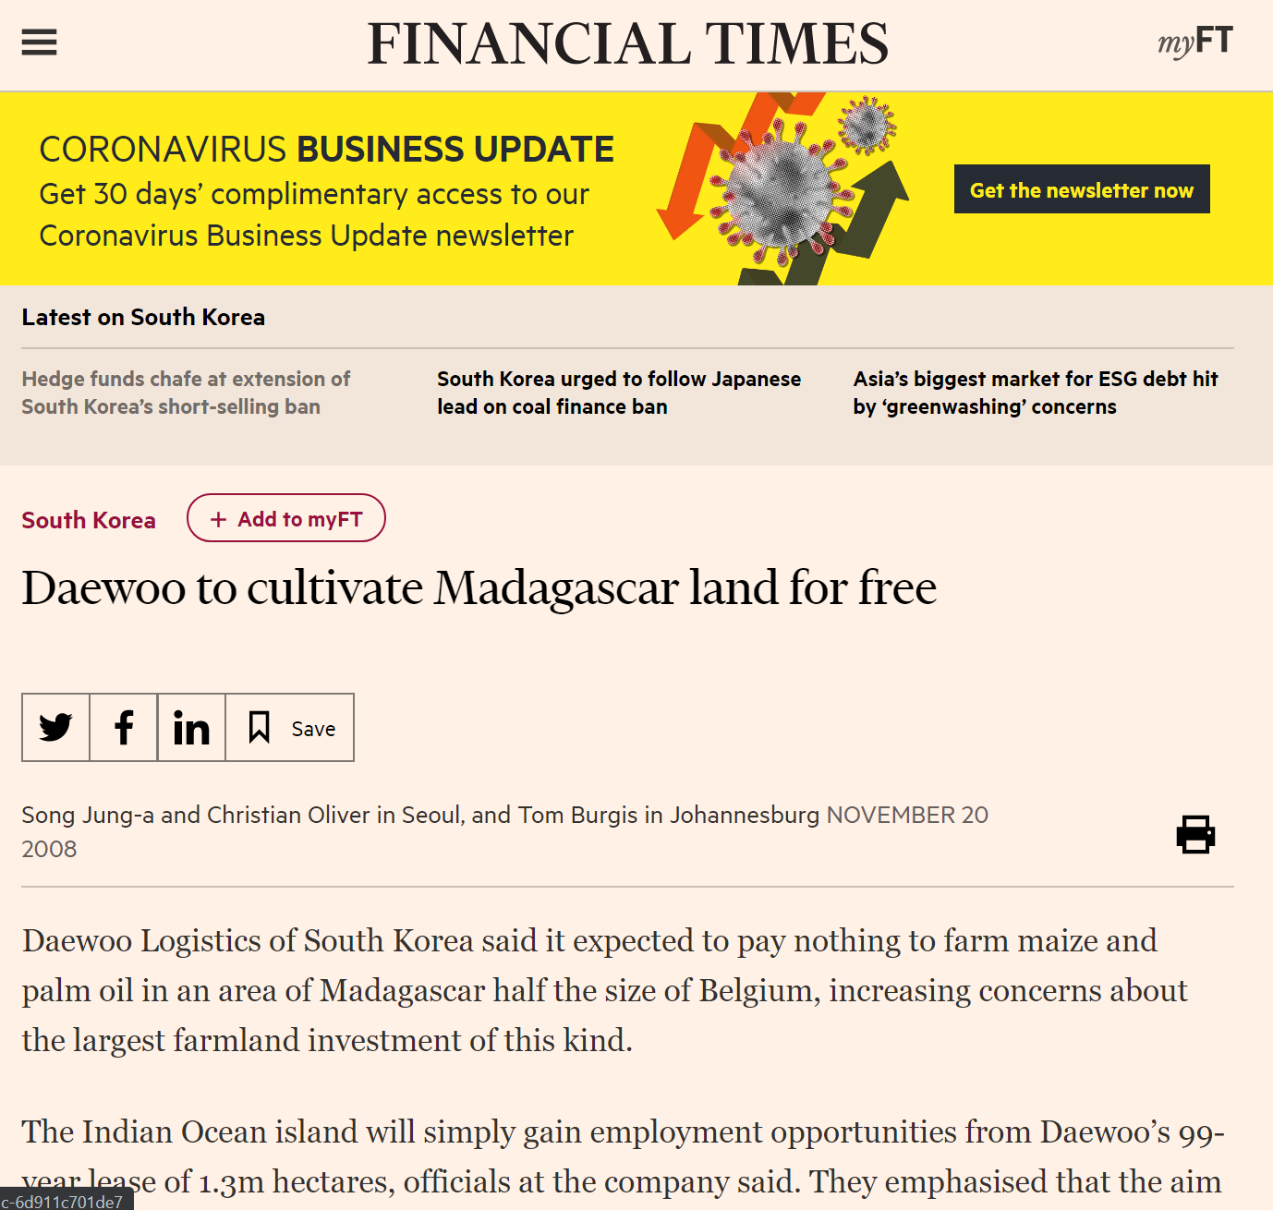

Slide 12
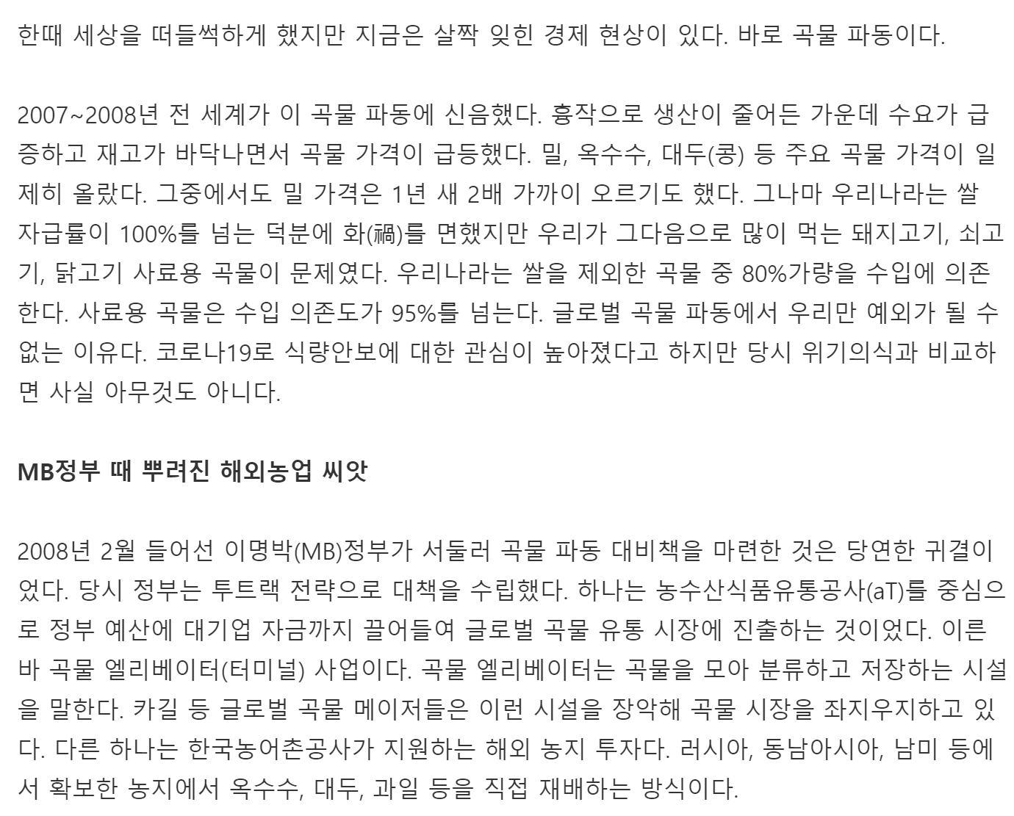
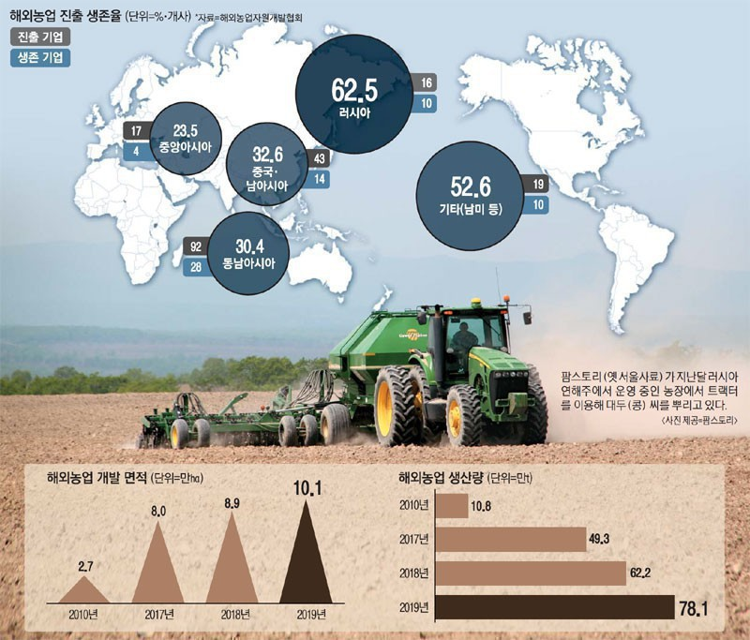

Slide 13
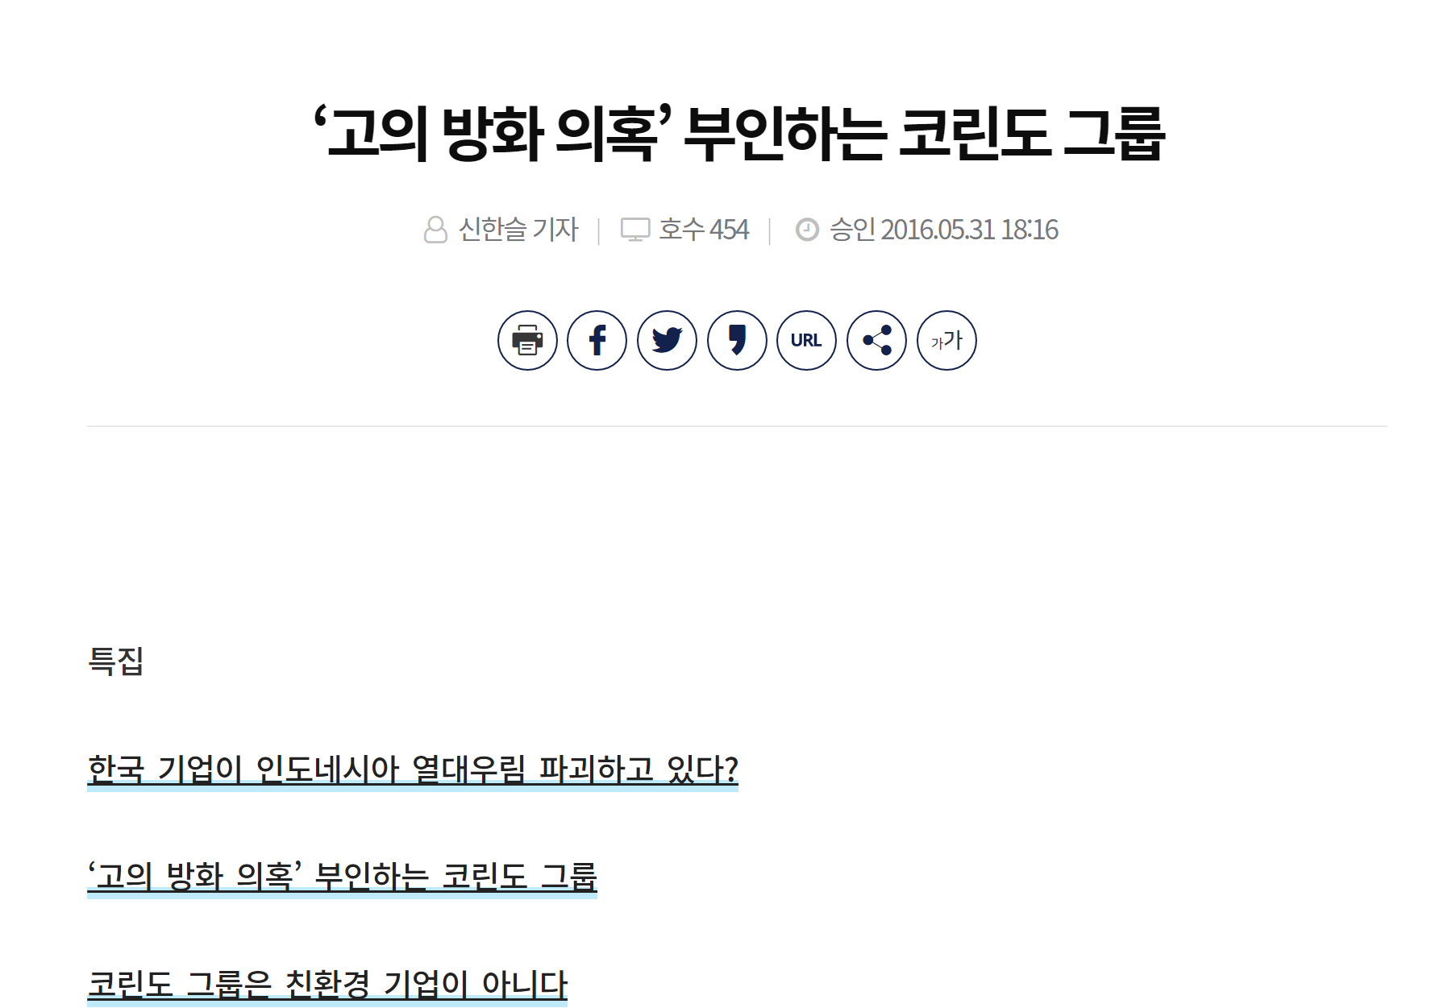
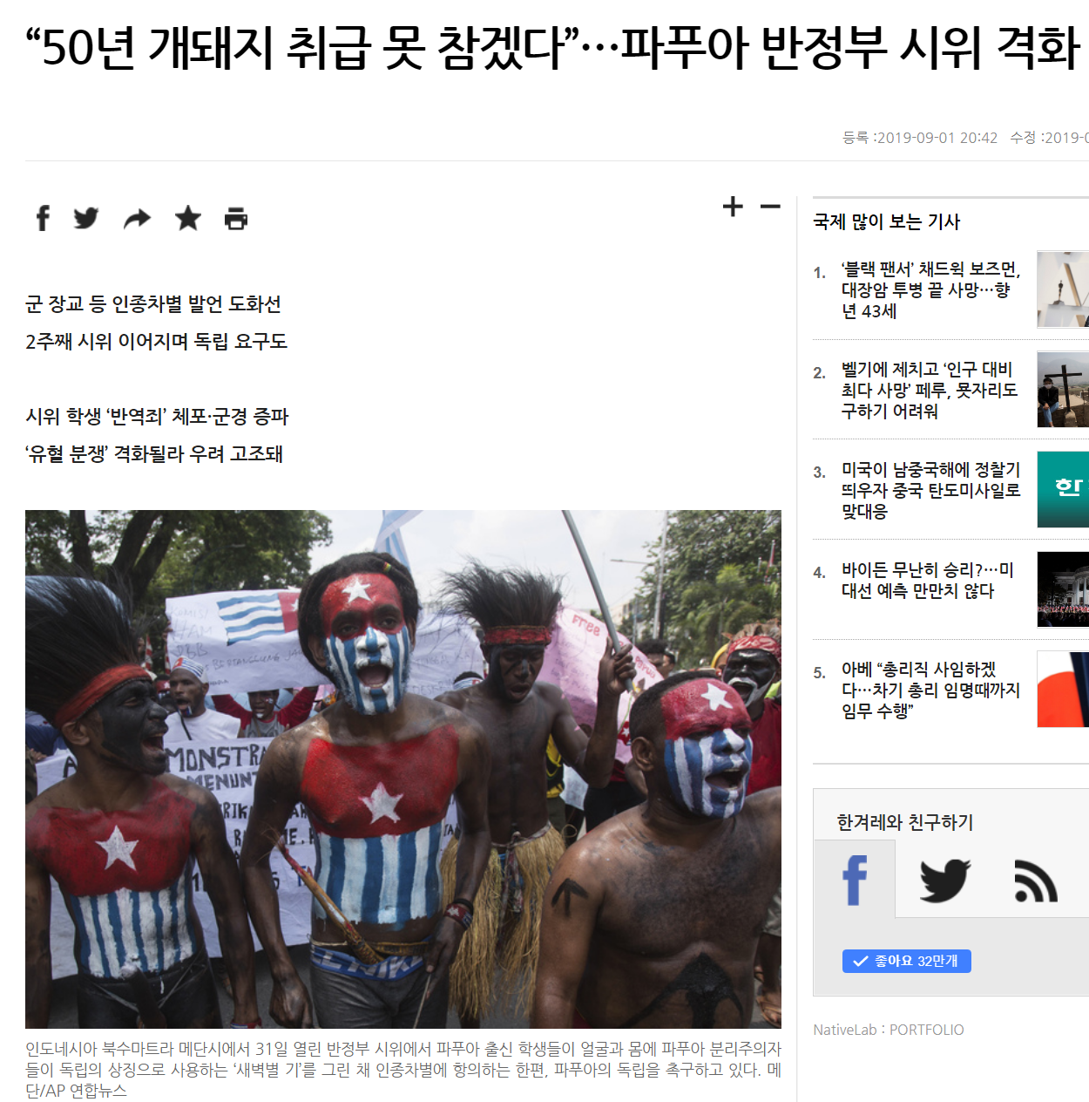
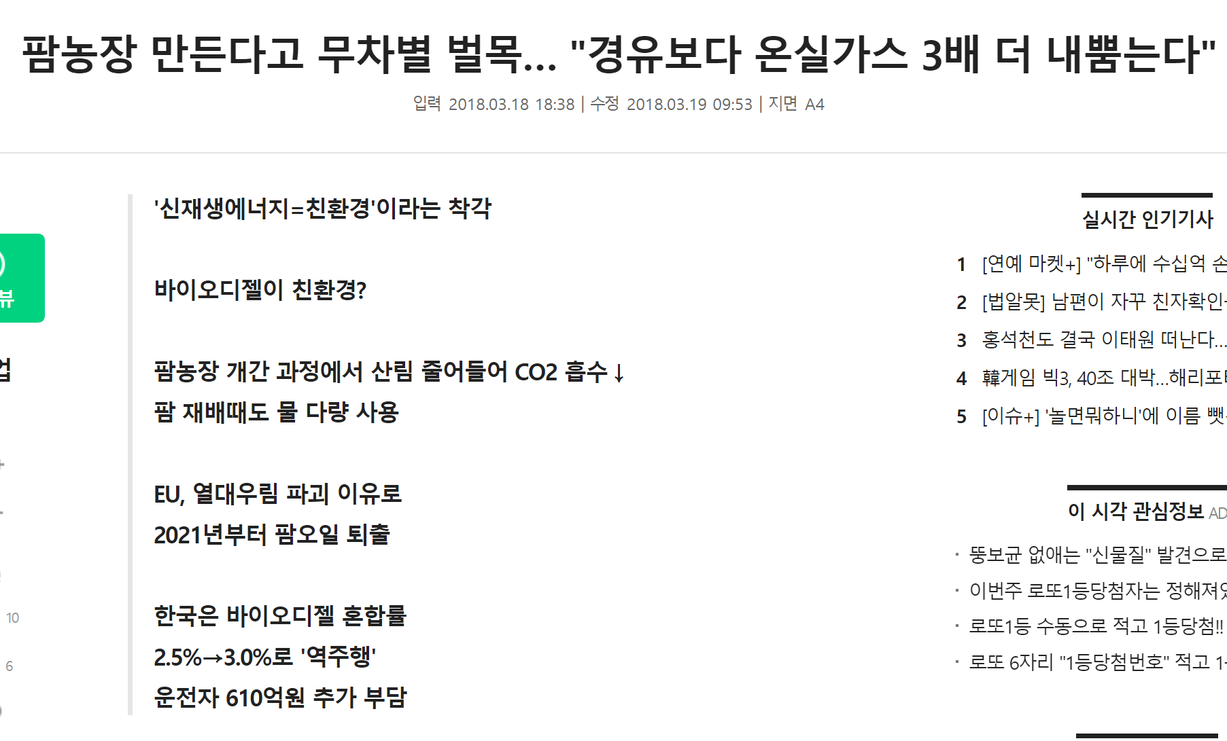

Slide 14
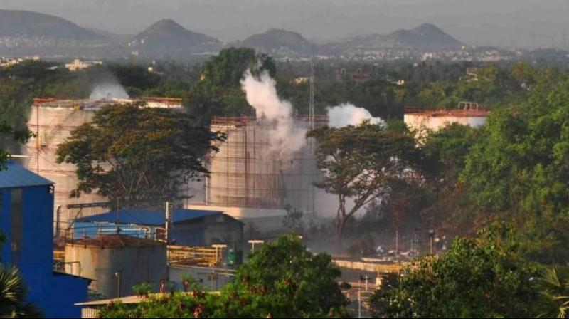
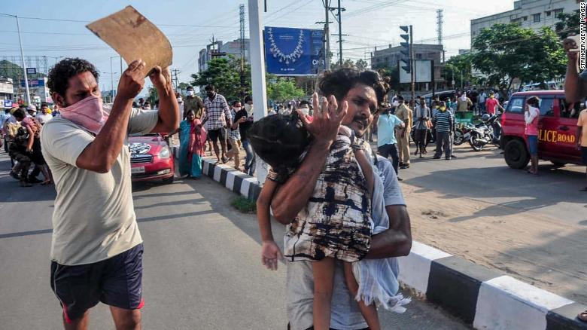

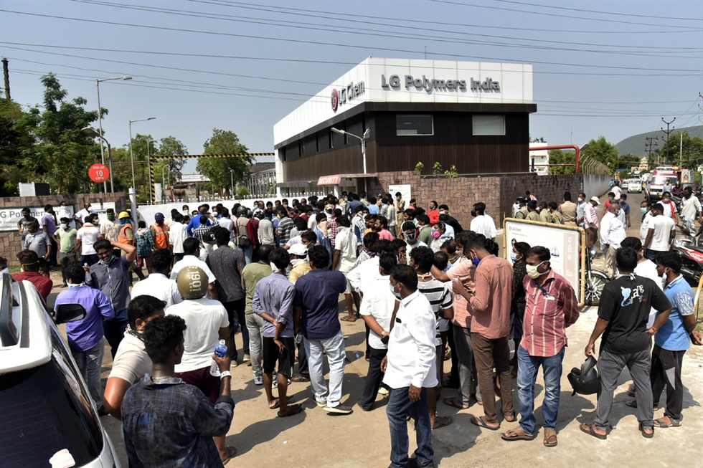
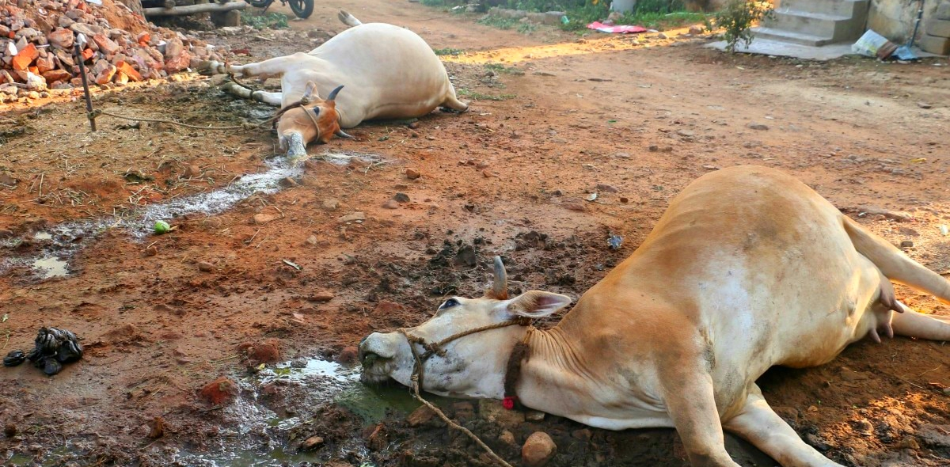
Case study 2: Chemical disaster in India by LG Chem
Notes:
Third, LG Chem's India Bikashapatnam gas disaster
based on these cases, I try to make a theoretical solution, a theory that can analyze these accidents critically. At the same time, I'm going to research, make it public, and active. I want to gather people in AYARF and expand my vision. I must inform this tregdy, Everyone who use and buy these companies product, you have obligation to knw truth. And I don’t forgive these companies, Break Green washing.

Slide 15
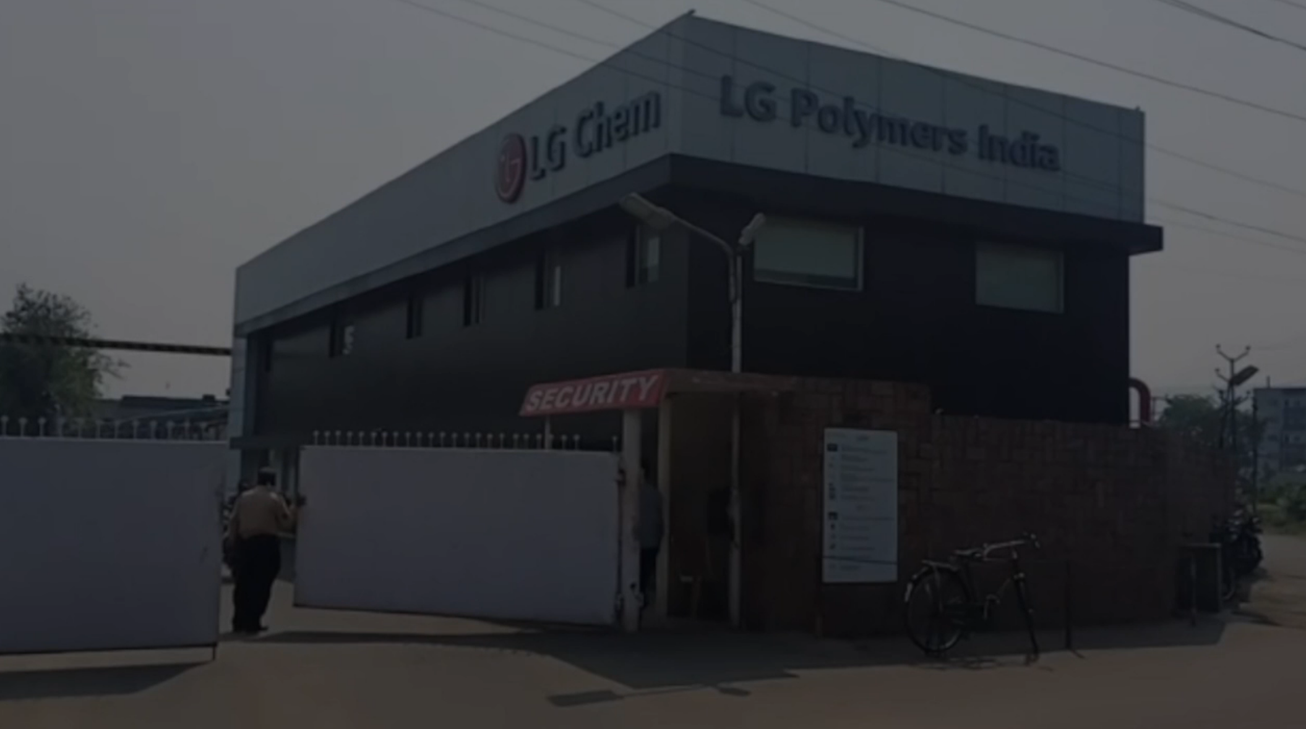
https://www.bbc.com/korean/news-52570235

Slide 16
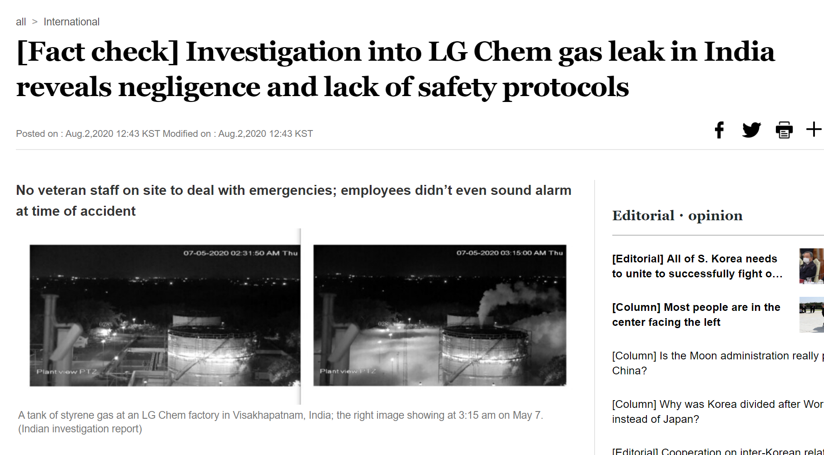
https://www.bbc.com/korean/news-52570235

Slide 17
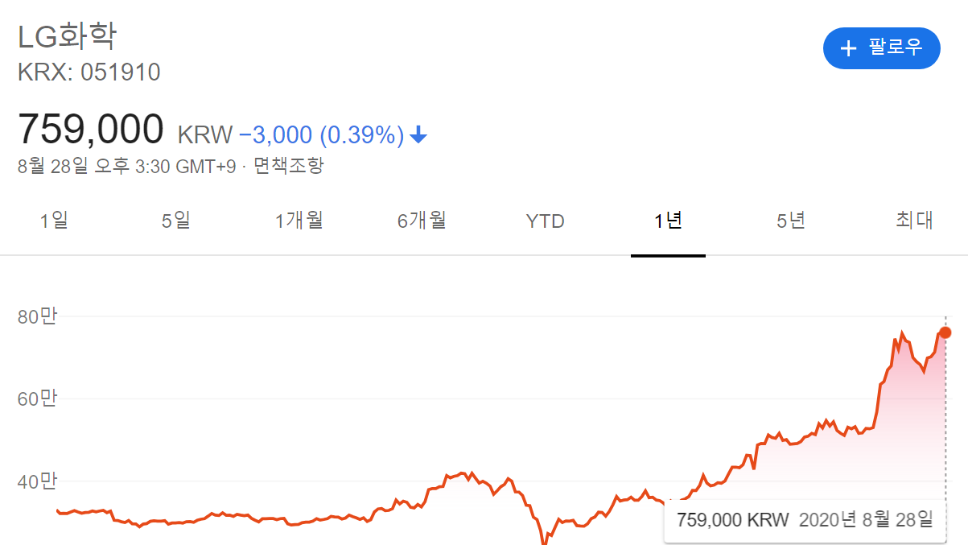

Slide 18
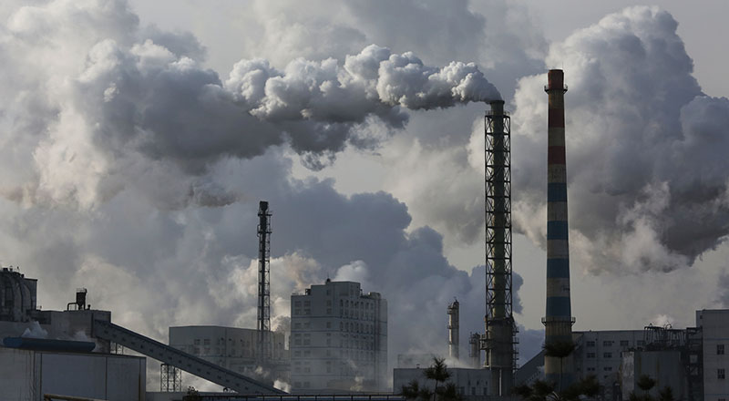
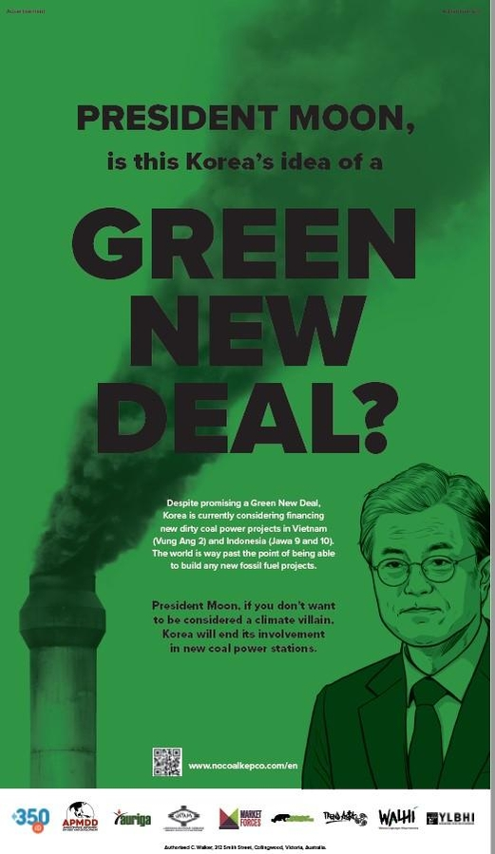
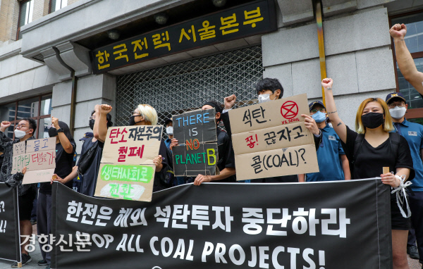
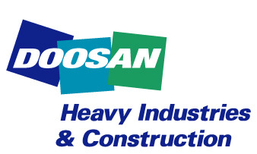


Case study 3: Overseas coal power plants investment in Vetnam, Pillipins, Indonesia by Kepco, Doosan, Samsung
Notes:
Second case. Kepco and Doosan, Samsung’s overseas coal power plant investment structure decision.

Slide 19
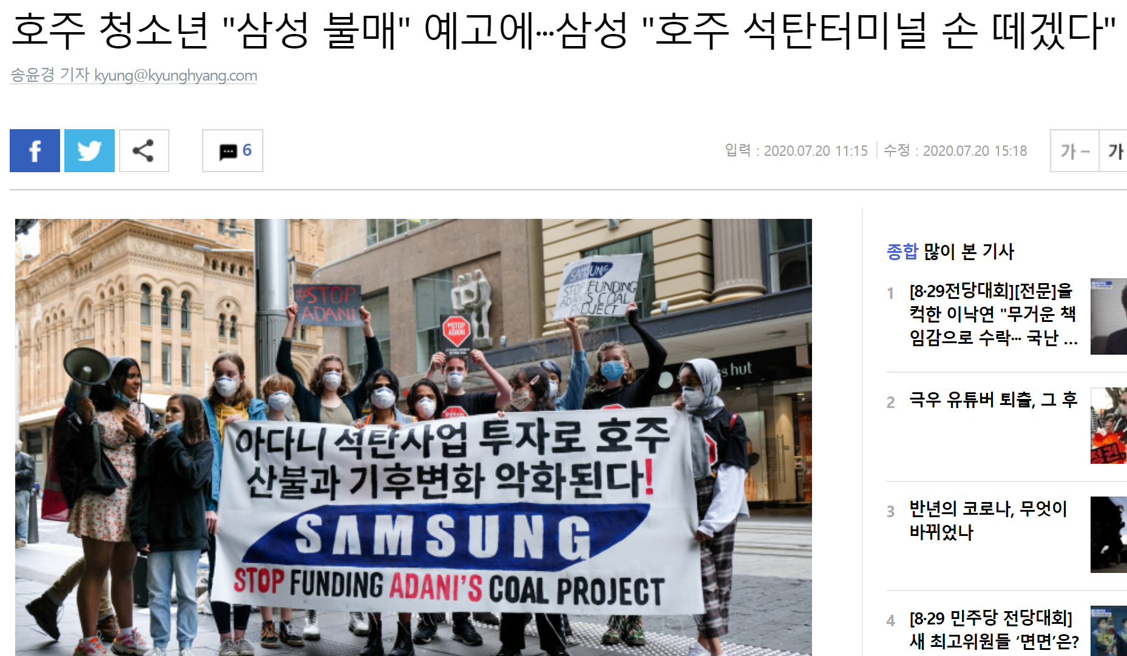
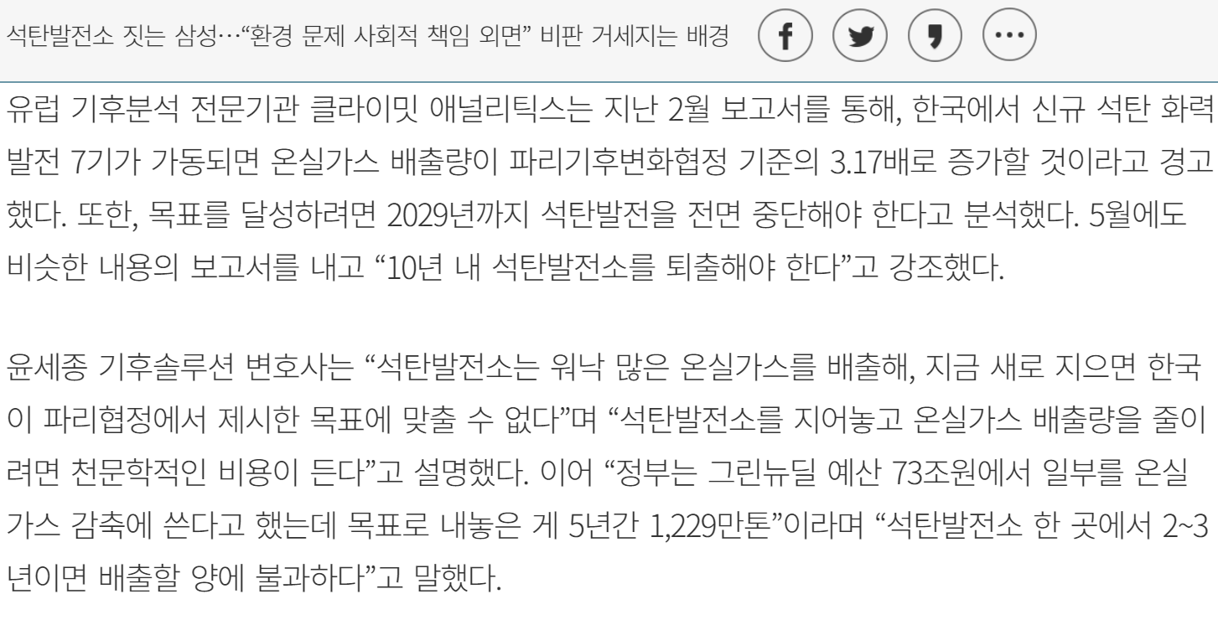

Slide 20
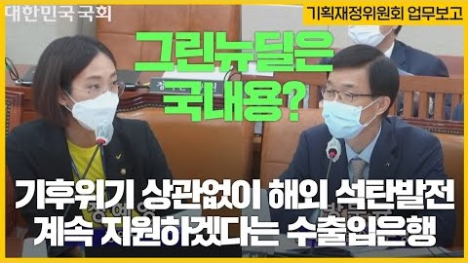
"그린뉴딜은 국내정책"이고 수출입은행의 해외석탄화력발전 지원은 "대외 경제정책"이라는 수출입은행의 견해에 결코 동의하지 않습니다.

