Slide 1
Users
Security Monitoring
Anti-DDoS
IDS
IPS
WAF
CDN
리전
VPC
PRIVATE LB SUBNET
PRIVATE LB SUBNET
Load Balancer
Image
Optimizer
Zone A
Zone B
PUBLIC SUBNET
Object
Storage
VPC 외부
PRIVATE SUBNET
PRIVATE DB SUBNET
Cloud DB
for Redis
Master
Slaves
Cache
Cloud DB
© NAVER Cloud Corp. All Rights Reserved.

Slide 2
Users
Security Monitoring
Anti-DDoS
IDS
IPS
WAF
CDN
리전
VPC
PRIVATE LB SUBNET
PRIVATE LB SUBNET
Load Balancer
Image
Optimizer
Zone A
Zone B
PUBLIC SUBNET
NAT
Gateway
NAT
Gateway
Object
Storage
PRIVATE SUBNET
PRIVATE DB SUBNET
Cloud DB
for Redis
Master
Slaves
Cache
Cloud DB
© NAVER Cloud Corp. All Rights Reserved.

Slide 3
Users
리전
1
1
목적지 | Target유형
10.0.0.0/21 | LOCAL
0.0.0.0/0 | IGW
Internet Gateway
VPC
PRIVATE LB SUBNET
Load Balancer
PRIVATE LB SUBNET
Zone A
Zone B
Zone A
Zone B
1
2
PUBLIC SUBNET
2
3
목적지 | Target유형
10.0.0.0/21 | LOCAL
0.0.0.0/0 | NATGW1
NAT
Gateway1
목적지 | Target유형
10.0.0.0/21 | LOCAL
0.0.0.0/0 | NATGW2
2
PRIVATE SUBNET
3
NAT
Gateway2
4
4
PRIVATE DB SUBNET
목적지 | Target유형
10.0.0.0/21 | LOCAL
Cloud DB
for Redis
Master
Slaves
Cache
Cloud DB
© NAVER Cloud Corp. All Rights Reserved.

Slide 4
Users
리전
1
1
목적지 | Target유형
10.0.0.0/21 | LOCAL
0.0.0.0/0 | IGW
Internet Gateway
VPC
PRIVATE LB SUBNET
Load Balancer
PRIVATE LB SUBNET
Zone A
Zone B
Zone A
Zone B
1
2
PUBLIC SUBNET
2
3
목적지 | Target유형
10.0.0.0/21 | LOCAL
0.0.0.0/0 | NATGW1
목적지 | Target유형
10.0.0.0/21 | LOCAL
0.0.0.0/0 | NATGW2
NAT
Gateway1
2
PRIVATE SUBNET
3
NAT
Gateway2
4
4
PRIVATE DB SUBNET
목적지 | Target유형
10.0.0.0/21 | LOCAL
Cloud DB
for Redis
Master
Slaves
Cache
Cloud DB
© NAVER Cloud Corp. All Rights Reserved.

Slide 5
Users
리전
목적지 | Target유형
10.0.0.0/21 | LOCAL
0.0.0.0/0 | IGW
Internet Gateway
2
VPC
PRIVATE LB SUBNET
Load Balancer
PRIVATE LB SUBNET
목적지 | Target유형
10.0.0.0/21 | LOCAL
0.0.0.0/0 | VPCPEERING
Zone A
Zone B
Zone A
Zone B
NAT
Gateway1
PUBLIC SUBNET
2
NAT
Gateway2
목적지 | Target유형
10.0.0.0/21 | LOCAL
0.0.0.0/0 | NATGW1
192.168.0/0/16 | VPCPEERING
MGMT-DEV-VPC
192.168.0.0/16
2
PRIVATE SUBNET
2
2
VPC Peering
PRIVATE DB SUBNET
목적지 | Target유형
10.0.0.0/21 | LOCAL
Cloud DB
for Redis
Master
Slaves
Cache
Cloud DB
© NAVER Cloud Corp. All Rights Reserved.

Slide 6
Users
리전
목적지 | Target유형
10.0.0.0/21 | LOCAL
0.0.0.0/0 | IGW
Internet Gateway
VPC
PRIVATE LB SUBNET
Load Balancer
PRIVATE LB SUBNET
Zone A
Zone B
Zone A
Zone B
NAT
Gateway1
PUBLIC SUBNET
2
NAT
Gateway2
목적지 | Target유형
10.0.0.0/21 | LOCAL
0.0.0.0/0 | NATGW1
192.168.0/0/16 | VPCPEERING
온프라미스 | VGW
2
3
2
PRIVATE SUBNET
2
목적지 | Target유형
10.0.0.0/21 | LOCAL
10.0.0.0 / 16 | VGW
VPC Peering
3
3
PRIVATE DB SUBNET
3
Cloud Connect
2
목적지 | Target유형
10.0.0.0/21 | LOCAL
온프라미스 | VGW
온프라미스
Cloud DB
for Redis
Master
Slaves
3
Cache
Cloud DB
IPsec VPN
© NAVER Cloud Corp. All Rights Reserved.

Slide 7
Users
리전
1
1
목적지 | Target유형
10.0.0.0/21 | LOCAL
0.0.0.0/0 | IGW
CDN
Internet Gateway
VPC
PRIVATE LB SUBNET
PRIVATE LB SUBNET
Load Balancer
Image
Optimizer
Zone A
Zone B
1
2
PUBLIC SUBNET
2
NAT
Gateway1
NAT
Gateway2
Object
Storage
목적지 | Target유형
10.0.0.0/21 | LOCAL
0.0.0.0/0 | NATGW1
2
PRIVATE SUBNET
4
4
PRIVATE DB SUBNET
목적지 | Target유형
10.0.0.0/21 | LOCAL
Cloud DB
for Redis
Master
Slaves
Cache
Cloud DB
© NAVER Cloud Corp. All Rights Reserved.

Slide 8
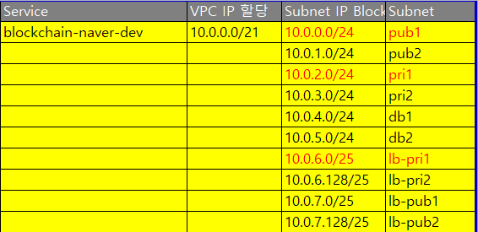

Slide 9
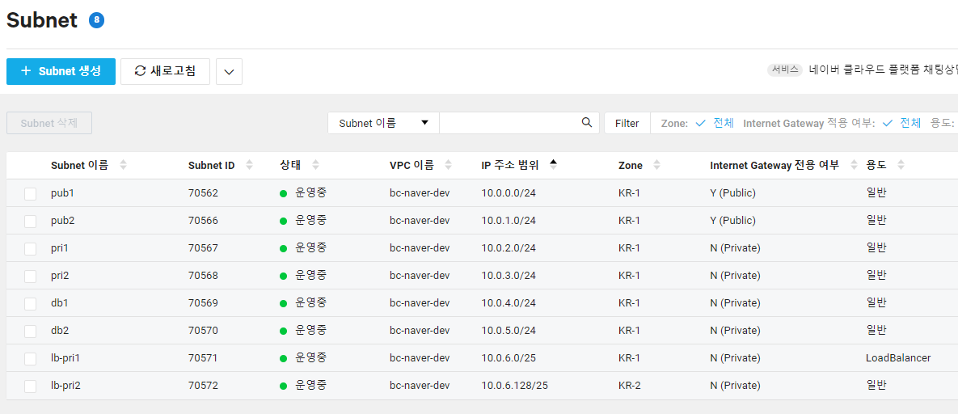

Slide 10
Users
리전
1
1
목적지 | Target유형
10.0.0.0/21 | LOCAL
0.0.0.0/0 | IGW
CDN
Internet Gateway
VPC
PRIVATE LB SUBNET
PRIVATE LB SUBNET
Load Balancer
Image
Optimizer
Zone A
Zone B
1
2
PUBLIC SUBNET
2
NAT
Gateway1
NAT
Gateway2
Object
Storage
3
목적지 | Target유형
10.0.0.0/21 | LOCAL
0.0.0.0/0 | NATGW1
목적지 | Target유형
10.0.0.0/21 | LOCAL
0.0.0.0/0 | NATGW2
2
PRIVATE SUBNET
3
4
4
PRIVATE DB SUBNET
목적지 | Target유형
10.0.0.0/21 | LOCAL
Cloud DB
for Redis
Master
Slaves
Cache
Cloud DB
© NAVER Cloud Corp. All Rights Reserved.

Slide 11
Users
리전
2
Internet Gateway
VPC
PRIVATE LB SUBNET
PRIVATE LB SUBNET
Load Balancer
4
Zone A
Zone B
1
PUBLIC SUBNET
목적지 | 타켓
NAT
Gateway
NAT
Gateway
CDN
3
PRIVATE SUBNET
Image
Optimizer
Object
Storage
PRIVATE DB SUBNET
Cloud DB
for Redis
Master
Slaves
Cache
Cloud DB
© NAVER Cloud Corp. All Rights Reserved.

Slide 12
Users
Zone A
Load Balancer
10.0.0.0/24 pub1
bastion
NAT
Gateway
auto scaling
10.0.2.0/24 pri1
Web Servers
10.0.4.0/24 db1
DB Servers
Cloud DB
for Redis
Master
Slaves
Cache
Cloud DB
© NAVER Cloud Corp. All Rights Reserved.

Slide 13
Users
Load Balancer
Zone A
auto scaling
Zone B
Web Servers
auto scaling
Was Servers
DB Servers
Cloud DB
for Redis
NAT
Gateway
Https
Master
Slaves
Cache
Cloud DB
© NAVER Cloud Corp. All Rights Reserved.

Slide 14
Auto Scaling을 활용한
가용성 확보
Users
Load Balancer
Auto scaling
Web Servers
Cloud DB
Master (write)
Slave (read)
© NAVER Cloud Corp. All Rights Reserved.

Slide 15
감사합니다

