Slide 1
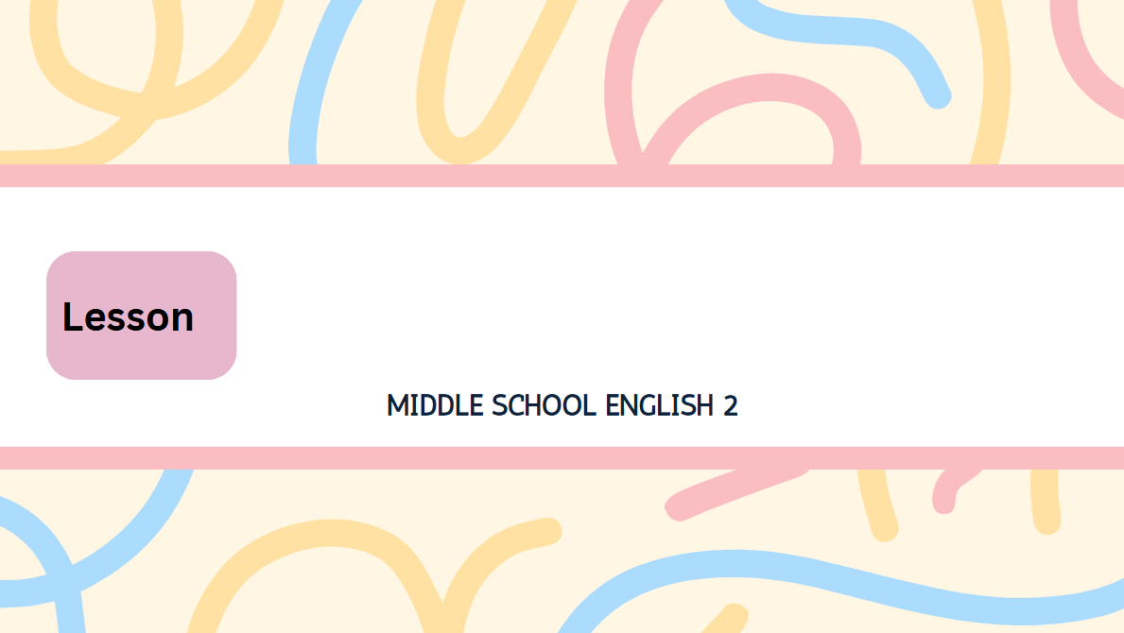
2
Text Better, Communicate Better!

Slide 2
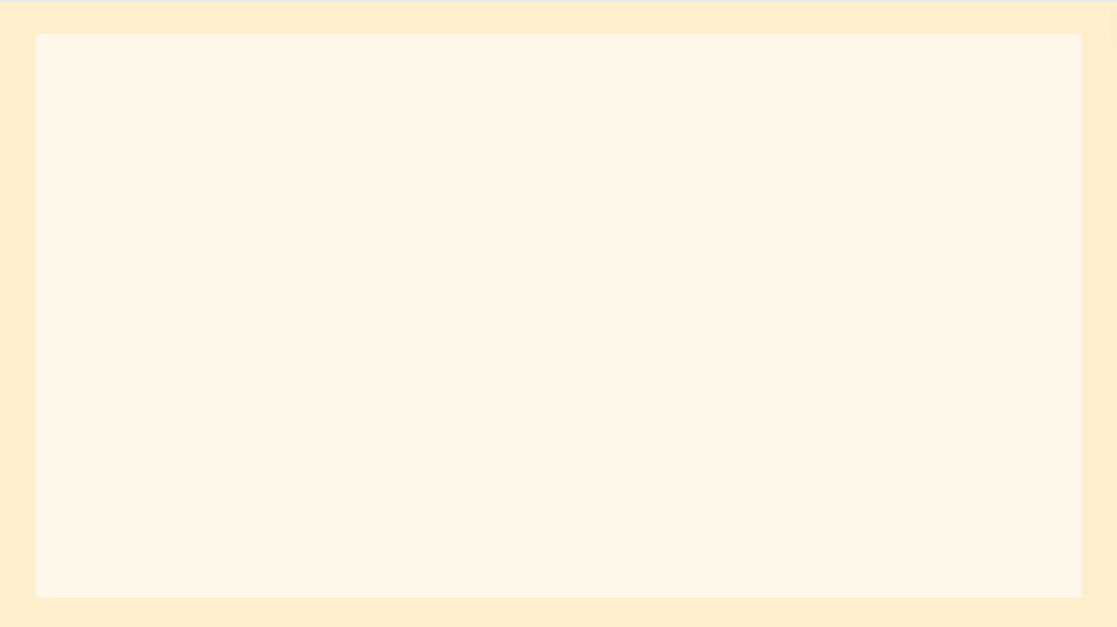
Texting is the main way of communication for many people these days, especially for teenagers.
Do you want to know how you can communicate
better through texting? Here are some useful tips.
┌ 단수 동사
동명사 주어(단수 취급)
󰃃 의사소통
요즘에는
󰃌 특히
󰃃 십 대
명사적 용법(want의 목적어)
간접의문문(의문사+주어+동사 / know의 목적어)
󰃤 ~을 통해서
여기 ~이 있다
(뒤에 복수 명사)
󰃰 유용한
󰃃 팁, 조언

Slide 3
1. You need to know who you are talking to.
Henry just sent the following text message to
his mother.
Henry: Mom, I want you to wait just a little longer. BRT.
Do you think Henry’s mother correctly understood
BRT? Probably not.
~할 필요가 있다
간접의문문(의문사+주어+동사 / know의 목적어)
󰃰 다음의
문자 메시지
~에게
조금
5형식(「want+목적어+to부정사」: (목적어)가 ~하기를 원하다)
think의 목적어 역할을 하는 명사절(앞에 접속사 that 생략)
󰃌 아마(도)

Slide 4
You can use expressions like BRT (be right there), JK (just kidding), or LOL (laughing out loud)
when you text your friends.
However, be careful with such expressions
when you text your teachers or parents.
You need to understand [that some of them may not know the meanings of such expressions].
󰃃 표현
󰃤 ~와 같은
시간의 부사절(~할 때)
접속부사(하지만)
명령문(주의해라)
시간의 부사절(~할 때)
= your teachers or parents
~할 필요가 있다
접속사(understand의 목적어절을 이끎)
조
~할지도 모른다
󰃃 의미, 뜻

Slide 5

2. You need to understand [that people use emojis
differently].
Yesterday, Jisu gave a birthday gift to her little brother Jihoo. Later, she got the following text message.
Jihoo: I loved your gift. Thanks a lot.
“Only one smiling face ( )? I guess he didn’t like my gift,” Jisu thought.
접속사(understand의 목적어절을 이끎)
󰃃 이모티콘
󰃌 다르게
󰃃 선물
└─ =(동격)──┘
󰃌 나중에, 후에
많이
│
│
󰃰 오직, 겨우
(that)
guess의 목적어 역할을 하는 명사절

Slide 6
When we talk with someone, we use not only words but also facial expressions and body language. In texting, we use emojis instead. Sometimes, a little emoji like can speak louder than many words. The problem is [that not everybody uses emojis in the same way].
시간의 부사절(~할 때)
not only A but also B: A뿐만 아니라 B도
표정
몸짓
󰃌 대신에
󰃌 때때로, 가끔
󰃤 ~와 같은
비교급+than: ~보다 더 크게
접속사(보어절을 이끎)
부분 부정(모두 ~한 것은 아니다)
같은 방식으로

Slide 7
Some people like to use them a lot, and some don’t. In addition, the same emojis can mean different things to different people.
= emojis
게다가
󰂿 의미하다

Slide 8
3. Sometimes, you need to pick up the phone.
Amy just got the following text message from her best friend Nari.
Nari: Did you really talk behind my back? I want you to apologize to me.
Amy wanted to text Nari and explain the situation, but she thought again.
수화기를 들다, 전화 통화를 하다
󰃤 ~로부터
└─ =(동격)─┘
┌ 󰂿 사과하다
┌ 나에게
talk behind one’s back: ~에 대해 험담하다
5형식(want+목적어+to부정사: 목적어가 ~하기를 원하다)
명사적 용법(wanted의 목적어)
앞에 to 생략
󰃃 상황

Slide 9
“Well, this is too much for a text,” she said to herself and called Nari. Texting is okay for casual situations, but sometimes, you need to pick up the phone. This is because misunderstandings can easily happen when you text.
say to oneself: 혼잣말하다
󰂿 전화하다
󰃰 평상시의
󰃥 ~때문에
󰃃 오해, 착오
󰂿 일어나다, 발생하다
시간의 부사절(~할 때)

Slide 10
Do you need to talk about sensitive issues with your friends? Then, don’t text them. Call them instead.
󰃰 민감한, 예민한
󰃃 문제
부정명령문(~하지 마라)
= your friends
󰃌 대신에

