Slide 1
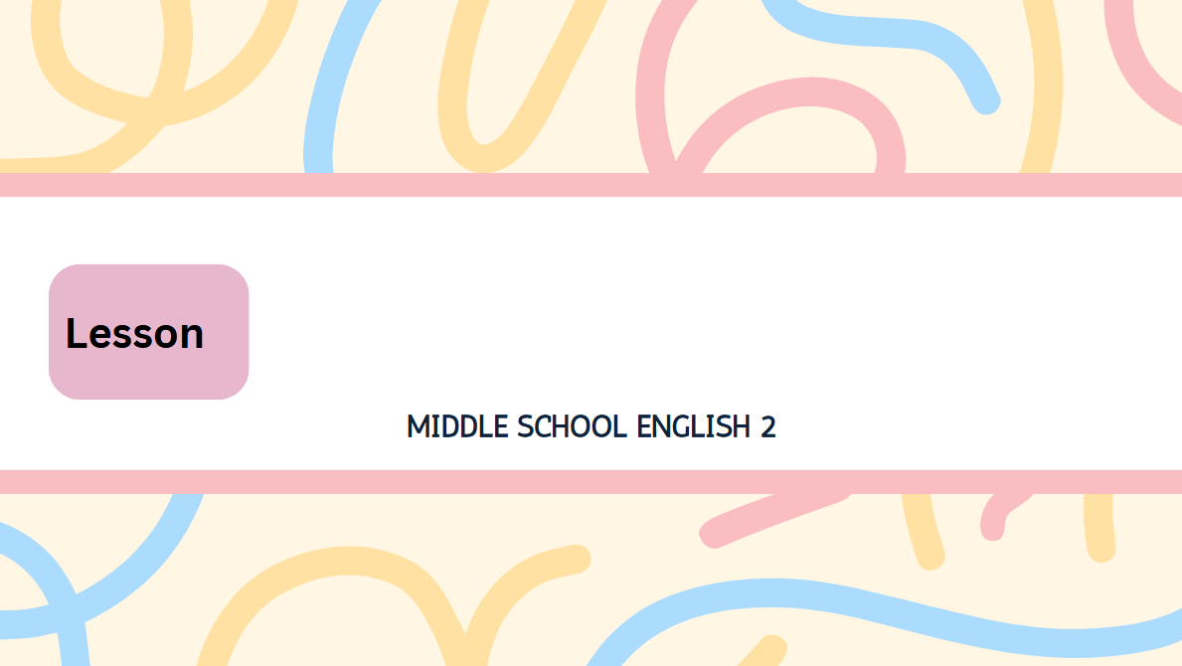
1
Live Freely and Happily Ever After!

Slide 2

You can work with NGOs as a teenager.
It is a great way to learn about social issues and
make the world better. Are you interested?
Then, read Inho’s blog below.
중요It : 1. 가주어/진주어 2. 지시대명사 3. 비인칭 주어
여기서는 work with NGO를 가리키는 것이 더 자연스러움!
= 비정부 기구 (사회 문제 해결과 공익을 위한 민간 단체)
조동사(가능: ~할 수 있다)
󰃤 ~로서
=To work with NGOs~
(정정)to부정사의 형용사적 용법
󰃃 문제, 사안
to부정사의 형용사적 용법(앞에 to 생략 / a great way 수식)
5형식(「make+목적어+형용사」: (목적어)를 ~하게 만들다)
명령문(~해라)
󰃌 아래에

Slide 3
JAN 5
I grew up in Jeju-do, so I had many chances to see dolphins. Then, I learned that many dolphins are in danger. Some are even endangered.
I thought I should do something.
자라다, 성장하다
󰃥 그래서
to부정사의 형용사적 용법
명사절을 이끄는 접속사
위험에 처한
󰃰 멸종 위기에 처한
│
│
(that) thought의 목적어 역할을 하는 명사절

Slide 4
So, I searched the Internet and found
an NGO, Dolphin Lovers. It does various activities such as cleaning up beaches and helping dolphins.
After some thought, I joined it today.
󰂿 검색하다
┌ 󰃰 다양한
└─── =(동격) ───┘
= Dolphin Lovers (It: 지시대명사)
~와 같은
└─── 접속사 and로 연결된 동명사구 ───┘
󰃤 ~후에
󰃃 생각, 심사숙고
= Dolphin Lovers

Slide 5
JAN 20
Many dolphins get sick or even die because of plastic waste and fishing nets, so cleaning up beaches is important. There was a beach cleanup party today, and I took part in it. Cleaning up the beach was not easy, but I enjoyed it.
병에 걸리다
󰃌 심지어
~ 때문에(뒤에 명사(구))
󰃃 쓰레기
󰃃 그물
동명사구 주어(단수 취급)
단수 동사
~이 있었다(뒤에 단수 명사)
󰃃 모임, 단체
take part in: ~에 참여하다
= a beach cleanup party
동명사구 주어
󰃥 그러나
= cleaning up the beach

Slide 6
Oh, I saw Aunt Sumi there. She is also a member of Dolphin Lovers. What a small world!
󰃃 회원
감탄문(What+a(n)+형용사+명사) / 뒤에 주어와 동사 생략
FEB 14
This afternoon, I took part in a training class for Halla and Olle, two dolphins in an aquarium in Jeju-do.
훈련 수업
└─── =(동격) ───┘
󰃃 수족관

Slide 7
The latest project of Dolphin Lovers is to return them to the sea. For this, Halla and Olle first need to learn some skills. They will need them to survive in the wild. I really wanted to be part of the project.
Luckily, I got the chance. I just ran some errands in the training class today, but the experience made me so excited.
󰃰 최근의
to부정사의 명사적 용법(보어 역할)
= Halla and Olle
~할 필요가 있다
= Halla and Olle
= some skills
to부정사 부사적 용법
야생에서
~의 일부가 되는
󰃌 운 좋게도
run an errand: 심부름을 하다
5형식 문장(주어+동사+목적어+목적보어)(「make+목적어+형용사」: (목적어)가 ~하게 하다)

Slide 8
APR 22
Today, Halla and Olle went back to the sea.
There was a small ceremony, and all the members of Dolphin Lovers were there.
The ceremony made us quite emotional.
In fact, I cried a little.
go back: 돌아가다
~이 있었다 (뒤에 단수 명사)
󰃃 의식
┌ 󰃌 꽤, 상당히
┌ 󰃰 감정적인
5형식 문장(「make+목적어+형용사」: (목적어)가 ~하게 하다)
사실
조금, 약간

Slide 9
Now I cannot see Halla and Olle anymore!
However, I was very happy at the same time.
After 10 years of hard life in an aquarium, now all the sea is their home.
“Live freely and happily ever after!”
I shouted and waved goodbye to them.
└─── not ~ anymore: 더 이상 ~하지 않다 ───┘
접속 부사: 하지만
동시에
󰃤 ~후에
󰃰 힘든
= Halla and Olle‘s
명령문
󰃌 자유롭게
영원히, 오래오래
손을 흔들어 작별 인사하다
= Halla and Olle

