Slide 1
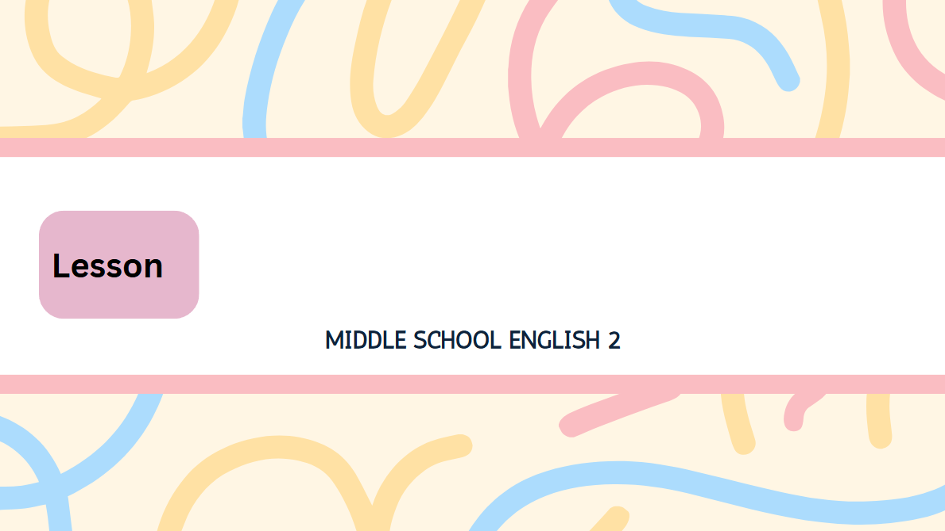
Be a Smart Shopper
4

Slide 2
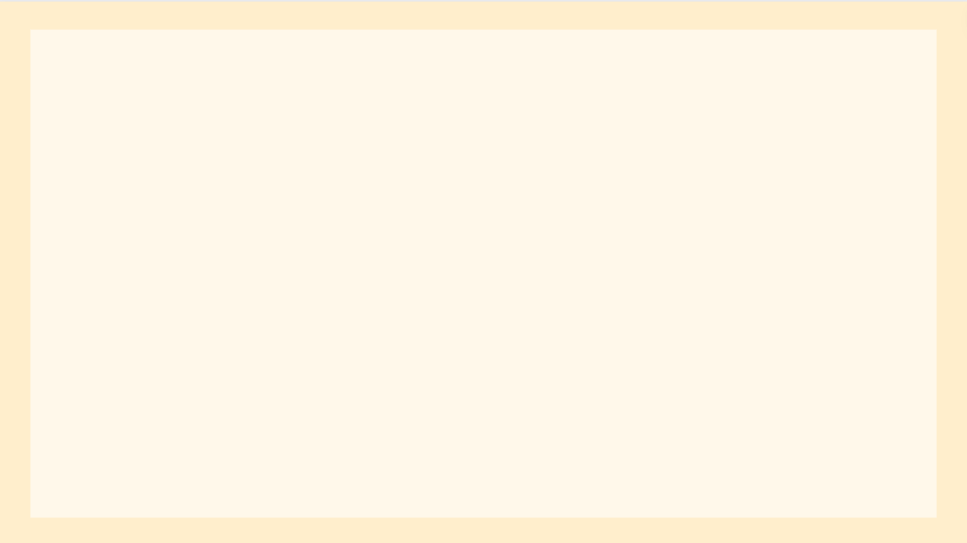
Do you think you are a smart shopper? Well, you may think you are, but hold on! There are various marketing strategies which influence your decisions. Learning about them will make you a smarter shopper.
│
│
(that) think의 목적어 역할을 하는 명사절
│
│
기다려, 멈춰
there are+복수명사: ~이 있다
(a smart shopper)
___________________
󰂿 영향을 주다
󰃃 전략
주격 관계대명사절
__________
= various marketing strategies
동명사구 주어
「make+목적어+목적격 보어(명사)」: (목적어)를 ~로 만들다

Slide 3
Hunger Marketing
󰃃 배고픔
Jihoo: What? The sale ends in two hours? If I don’t buy the sneakers now, I will have to buy them at a higher price.
Stop, Junho! You’re buying the sneakers
just because you don’t want to miss the sale. You’re falling for a hunger marketing strategy.
󰃤 (시간)~ 후에, 만에
조건의 접속사(만약 ~라면)
󰃃 운동화
~해야 할 것이다
= sneakers
󰃃 가격
명령문
┌ 󰂿 놓치다
이유의 부사절(단지 ~ 때문에)
명사적 용법(want의 목적어)
fall for: ~에 속다

Slide 4
If people can buy a product only for a limited time, they often feel “hungry” for it and want to buy it. About missing the sale, don’t worry, Junho. You’ll soon see a similar sale again.
조건의 접속사(만약 ~라면)
󰃃 상품, 제품
󰃰 한정된, 제한된
감각동사+형용사(~하게 느끼다)
= a product
┌ 부정명령문(~하지 마라)
= a product
전치사 about의 목적어 역할을 하는 동명사구
󰃰 비슷한, 유사한

Slide 5
Viral Marketing
󰃰 바이러스성의
Yuna: That’s the hottest dress on social media now. Lots of people are wearing it. I have to get that dress, too!
Wait, Yuna! You only want the dress because you saw it again and again on social media.
󰃰 인기 있는
┌ ~해야 한다
= A lot of, Many
= the hottest dress
명령문
이유의 접속사
= the dress
계속해서, 되풀이해서

Slide 6
It isn’t just you. There are a lot of people who fall for a viral marketing strategy. Why?
Information about a product can spread quickly and widely on the Internet, just like a “virus.”
If a product becomes hot on social media, people naturally want to have it. Yuna, just remember
[that a popular product isn’t always right for you].
앞 문장 전체의 내용
주격 관계대명사
󰃃 정보
󰂿 퍼지다, 확산되다
󰃌 빠르게
󰃌 널리
󰃤 ~처럼
󰃃 바이러스
조건의 접속사(만약 ~라면)
󰃌 자연스럽게
= a product
명령문
remember의 목적어절을 이끄는 접속사
부분 부정(항상 ~인 것은 아니다)

Slide 7
Anchoring Effect
Somi: I’m looking for a lipstick for my mom.
Salesperson: How about this?
Somi: Expensive! I thought [I could buy a lipstick
for 30 dollars].
Salesperson: This is also popular.
Somi: That’s better!
~을 찾다
󰃃 립스틱
~은 어때요?
│
│
󰃰 비싼 / ↔ cheap
(that) thought의 목적어 역할을 하는 명사절
󰃰 인기 있는

Slide 8
Hold on, Somi! Your budget was 30 dollars, but you are buying a 40-dollar lipstick. The 40-dollar lipstick sounds cheap only because the salesperson showed you a 50-dollar lipstick first. This is an example of the anchoring effect.
󰃃 예산
감각동사(sound)+형용사:
~하게 들리다
이유의 부사절(단지 ~ 때문에)
4형식(show+간접목적어+직접목적어: ~에게 ...을 보여주다)
󰂿 닻을 내리다

Slide 9
Usually, the first piece of information becomes an “anchor” and influences the shopper’s decision. In your case, the 50-dollar lipstick was the anchor. Somi, don’t just rely on the first piece of information that is given to you.
󰃃 정보(셀 수 없는 명사)
󰂿 영향을 주다
부정 명령문: ~하지 마라
의존하다
선행사
┌ be given: 수동태
주격 관계대명사절

