Slide 1
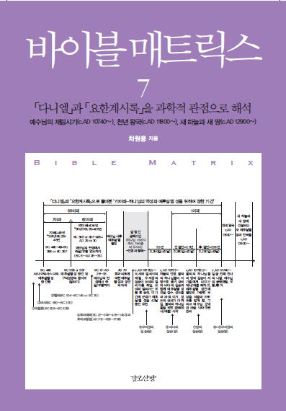
Bible Matrix ⑦: Historical & Scientific Views on <Daniel> and <Revelation>
Bible Matrix ⑦: Historical & Scientific Views on <Daniel> and <Revelation>
Part 1. <Daniel>,
Part 2. <Revelation>
This on Youtube:
https://www.youtube.com/watch?v=aXO4R6F_5PE
Bible Matrix Series:
https://www.youtube.com/channel/UCrXiOQuBMdny7r_6GfoKocw
Dr. Won Yong Cha, English Education(BS), MBA, MISE(Ph.D.), Futurist or Futurologist biblematrix@gmail.com

Slide 2
Bible Matrix ⑦: Historical & Scientific Views on <Daniel> and <Revelation>
Chapter 3 of Revelation
Part 2. <Revelation>
<Revelation> 3:14~22 - To the Church in Laodicea → Lukewarm faith and naked church, Receiving Only Rebuke and discipline from Jesus
<Revelation> 3:14~22 – The future churches until the Second Coming of Jesus in c.AD 10,740~ (early Laodicea Church - Naked Churches - Future Churches)
○ The name of Laodicea means 'the justice of the people’, or 'to judge the people’, or 'the judged people'. In short, judgment is justice or is to set up the justice. As the name implies, the church in Laodicea is the church of the past-present-future that is the object of judgment in order to establish the justice. However, as we have examined in the previous churches, except for the Smyrna church and the Philadelphia church, all other churches are targets of justice. In other words, if they do not repent, they are all objects of judgment.
○ Many people interpret this church of Laodicea as the last church before the Second Coming of Jesus, because it appears as the last church, but I think that is wrong. Of course, it can be interpreted that way from the perspective of Christian history, but this is not the case given that the time of Jesus' second coming will be c.AD 10,740~.

Slide 3
Bible Matrix ⑦: Historical & Scientific Views on <Daniel> and <Revelation>
Chapter 3 of Revelation
○ Therefore, we must not forget that all seven churches are the past-present-future tense. The seventh church, the church in Laodicea, is only one of the seven types of churches. The point is that the seven types of churches will be repeated countless times until the Second Coming of Jesus c.AD 10,740~. Remember that history repeats itself.
○ However, from the perspective of the church in Laodicea which was rich in money and material, and of churches that are rich in money and material today, it suggests that churches with more money and material will appear again and again in the future than in the past or now.
☞ Churches that are rich in money and material look rich to live in the eyes of human, but in the eyes of Jesus Christ, they are so blind that they cannot see the words of the Bible or Jesus Christ, that is, the truth. Therefore, Jesus says, “Buy from me medicine [drops or salve or ointment] to put on your eyes so you can truly see”(EXB). (Revelation 3:18)
☞ So faith and actions take a backseat to money and material things. Therefore, Jesus says, “So be earnest, and repent” (NIV). (Revelation 3:19)

Slide 4
Bible Matrix ⑦: Historical & Scientific Views on <Daniel> and <Revelation>
Any question to me
☞ Next topic: <Revelation> 3:14 – (1) These are the words of the Amen, the faithful and true witness, the ruler of God's creation
This on Youtube:
https://www.youtube.com/watch?v=aXO4R6F_5PE
Bible Matrix Series:
https://www.youtube.com/channel/UCrXiOQuBMdny7r_6GfoKocw
Q&A
If you have any question, please email me: biblematrix@gmail.com
+82-10-5273-5763

