Slide 1
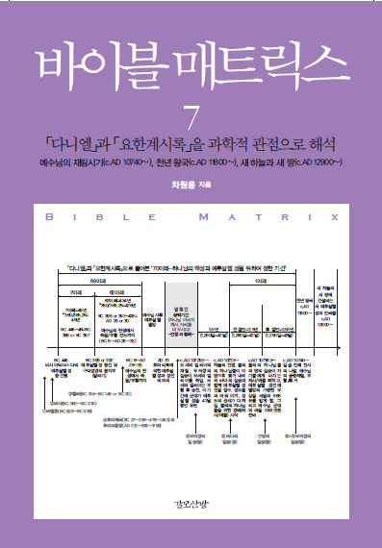
Bible Matrix ⑦: Historical & Scientific Views on <Daniel> and <Revelation>
Bible Matrix ⑦: Historical & Scientific Views on <Daniel> and <Revelation>
Part 1. <Daniel>,
Part 2. <Revelation>
This on Youtube:
https://www.youtube.com/watch?v=hE6Ep8jmc-k
Bible Matrix Series:
https://www.youtube.com/channel/UCrXiOQuBMdny7r_6GfoKocw
Dr. Won Yong Cha, English Education(BS), MBA, MISE(Ph.D.), Futurist or Futurologist biblematrix@gmail.com

Slide 2
Bible Matrix ⑦: Historical & Scientific Views on <Daniel> and <Revelation>
Chapter 3 of Revelation
Part 2. <Revelation>
<Revelation> 3:7~13 - To the Church in Philadelphia → A faithful church of little power, Receiving Only Praise from Jesus
<Revelation> 3:12 - (2) I will make a pillar in the temple of God the Father
☞ Revelation 3:12 - Him who overcomes I will make a pillar in the temple of my God. Never again will he leave it. I will write on him the name of my God and the name of the city of my God, the new Jerusalem, which is coming down out of heaven from my God; and I will also write on him my new name. (NIV); Him that overcometh will I make a pillar in the temple of my God, and he shall go no more out: and I will write upon him the name of my God, and the name of the city of my God, which is new Jerusalem, which cometh down out of heaven from my God: and I will write upon him my new name. (KJV); All who are victorious will become pillars in the Temple of my God, and they will never have to leave it. And I will write on them the name of my God, and they will be citizens in the city of my God - the new Jerusalem that comes down from heaven from my God. And I will also write on them my new name.) (NLT)
(2-1) But there is one problem. Solomon's physical temple of Jerusalem (or of God) had the pillars, namely Jachin and Boaz, but there will be no physical temple of God the Father in the Holy City of New Jerusalem as written in the chapter 21 of <Revelation>.

Slide 3
Bible Matrix ⑦: Historical & Scientific Views on <Daniel> and <Revelation>
Chapter 3 of Revelation
☞ The physical temple of God indicates that God exists within the temple, so the distinction between the inside and the outside of the temple is clear, and the inside and the outside of the temple is blocked. But in ‘the Holy City of New Jerusalem’, because God the Father and Jesus are its temple (Revelation 21:22) through the entire Holy City of New Jerusalem, so there is no need for a physical temple that blocks the inside and the outside.
☞ Until now, no one except Jesus (John 6:46) has seen God the Father (1 Timothy 6:16, John 1:18, 1 John 4:12), but in the Holy City of New Jerusalem, everyone will see the face of God the Father (Revelation 22:4).
(2-2) Therefore, ‘to make the one who overcomers a pillar in the temple of God’ does not mean a pillar in the physical temple, but means to always see God the Father and Jesus Christ from a close distance, walk and talk with them, assist and serve them.
☞ As recorded in <Ezekiel> 44:15, only the priest has the position to directly assist and serve LORD God. In conclusion, ‘pillars in the temple of God’ means to be priests (Revelation 1:6, 5:10) of God the Father and Jesus Christ or kings of the nations in the Holy City of New Jerusalem.

Slide 4
Bible Matrix ⑦: Historical & Scientific Views on <Daniel> and <Revelation>
Any question to me
☞ Next topic: <Revelation> 3:12 – Never again will he leave it
This on Youtube:
https://www.youtube.com/watch?v=hE6Ep8jmc-k
Bible Matrix Series:
https://www.youtube.com/channel/UCrXiOQuBMdny7r_6GfoKocw
Q&A
If you have any question, please email me: biblematrix@gmail.com
+82-10-5273-5763

