Slide 1

English Listening Course with KJV
『KJV』357 - 영어 듣기 훈련
레위기 제7장
Leviticus Chapter 7
영어 해석 강의는 검색어 ‘바이블로’
(이 프로그램은 기독교인 여부와 무관하게 활용할 수 있습니다.)
영어문장 듣기 연습 프로그램
teacher : David Kang (elgift@knou.ac.kr)

Slide 2
Leviticus Chapter 7
레위기 제7장
007:001 Likewise this is the law of the trespass offering: it is most holy.
007:002 In the place where they kill the burnt offering shall they kill the trespass offering: and the blood thereof shall he sprinkle round about upon the altar.
007:003 And he shall offer of it all the fat thereof; the rump, and the fat that covereth the inwards,
007:004 And the two kidneys, and the fat that is on them, which is by the flanks, and the caul that is above the liver, with the kidneys,

Slide 3
Leviticus Chapter 7
레위기 제7장
it shall he take away:
007:005 And the priest shall burn them upon the altar for an offering made by fire unto the LORD: it is a trespass offering.
007:006 Every male among the priests shall eat thereof: it shall be eaten in the holy place: it is most holy.
007:007 As the sin offering is, so is the trespass offering: there is one law for them: the priest that maketh atonement therewith shall have it.
007:008 And the priest that offereth

Slide 4
Leviticus Chapter 7
레위기 제7장
any man's burnt offering, even the priest shall have to himself the skin of the burnt offering which he hath offered.
007:009 And all the meat offering that is baken in the oven, and all that is dressed in the fryingpan, and in the pan, shall be the priest's that offereth it.
007:010 And every meat offering, mingled with oil, and dry, shall all the sons of Aaron have, one as much as another.
007:011 And this is the law of the sacrifice of peace offerings, which he shall offer unto the LORD.

Slide 5
Leviticus Chapter 7
레위기 제7장
007:012 If he offer it for a thanksgiving, then he shall offer with the sacrifice of thanksgiving unleavened cakes mingled with oil, and unleavened wafers anointed with oil, and cakes mingled with oil, of fine flour, fried.
007:013 Besides the cakes, he shall offer for his offering leavened bread with the sacrifice of thanksgiving of his peace offerings.
007:014 And of it he shall offer one out of the whole oblation for an heave offering unto the LORD, and it shall be the priest's

Slide 6
Leviticus Chapter 7
레위기 제7장
that sprinkleth the blood of the peace offerings.
007:015 And the flesh of the sacrifice of his peace offerings for thanksgiving shall be eaten the same day that it is offered; he shall not leave any of it until the morning.
007:016 But if the sacrifice of his offering be a vow, or a voluntary offering, it shall be eaten the same day that he offereth his sacrifice: and on the morrow also the remainder of it shall be eaten:
007:017 But the remainder of the flesh of the sacrifice on the third day shall be burnt with fire.

Slide 7
Leviticus Chapter 7
레위기 제7장
007:018 And if any of the flesh of the sacrifice of his peace offerings be eaten at all on the third day, it shall not be accepted, neither shall it be imputed unto him that offereth it: it shall be an abomination, and the soul that eateth of it shall bear his iniquity.
007:019 And the flesh that toucheth any unclean thing shall not be eaten; it shall be burnt with fire: and as for the flesh, all that be clean shall eat thereof.
007:020 But the soul that eateth of the flesh of the sacrifice of peace offerings,

Slide 8
Leviticus Chapter 7
레위기 제7장
that pertain unto the LORD, having his uncleanness upon him, even that soul shall be cut off from his people.
007:021 Moreover the soul that shall touch any unclean thing, as the uncleanness of man, or any unclean beast, or any abominable unclean thing, and eat of the flesh of the sacrifice of peace offerings, which pertain unto the LORD, even that soul shall be cut off from his people.
007:022 And the LORD spake unto Moses, saying,
007:023 Speak unto the children of Israel, saying,

Slide 9
Leviticus Chapter 7
레위기 제7장
Ye shall eat no manner of fat, of ox, or of sheep, or of goat.
007:024 And the fat of the beast that dieth of itself, and the fat of that which is torn with beasts, may be used in any other use: but ye shall in no wise eat of it.
007:025 For whosoever eateth the fat of the beast, of which men offer an offering made by fire unto the LORD, even the soul that eateth it shall be cut off from his people.
007:026 Moreover ye shall eat no manner of blood,

Slide 10
Leviticus Chapter 7
레위기 제7장
whether it be of fowl or of beast, in any of your dwellings.
007:027 Whatsoever soul it be that eateth any manner of blood, even that soul shall be cut off from his people.
007:028 And the LORD spake unto Moses, saying,
007:029 Speak unto the children of Israel, saying, He that offereth the sacrifice of his peace offerings unto the LORD shall bring his oblation unto the LORD of the sacrifice of his peace offerings.
007:030 His own hands shall bring the offerings

Slide 11
Leviticus Chapter 7
레위기 제7장
of the LORD made by fire, the fat with the breast, it shall he bring, that the breast may be waved for a wave offering before the LORD.
007:031 And the priest shall burn the fat upon the altar: but the breast shall be Aaron's and his sons'.
007:032 And the right shoulder shall ye give unto the priest for an heave offering of the sacrifices of your peace offerings.
007:033 He among the sons of Aaron, that offereth the blood of the peace offerings, and the fat, shall have the right shoulder for his part.

Slide 12
Leviticus Chapter 7
레위기 제7장
007:034 For the wave breast and the heave shoulder have I taken of the children of Israel from off the sacrifices of their peace offerings, and have given them unto Aaron the priest and unto his sons by a statute for ever from among the children of Israel.
007:035 This is the portion of the anointing of Aaron, and of the anointing of his sons, out of the offerings of the LORD made by fire, in the day when he presented them to minister unto the LORD in the priest's office;

Slide 13
Leviticus Chapter 7
레위기 제7장
007:036 Which the LORD commanded to be given them of the children of Israel, in the day that he anointed them, by a statute for ever throughout their generations.
007:037 This is the law of the burnt offering, of the meat offering, and of the sin offering, and of the trespass offering, and of the consecrations, and of the sacrifice of the peace offerings;
007:038 Which the LORD commanded Moses in mount Sinai, in the day that he commanded the children of Israel to offer their oblations

Slide 14
Leviticus Chapter 7
레위기 제7장
unto the LORD, in the wilderness of Sinai.

Slide 15
Leviticus Chapter 7
레위기 제7장
안내 사항
KJV 기반의 영어 해석 강좌는
신학적 내용이 빠져 있으므로
기독교인 여부와 무관하게
활용할 수 있습니다. (검색어 : 바이블로)
KJV 영어해석 강좌가 끝나면
NIV 영어구조분석 강좌(검색어 : 뉴바이블로)가
기독교인용으로 진행될 예정입니다.

Slide 16
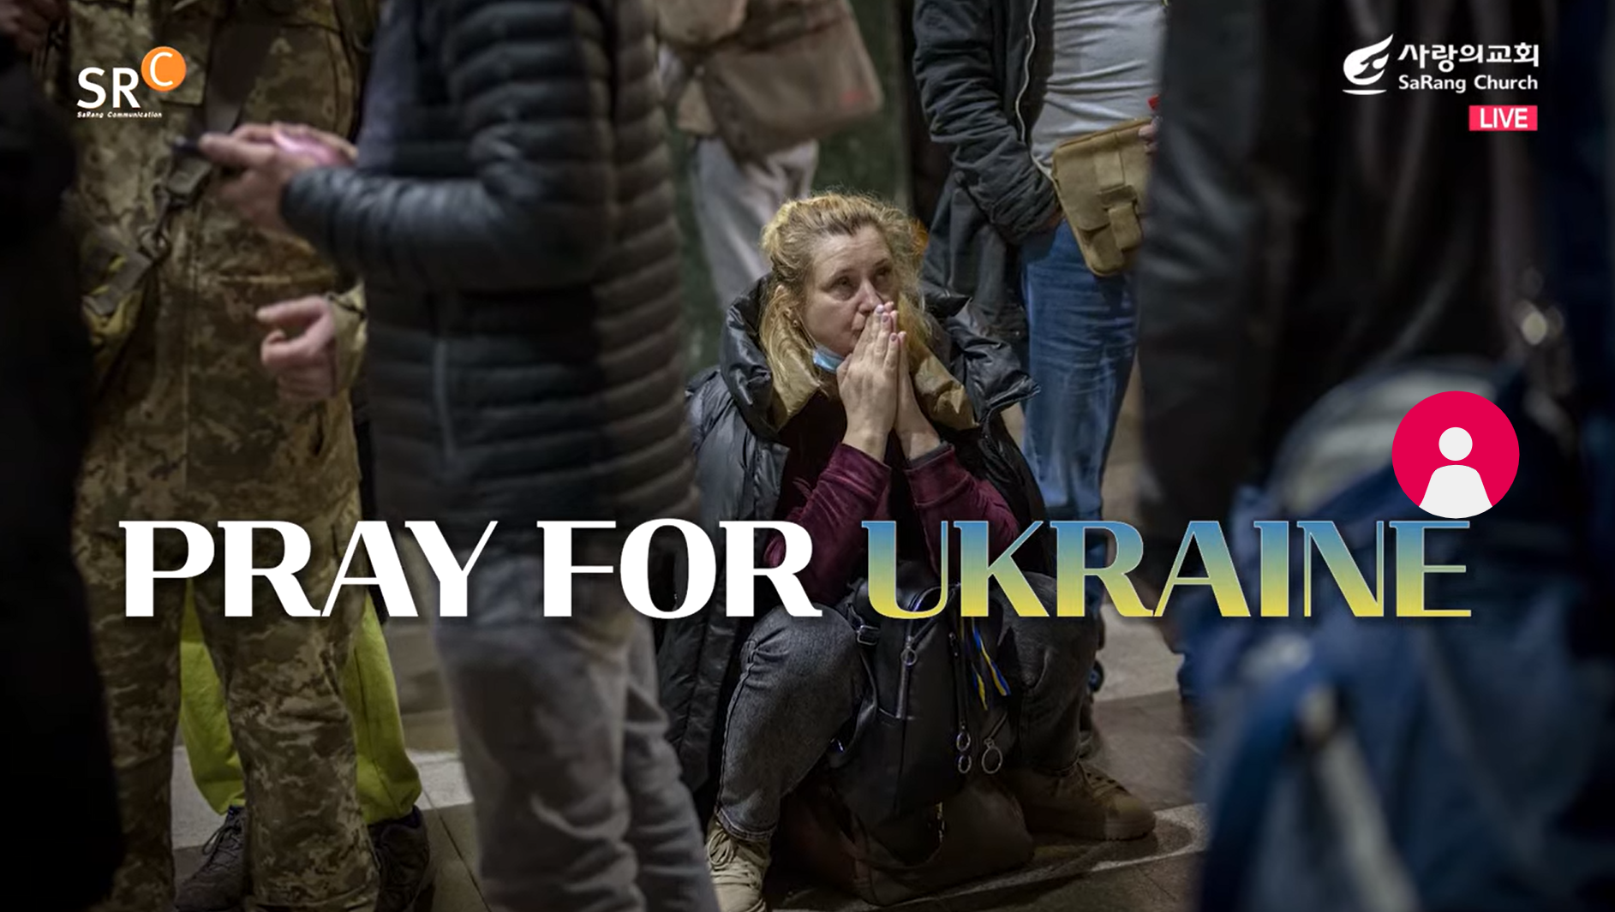
자유자재로 영어 하기 코스워크
레위기 제7장

