Slide 1








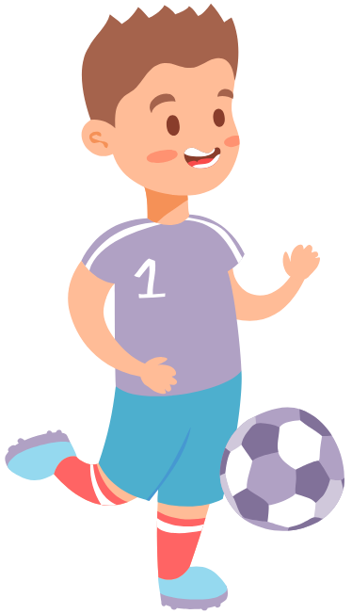



Lesson 1
It's the
World Cup Time!
Let's prepare for the class!
Teacher
Student
Park Sang Rok
High School Grade 1

Slide 2






Your Logo Here
Contents
Educational Presentation
1
Before You Read
2
Let's Read
3
After You Read

Slide 3




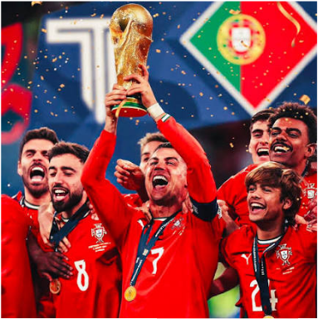
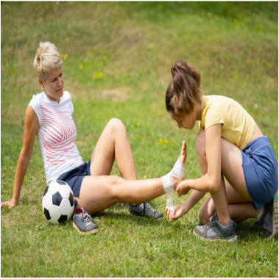

before you read
Get ready
Fill in the blanks with the words in the box. Make sentences as many as possible.
think/guess/wish
will/should
I ____ Portugal ____ win the World Cup!
I ____ she is injured.

Slide 4



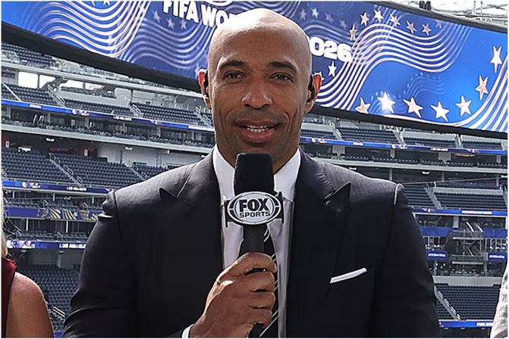
Let's read
Live from the World Cup
Passions Around the Globe
By Reporter Henry
Welcome to the Fifa World Cup 2026, a special time when football fans from all over the world showcase their unique traditions. Today, we are visiting three different fan zones to see how they cheer for their teams!

Slide 5


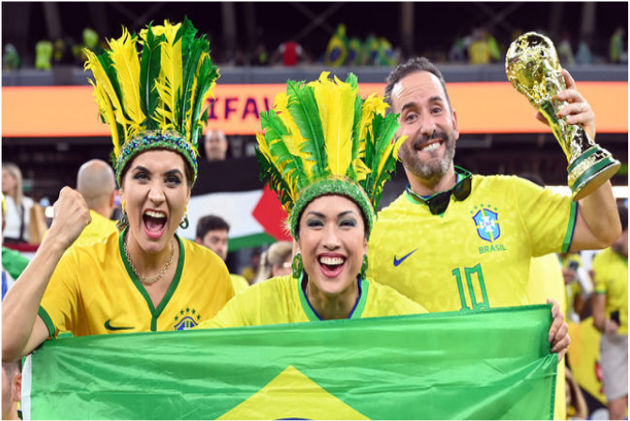
Let's read
Live from the World Cup
Scene 1: Brazil Fan Zone
Reporter Henry: I am standing in the middle of a crowded street where hundreds of Brazilian fans are dancing. The energy is unbelievable! Excuse me, sir, can you tell us about your cheering culture?
Lucas (Brazil Fan): Haha, welcome! In Brazil, we always play energetic samba music while watching the match. Dancing to the rhythm keeps our spirits high. I predict that Brazil will win the trophy this year because our team's rhythm is unstoppable!

Slide 6



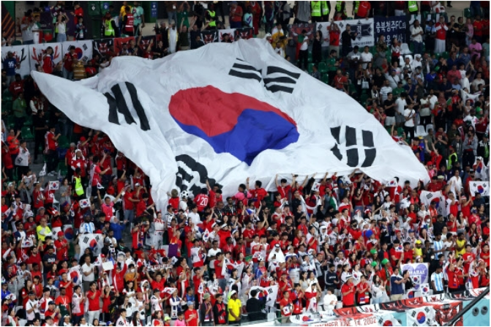
Let's read
Live from the World Cup
Scene 2: South Korea Fan Zone
Reporter Alex: Now, I have moved to a huge public square where a sea of red is chanting in perfect unison. Let's talk to one of the fans. Hello!
Minho (Korean Fan): Hello! We are the Red Devils, the passionate supporters of South Korea. We beat traditional drums and shout "Dae-han-min-guk!" like this. We shout with a deep wish. I sincerely hope that our voices reach the players and lead them to victory today!

Slide 7



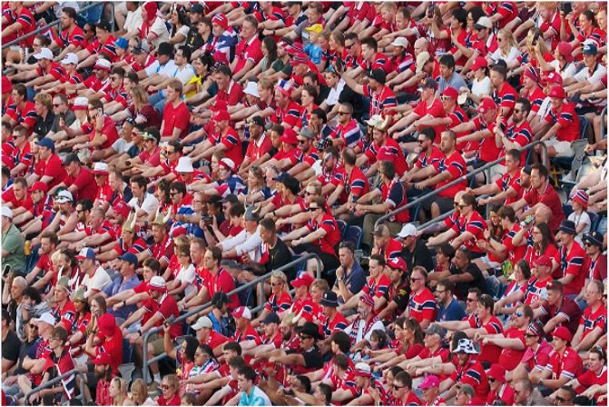
Let's read
Live from the World Cup
Scene 3: Norway Fan Zone
Reporter Alex: Finally, I am inside the stadium with Norwegian fans. Strangely, everyone is sitting down on the floor right now. What is happening here?
Astrid (Norway Fan): Watch this! When our team needs energy, thousands of fans mimic rowing a Viking ship together, shouting "Ro! Ro!" (Row! Row!). My expectation is that this rowing spirit will push our team forward. I wish for our players to fight like real Vikings on the pitch!

Slide 8

aFTER YOU READ
Gesture Game
Guess what country's football culture it is!

Slide 9
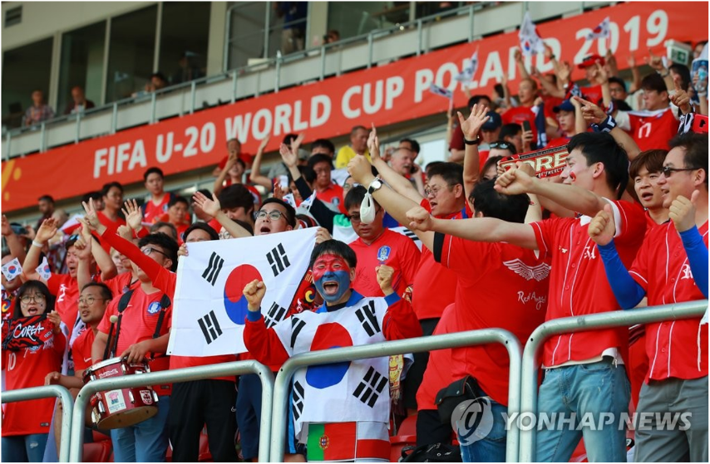
aFTER YOU READ
Gesture Game

Slide 10
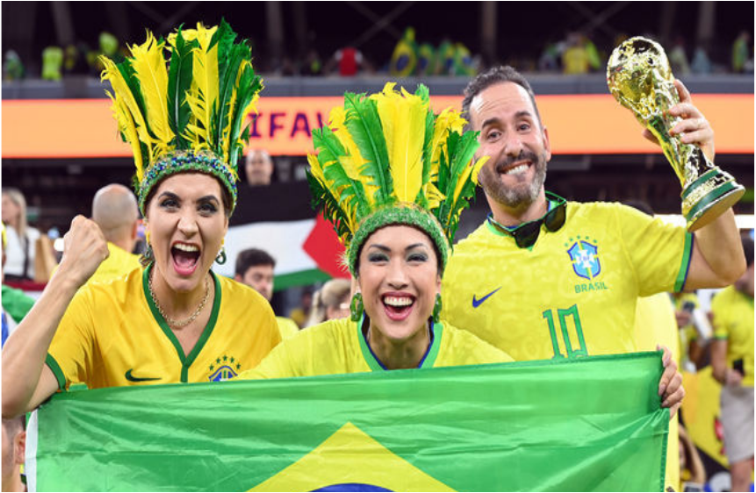

aFTER YOU READ
Gesture Game

Slide 11


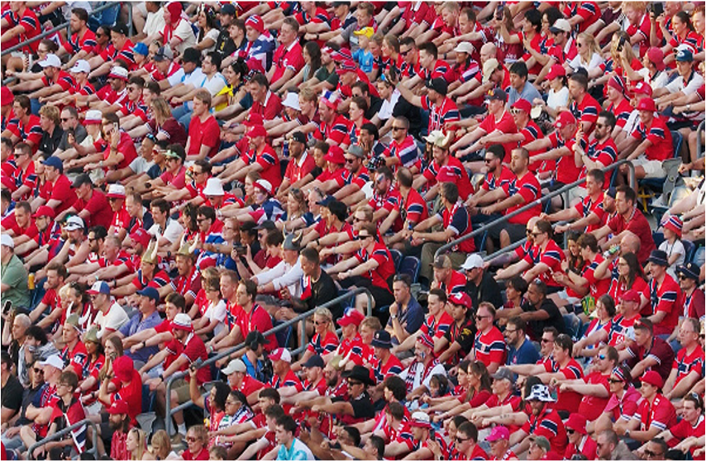
aFTER YOU READ
Gesture Game

Slide 12

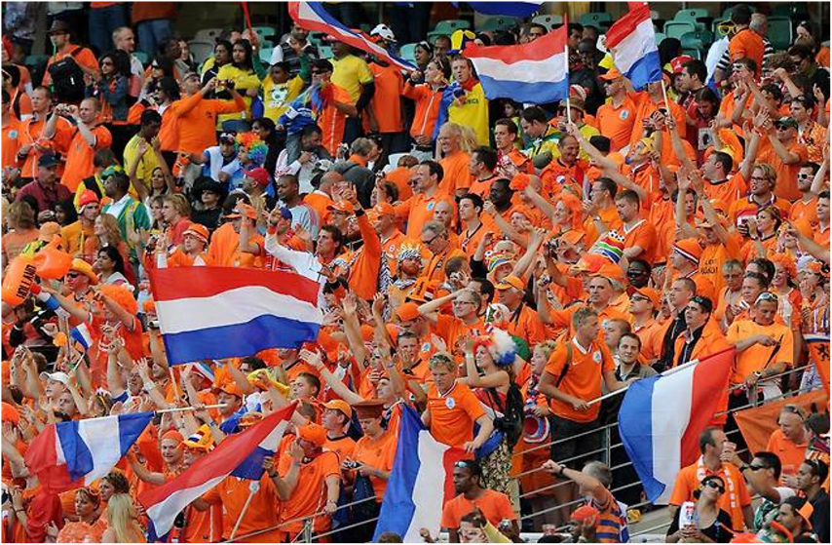
aFTER YOU READ
Gesture Game

Slide 13


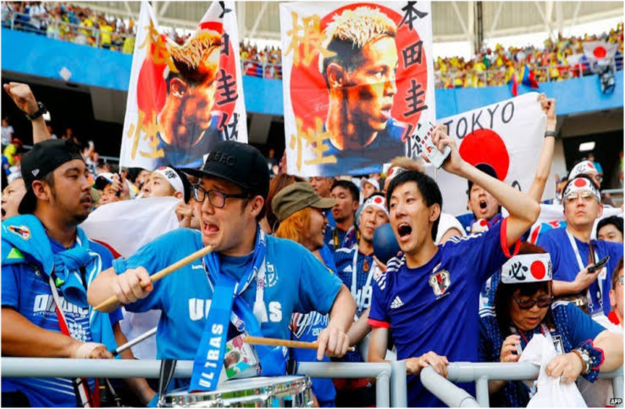
aFTER YOU READ
Gesture Game

Slide 14

Wrap-up
What we learned today
I think~
I guess~
We will~
They wish~

Slide 15

wrap-up
See You
Next Class!

