Slide 1
New Rulings on
Dominaria United
~신기능 룰링 분석~
Jaejeong Lee

Slide 2
0. Dominaria United Errata

Slide 3
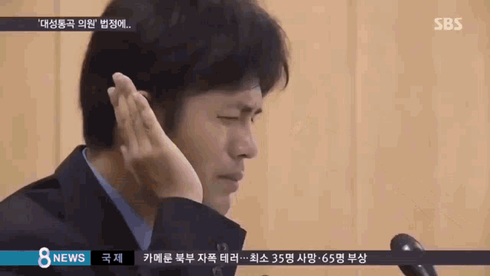
Wrong translation
Since there is no more Korean cards,
so we don’t have any translation problems.

Slide 4
1. Dominaria United Returning Mechanism

Slide 5
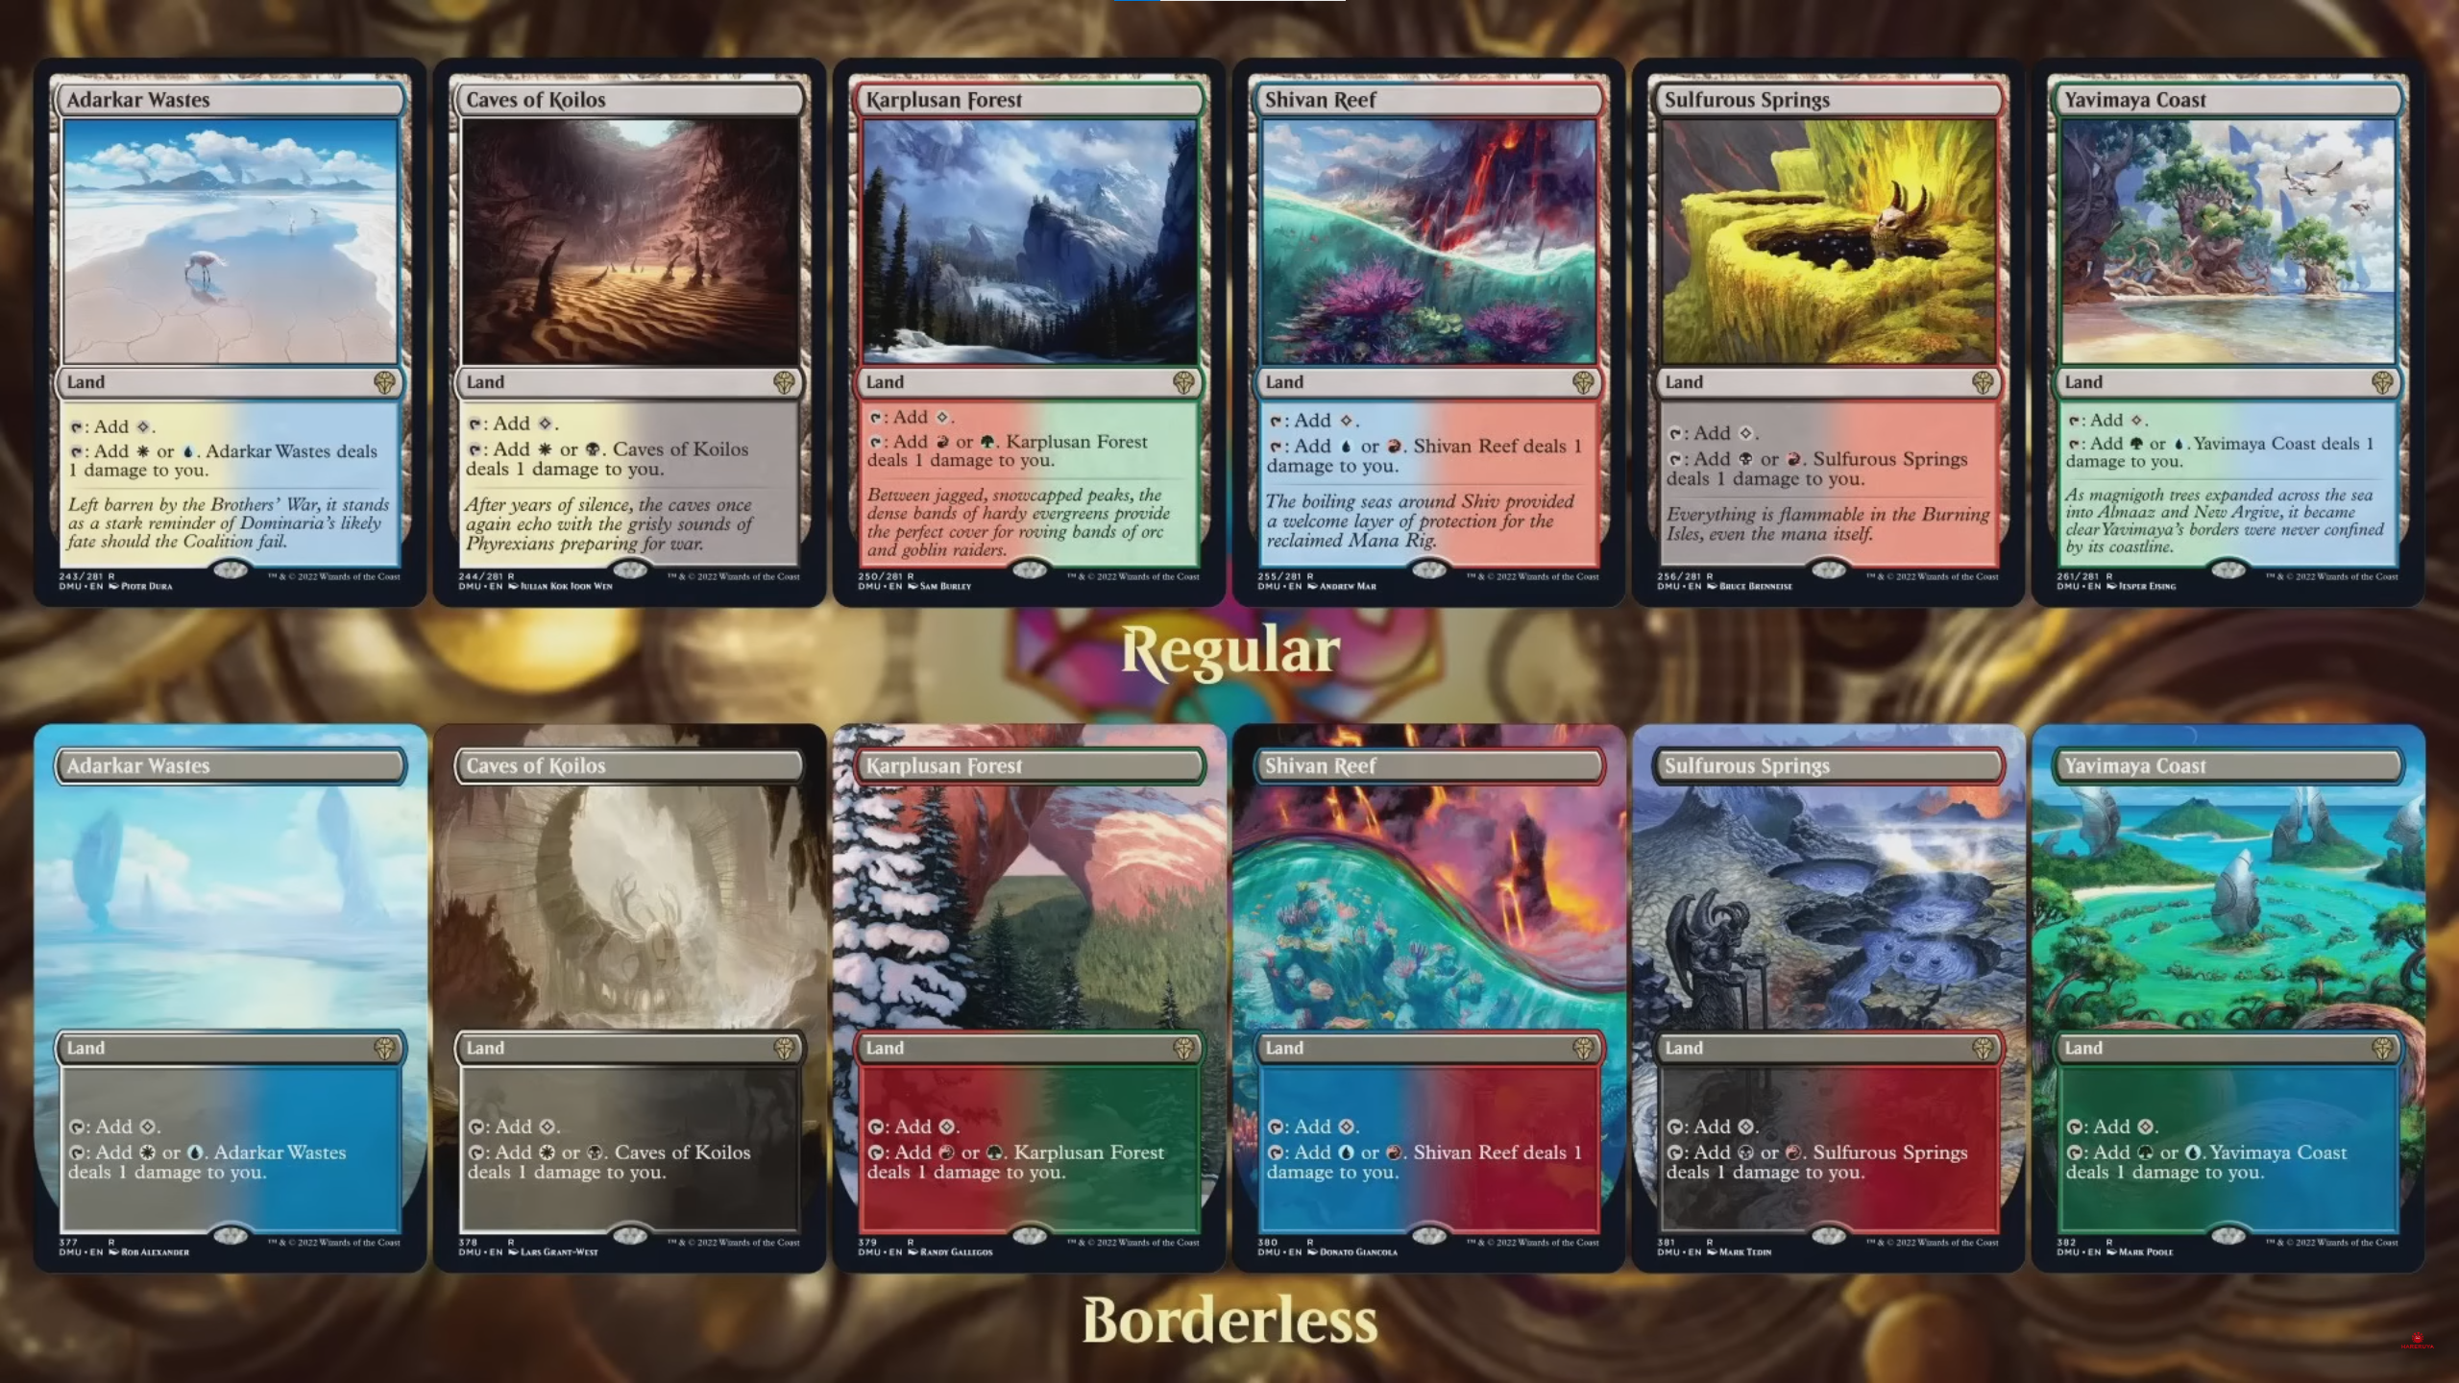
Returning Keywords : Pain lands

Slide 6
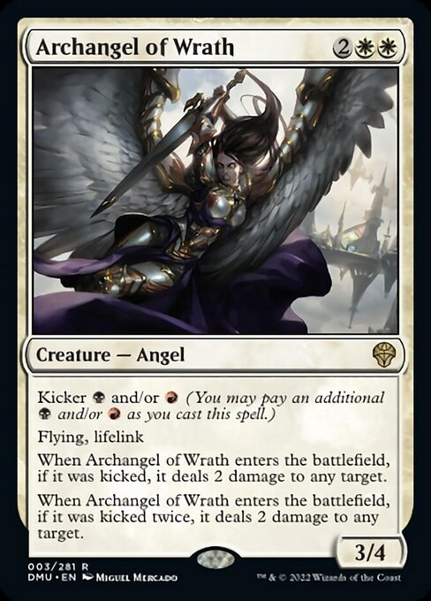
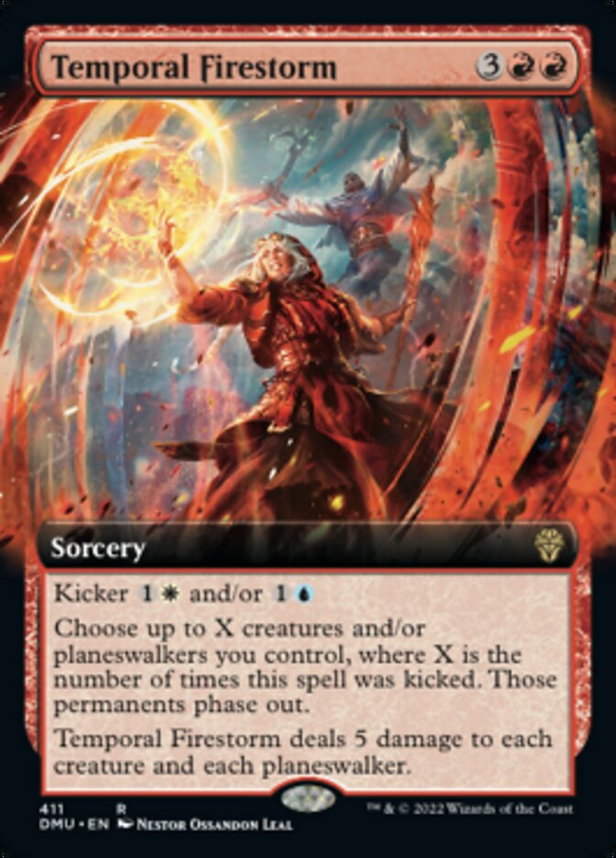
Returning Keywords : Kicker

Slide 7
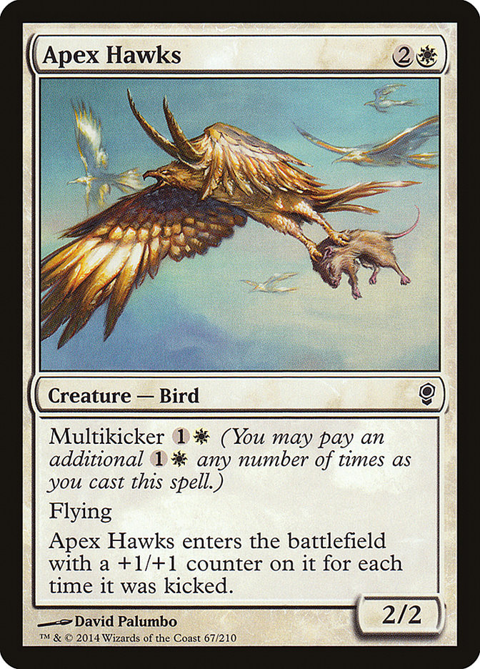
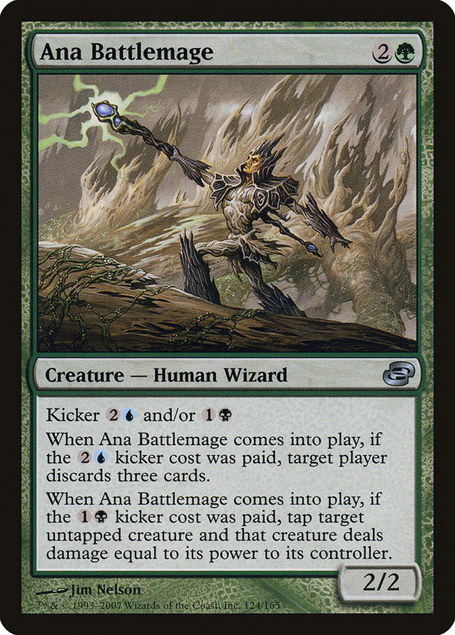
Difference with before kickers

Slide 8
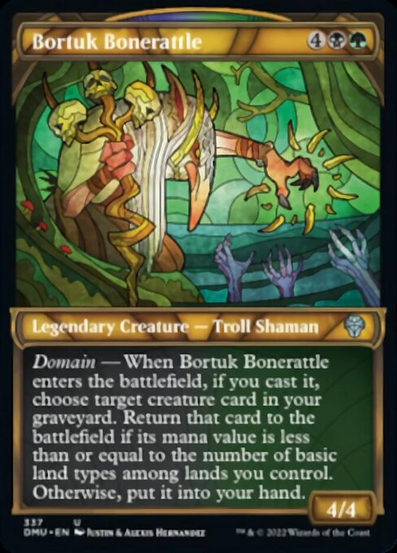
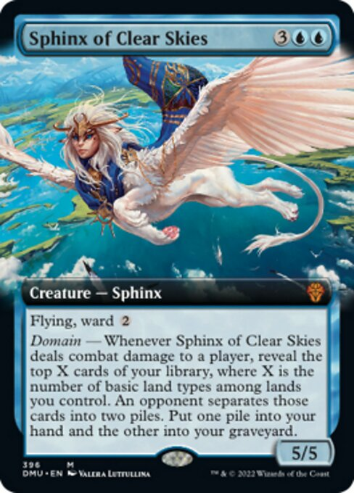
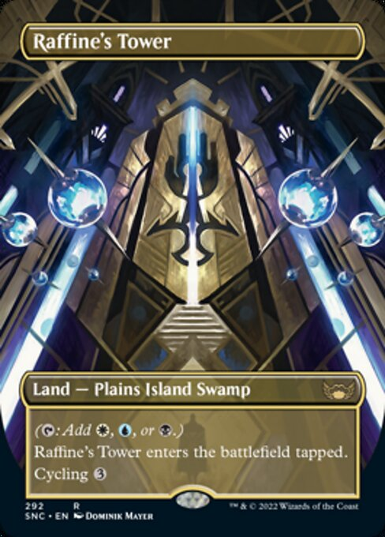
Returning Keywords : Domain

Slide 9
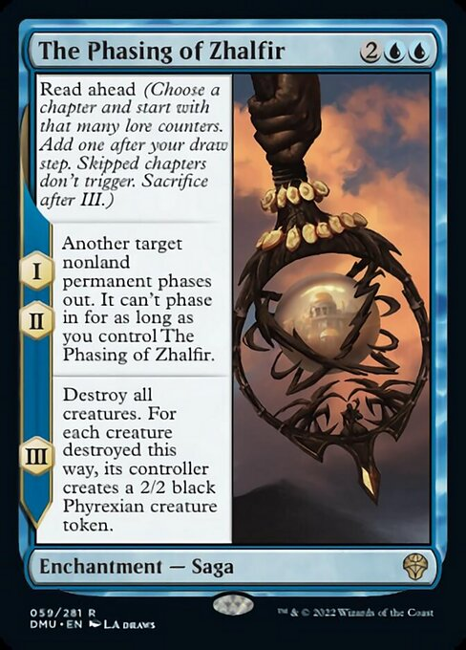
Returning Keywords : Sagas
New Keywords : Sagas with Read Ahead

Slide 10
2. Dominaria United New Mechanism

Slide 11
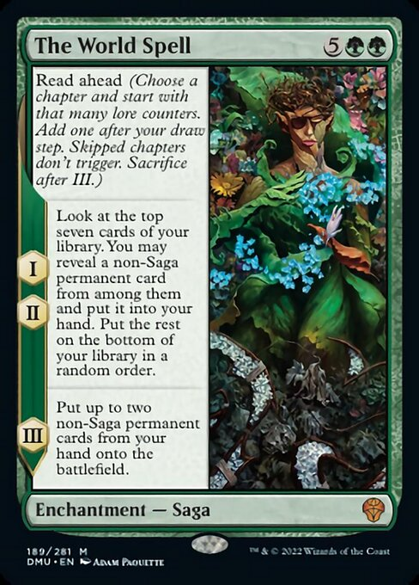
New Keywords : Sagas with Read Ahead

Slide 12
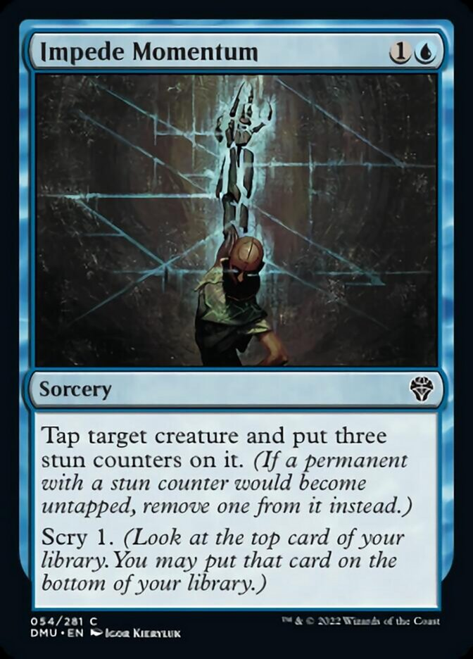
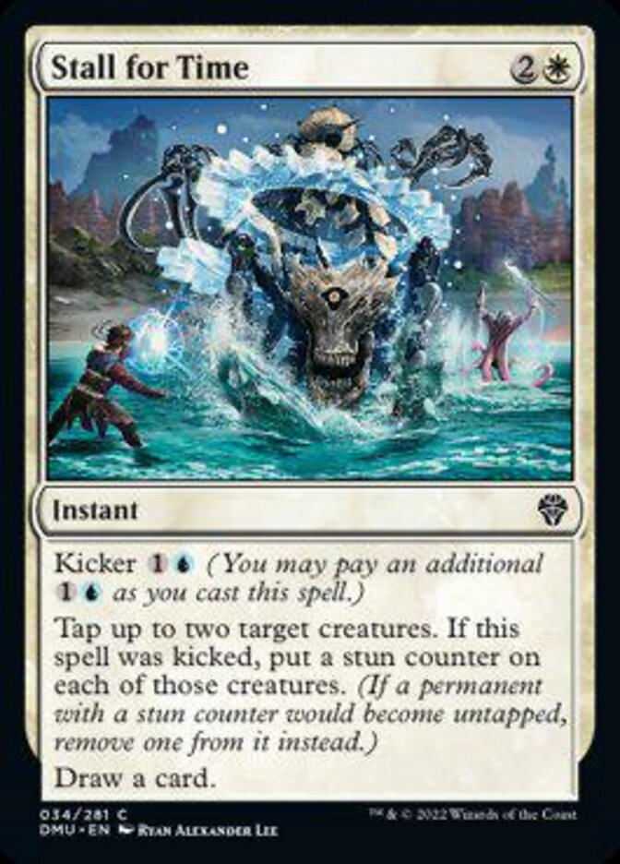
New Keywords : Stun Counters

Slide 13
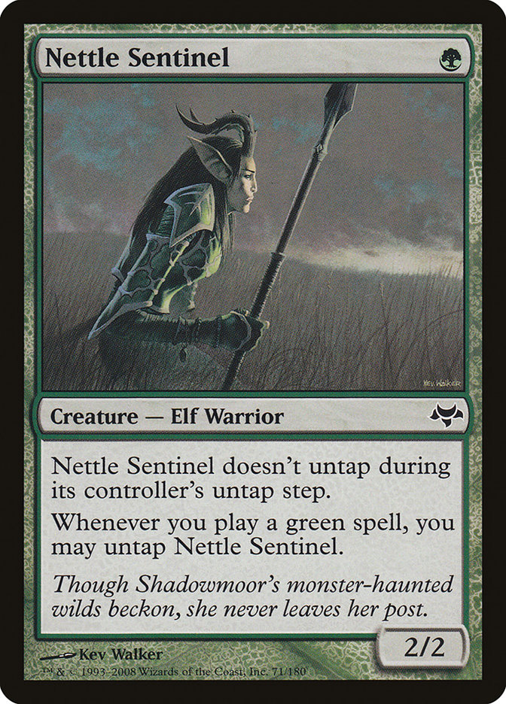
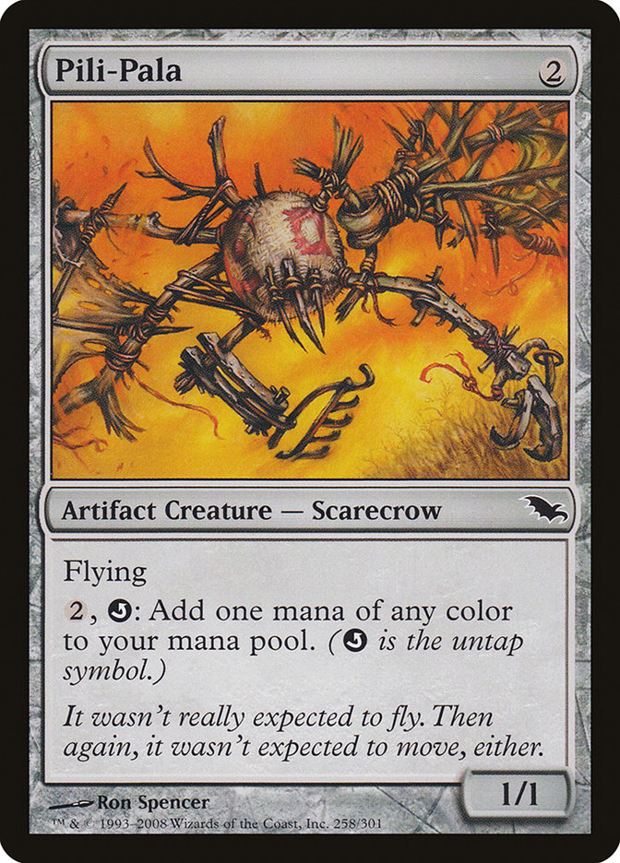
Stun Counters and Untap Effect

Slide 14
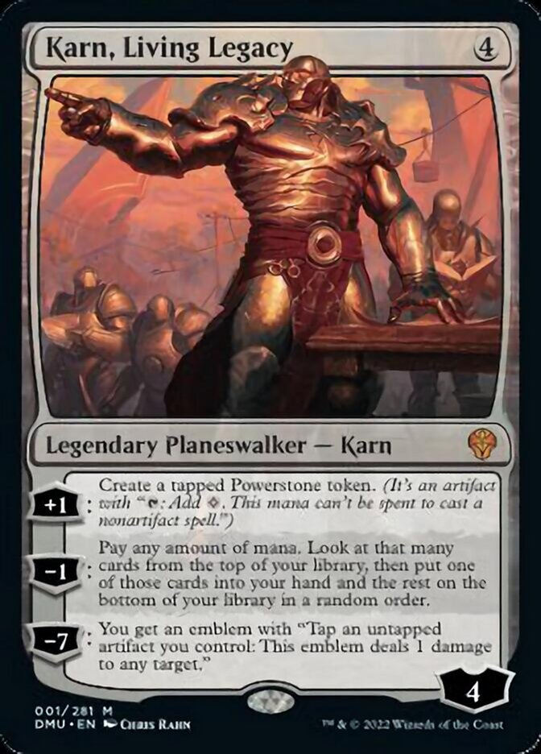
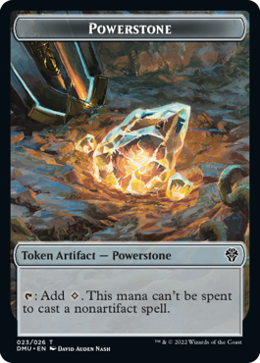
New Keywords : Powerstone Tokens

Slide 15
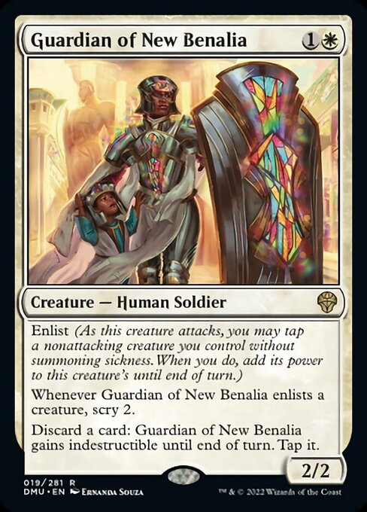
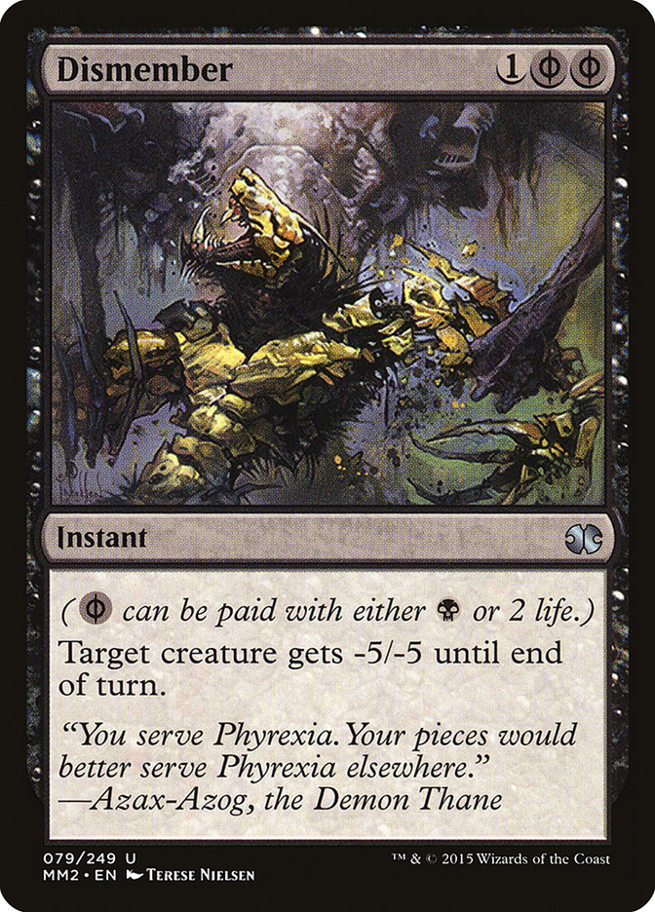
New Keywords : Enlist
The attacking player chooses whether to tap a creature for an enlist ability immediately after they tap the creatures that they have chosen to attack with. You can’t choose to enlist a creature later.
To enlist a creature, that creature must be untapped, it must not be attacking (even if it has vigilance), and it must have haste or have been under that attacking player’s control since the beginning of their current turn.
When a player taps a creature for an attacking creature’s enlist ability, that attacking creature gets +X/+0 until end of turn, where X is the tapped creature’s power. This is a triggered ability that goes on the stack immediately after attackers have been declared in the declare attackers step.
You may tap only one creature for an enlist ability of an attacking creature, and a single creature can’t be tapped for more than one enlist ability

Slide 16
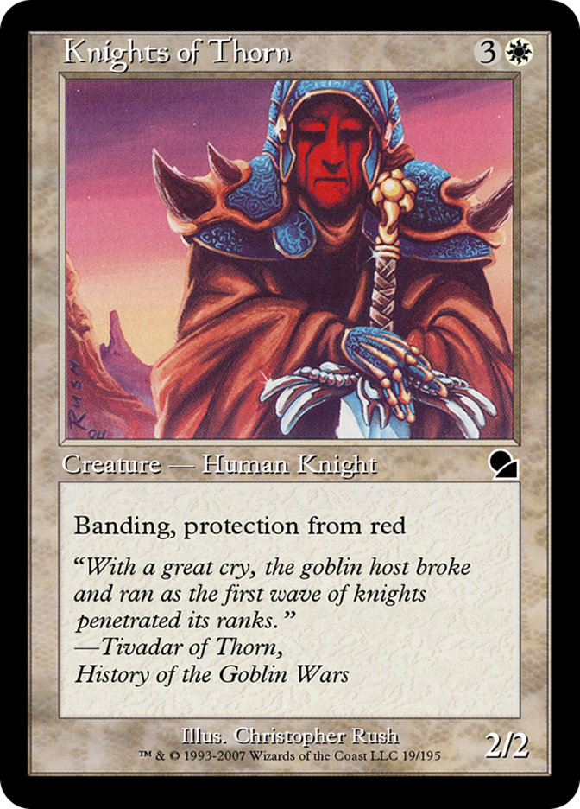
Enlist and Banding
Banding
Any creatures with banding, and up to one without, can attack in a band. Bands are blocked as a group. If any creatures with banding you control are blocking or being blocked by a creature, you divide that creature’s combat damage, not its controller, among any of the creatures it’s being blocked by or is blocking.

Slide 17
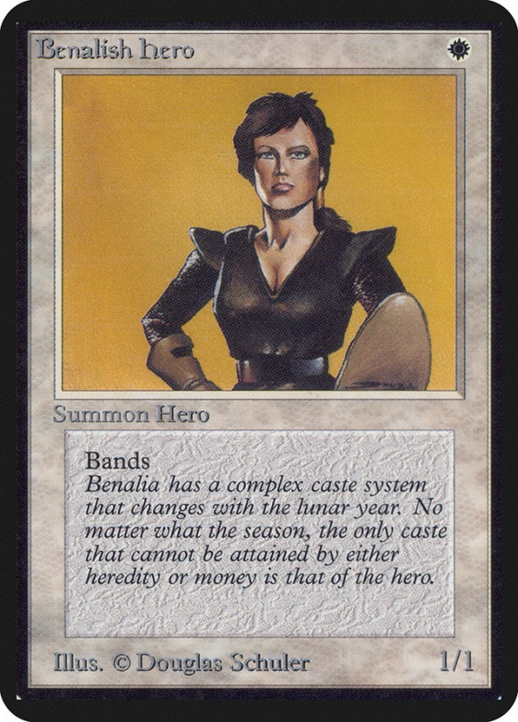
Enlist and Banding
In the beginning, Garfield created the Band(Alpha)
As you declare attacker, you can make band.
A band must include at least one creature with band.
A band can include only one more creature without. and
You can make multiple band.
Mark Rosewater rates the mechanic an 11 on the Storm Scale of 10.

Slide 18
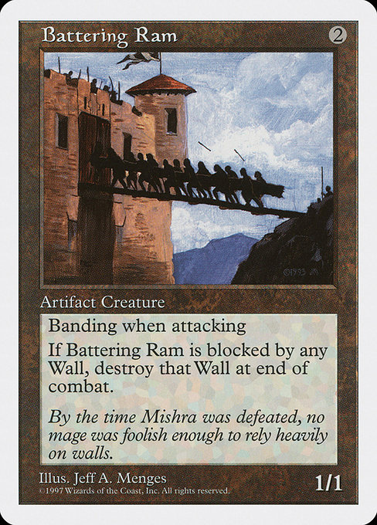
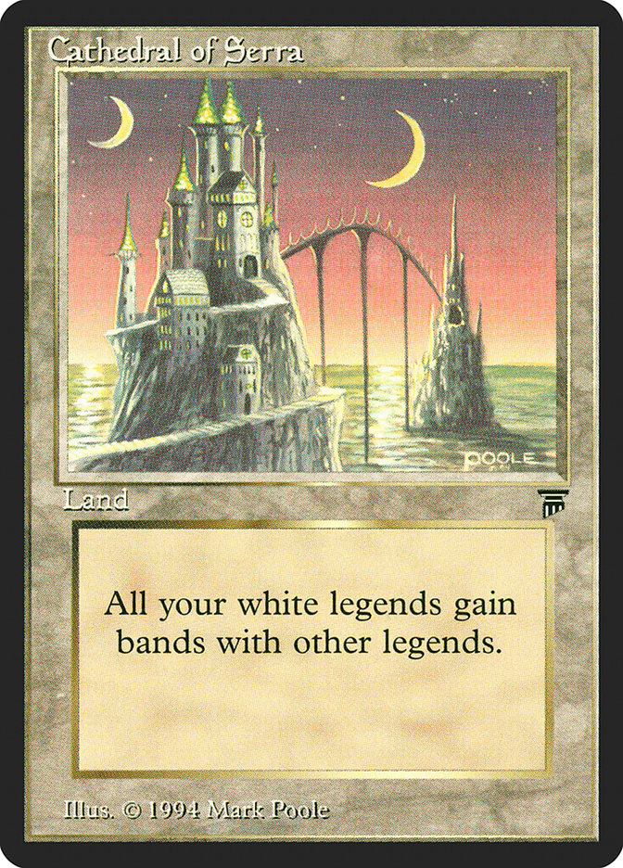
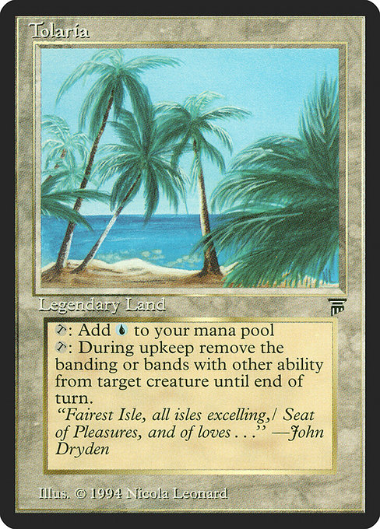
Banding Cards

Slide 19
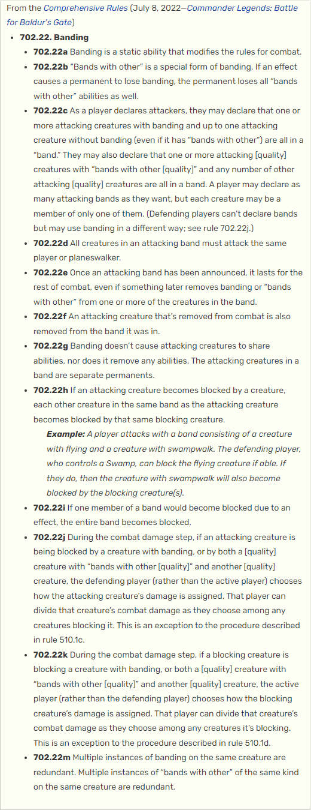
Banding

Slide 20
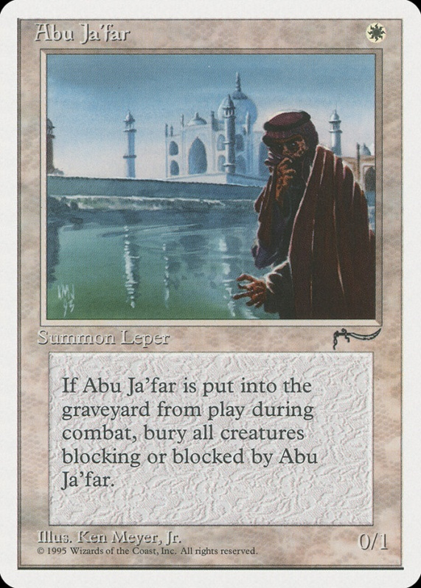
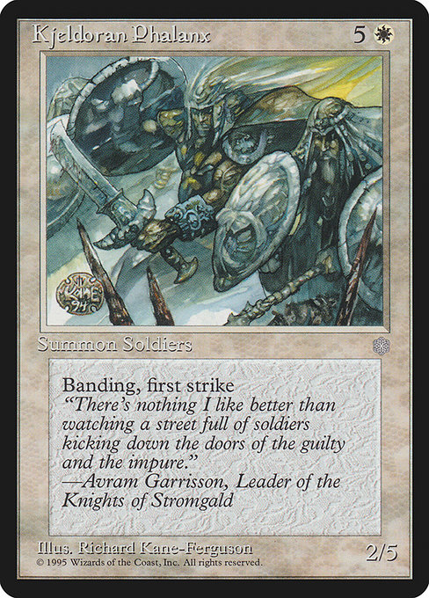
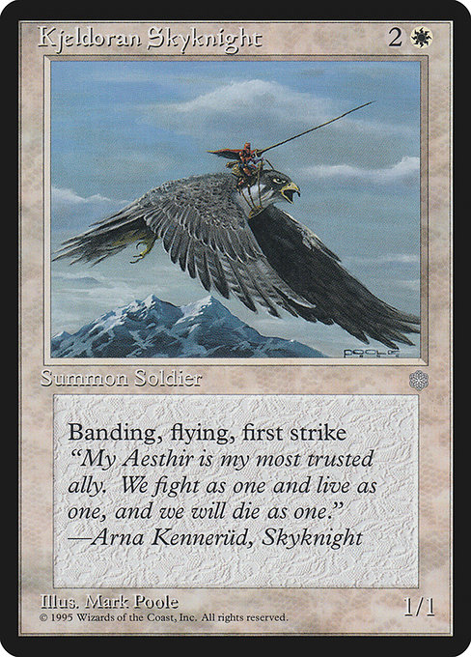
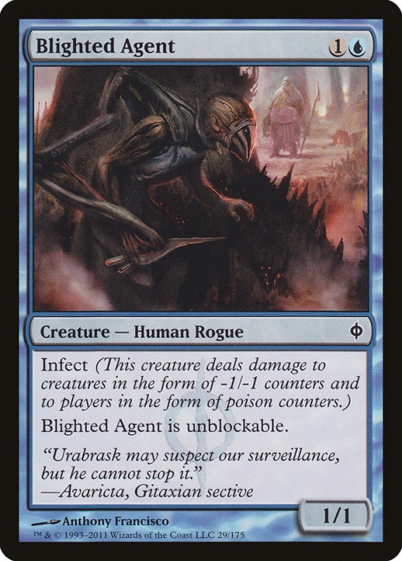
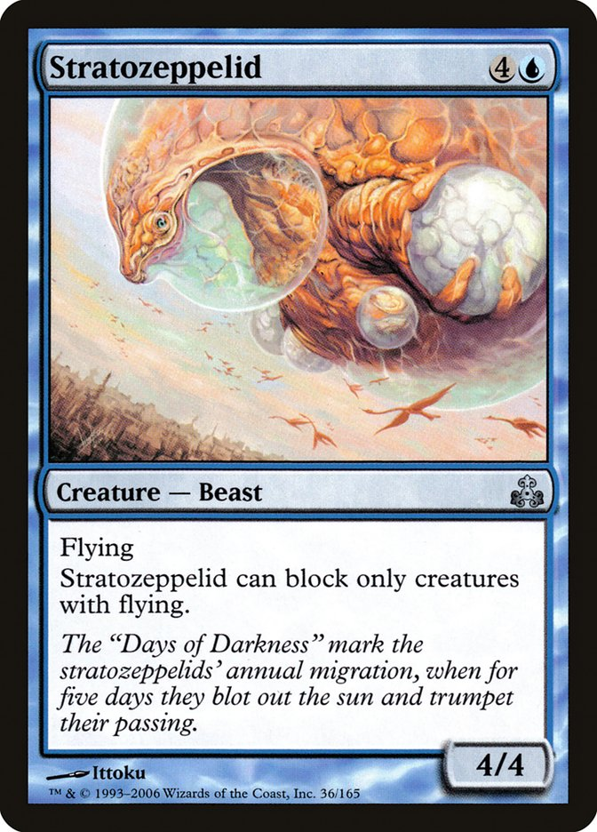
Banding example

Slide 21
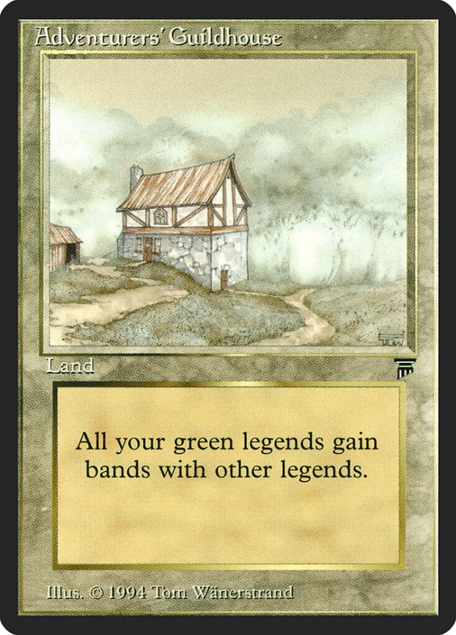
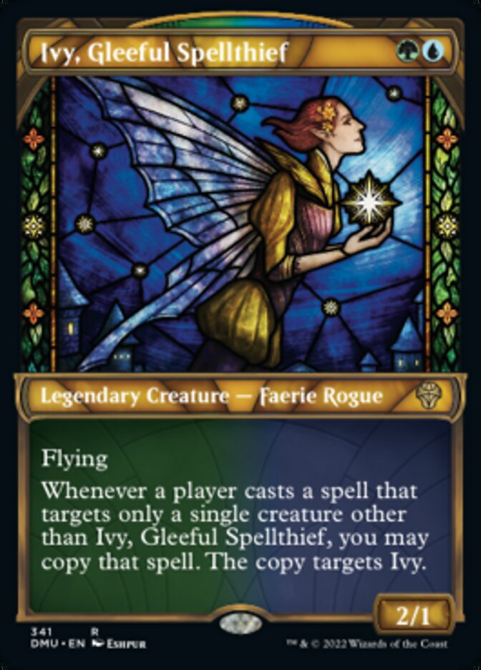
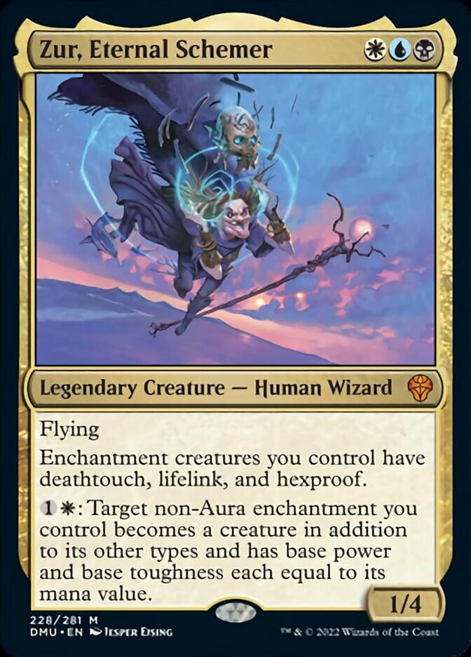
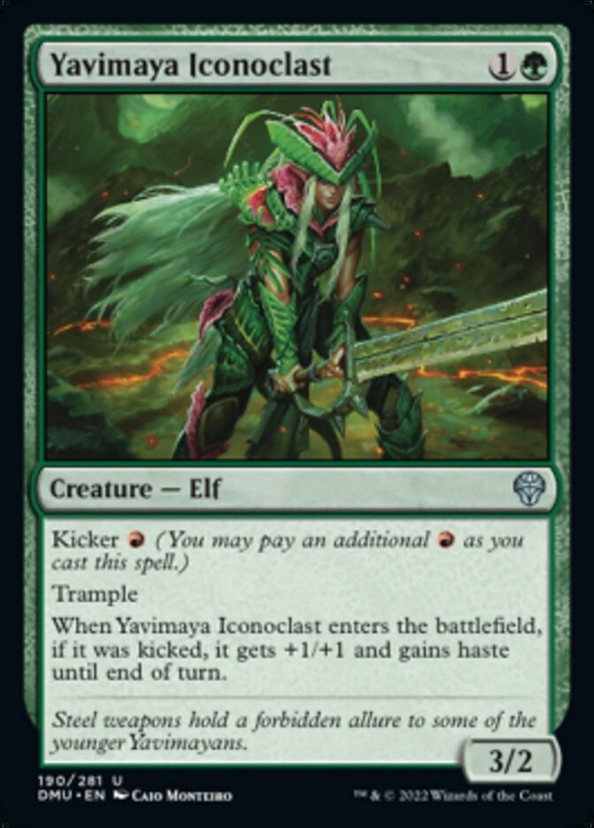
Band with~
Banding : any number of creatures with banding + 1 creature
Band with : any number of creatures that in condition + 0 creature

Slide 22
Why attacker makes a band?
Banded creatures blocked as one creature
Attack
Block
DISADVANTAGE

Slide 23
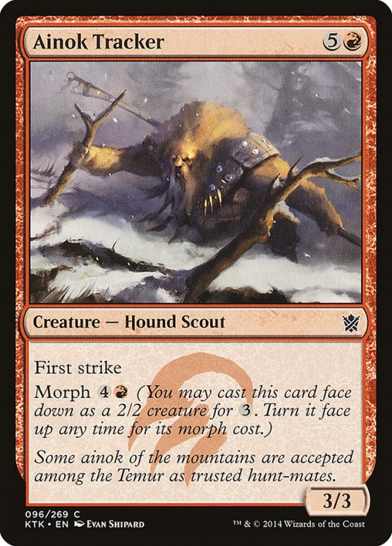
Why attacker makes a band?
Banded creatures does not share ability
Attack
Block
DISADVANTAGE

Slide 24
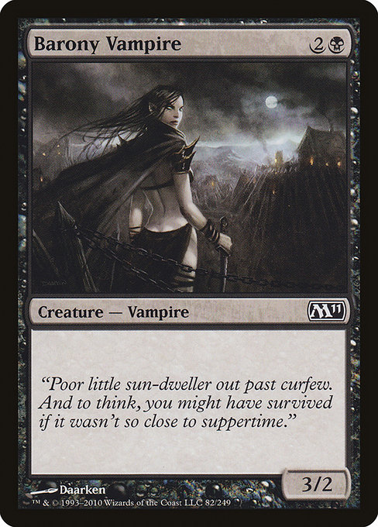
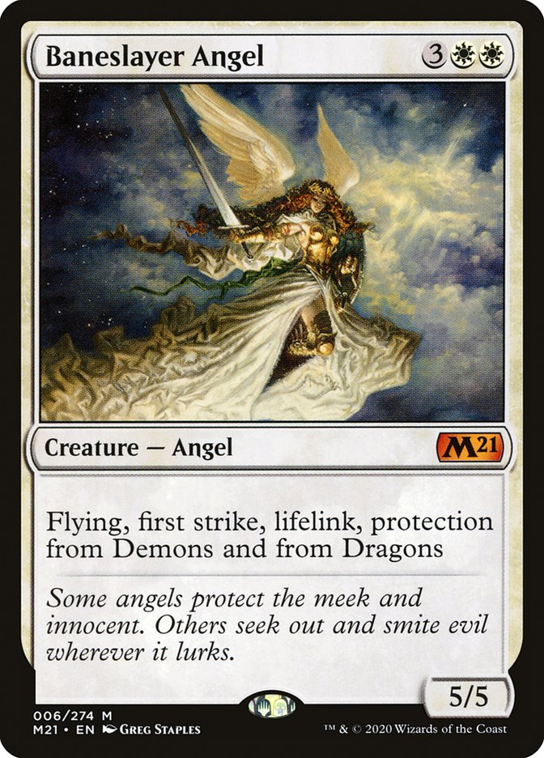
Why attacker makes a band?
Banded creatures can ignore damage assign order!
4
1
Attack
Block
ADVANTAGE

Slide 25
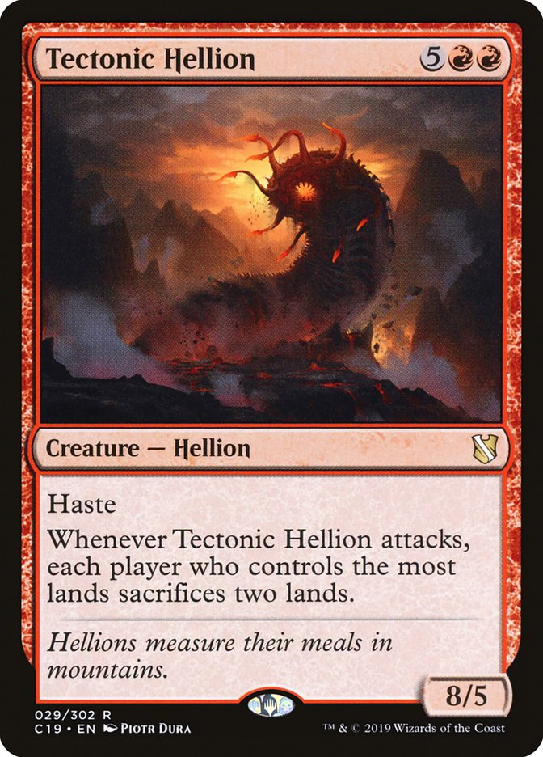
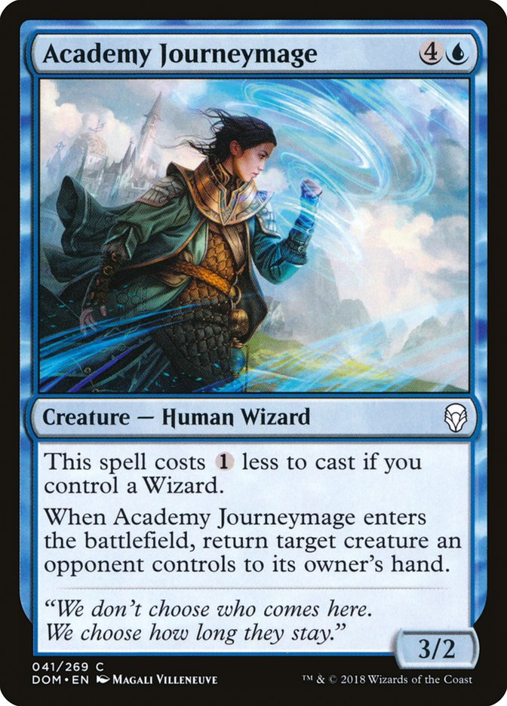
Banding and blocking
Banded creatures can ignore damage assign order even they blocks!
8
Attack
Block
ADVANTAGE

Slide 26
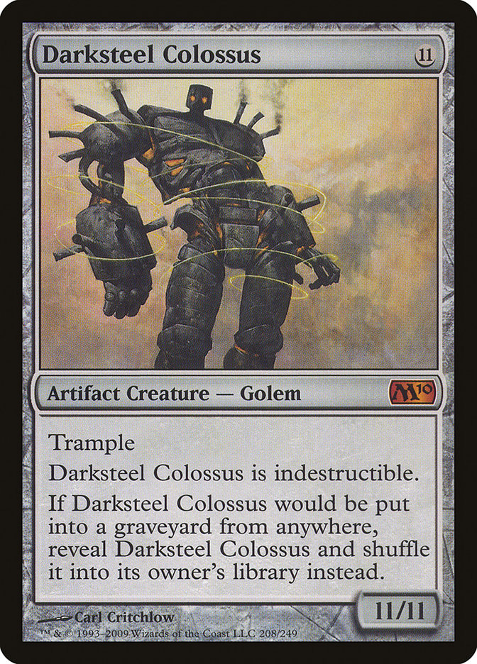
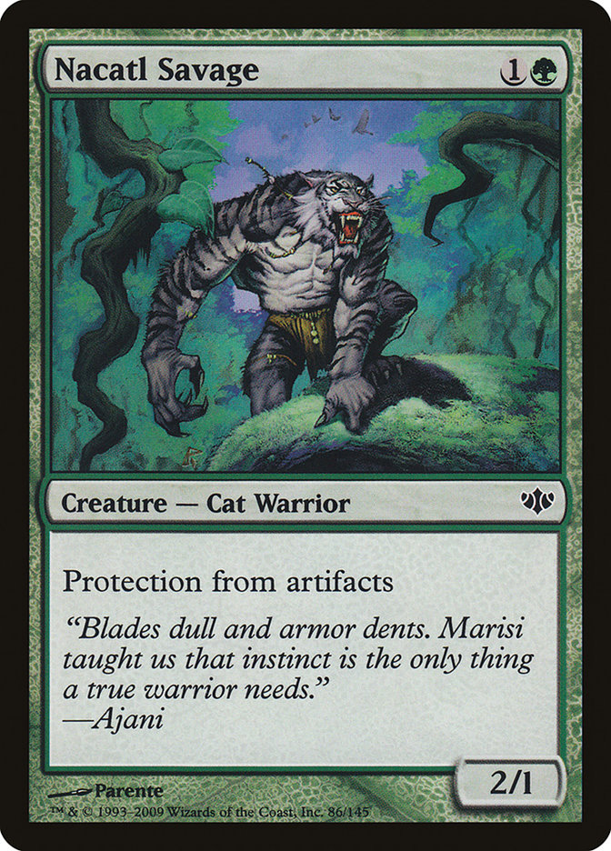
Banding vs Trample?
11
0 to player
Attack
Block

Slide 27
3. Others

Slide 28
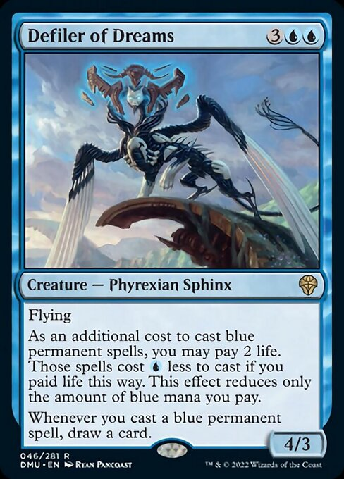
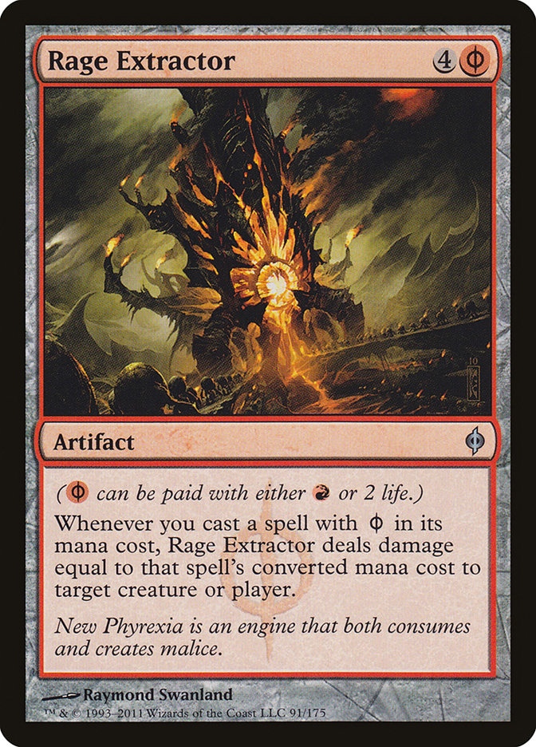
Phrexian mana came back?
NOPE!

Slide 29
Thank you for listening!

