Slide 1


1/13

Slide 2

2/13

Slide 3
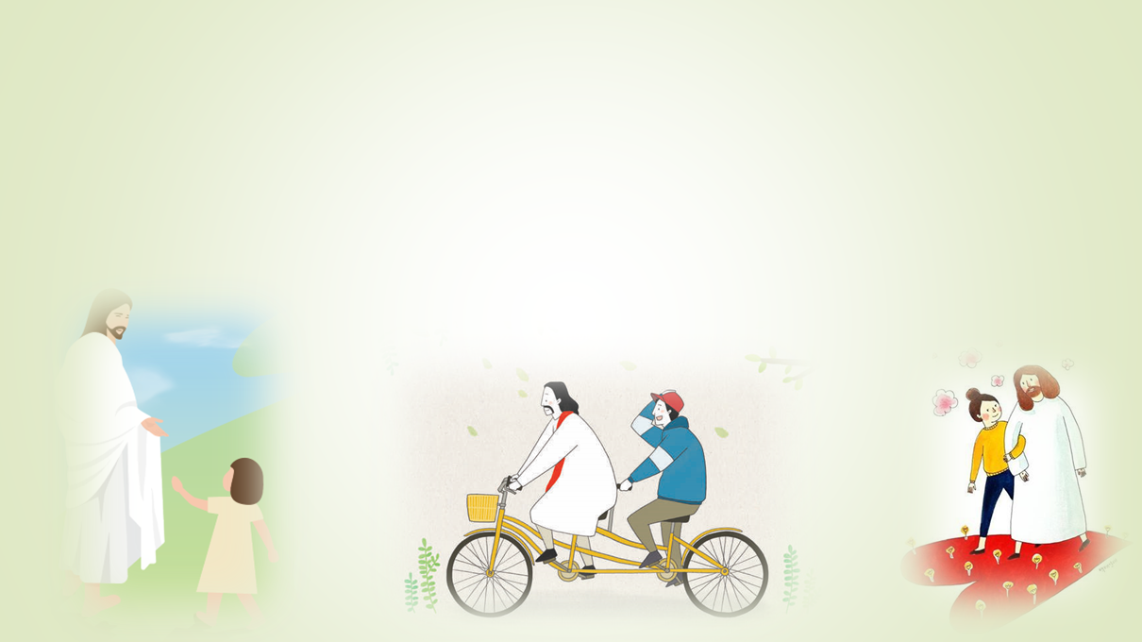

3/13

Slide 4

4/13

Slide 5
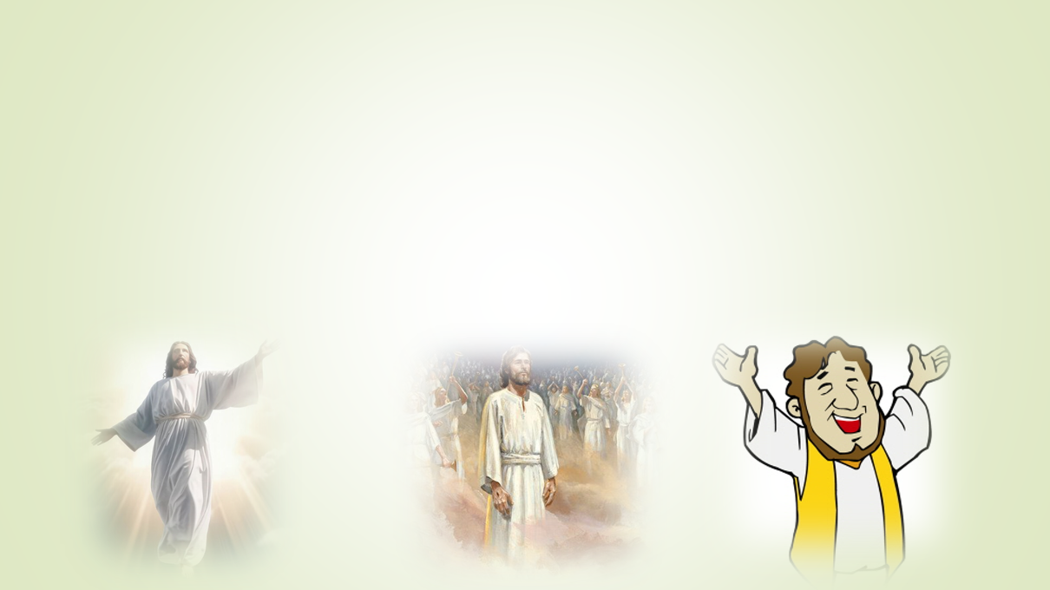

5/13

Slide 6

6/13

Slide 7


7/13

Slide 8


8/13

Slide 9

9/13

Slide 10

10/13

Slide 11
11/13

Slide 12
12/13

Slide 13

13/13

