Slide 1
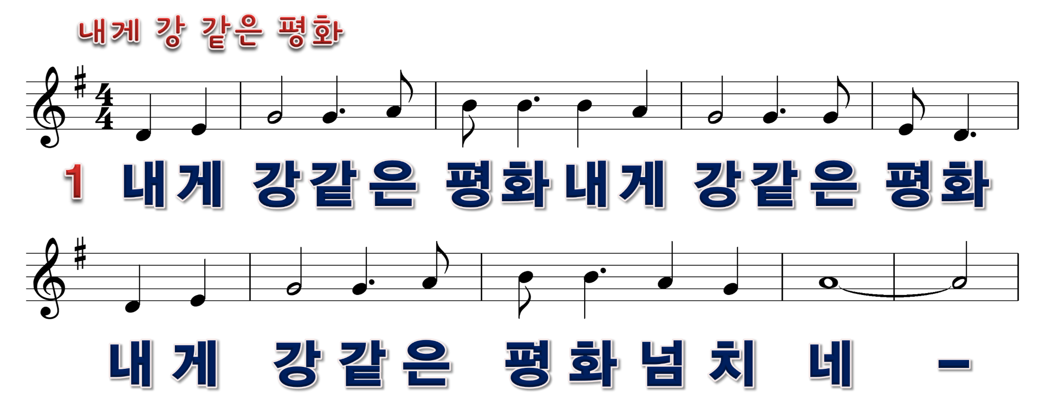
1/6

Slide 2

2/6

Slide 3

3/6

Slide 4

4/6

Slide 5

5/6

Slide 6

6/6

