Slide 1
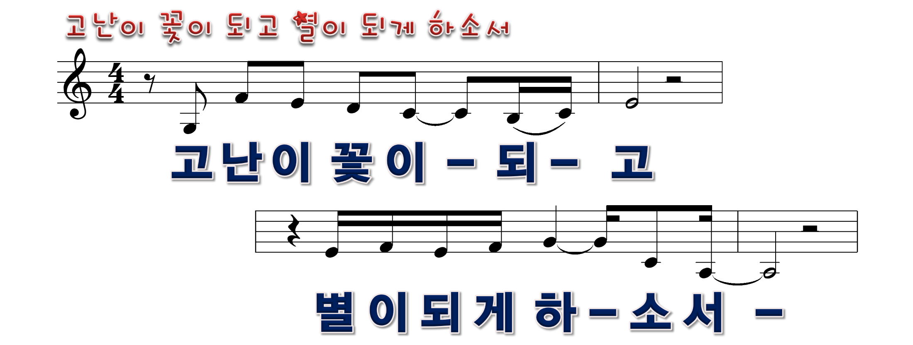
1/13

Slide 2

2/13

Slide 3
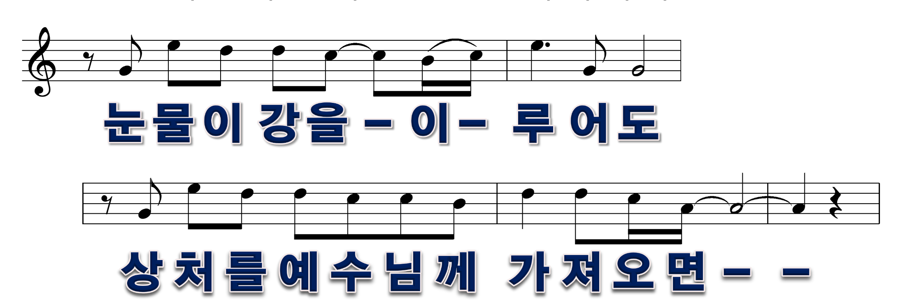
3/13

Slide 4

4/13

Slide 5
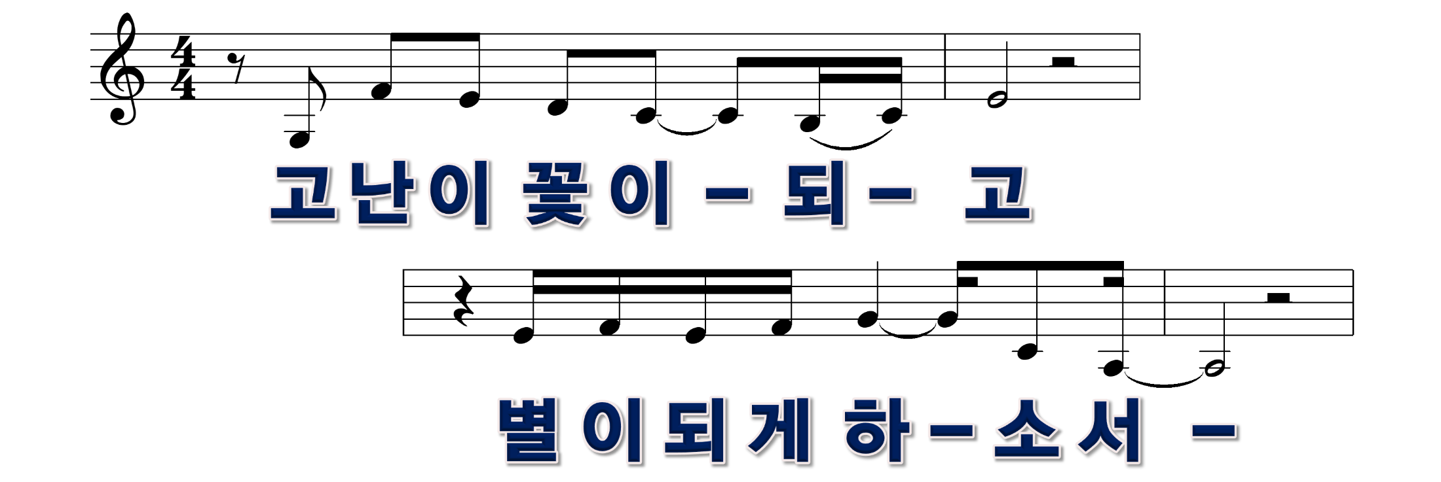
5/13

Slide 6

6/13

Slide 7
7/13

Slide 8

8/13

Slide 9

9/13

Slide 10
10/13

Slide 11

11/13

Slide 12
12/13

Slide 13


12/13

