Slide 1
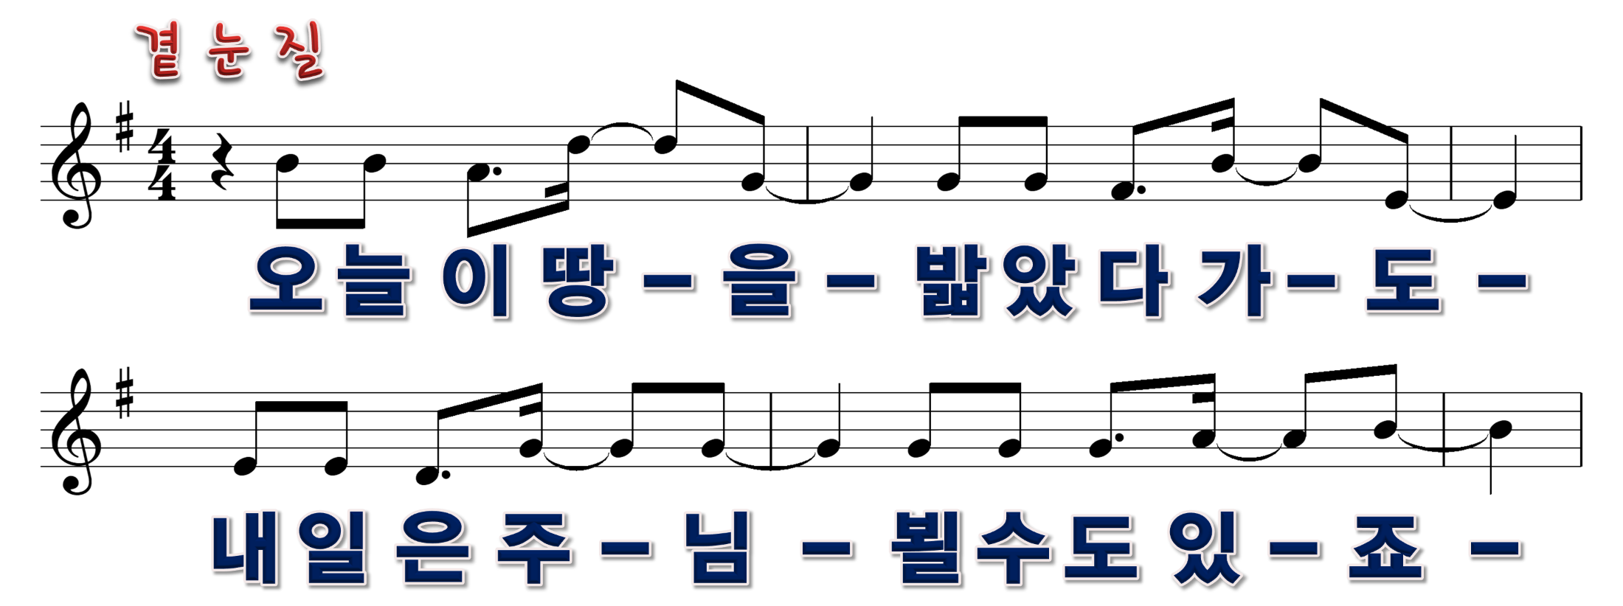
1/11

Slide 2

2/11

Slide 3
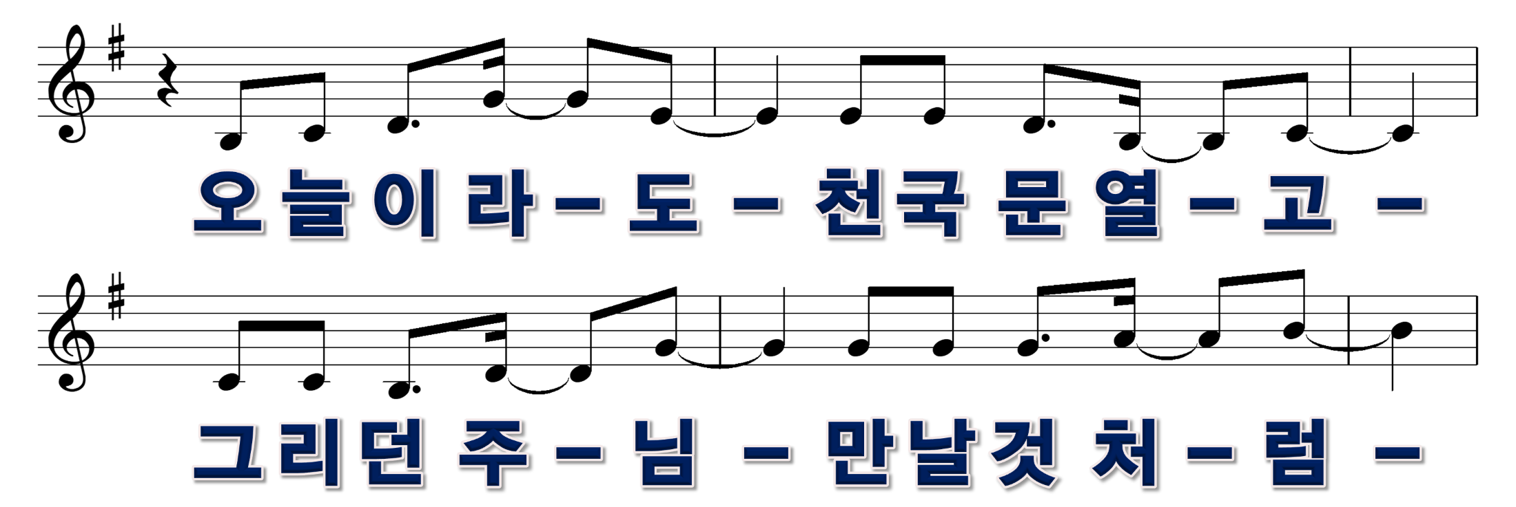
3/11

Slide 4
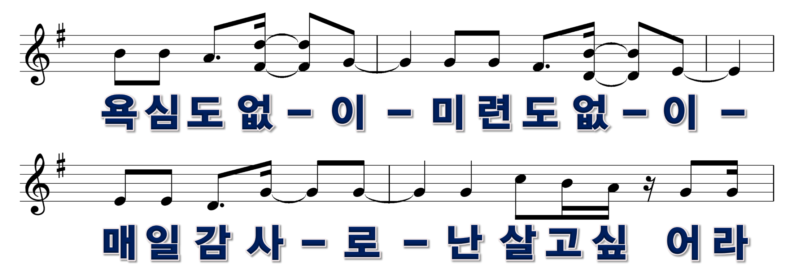
4/11

Slide 5
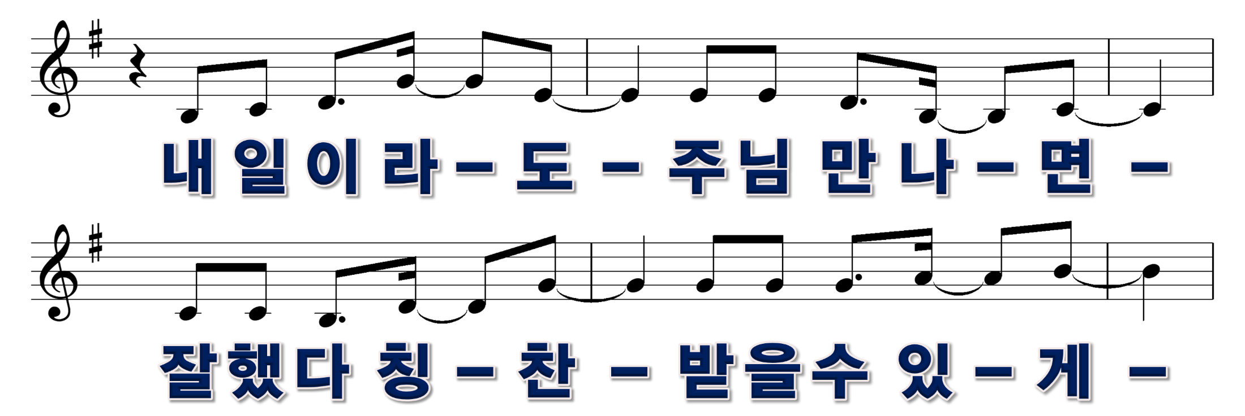
5/11

Slide 6
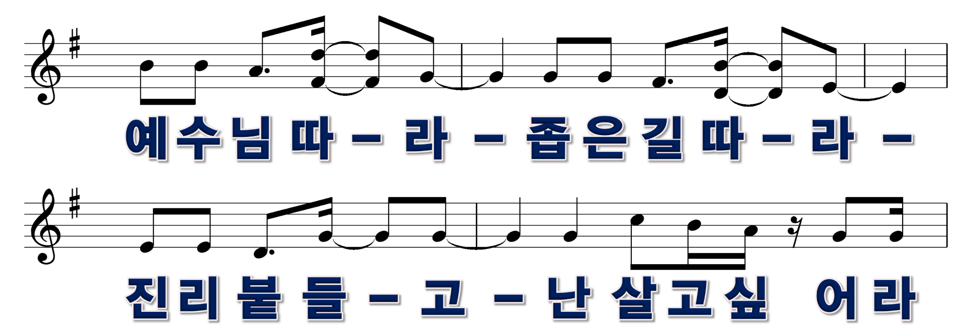
6/11

Slide 7

7/11

Slide 8

8/11

Slide 9
9/11

Slide 10


10/11

Slide 11

11/11

