Slide 1
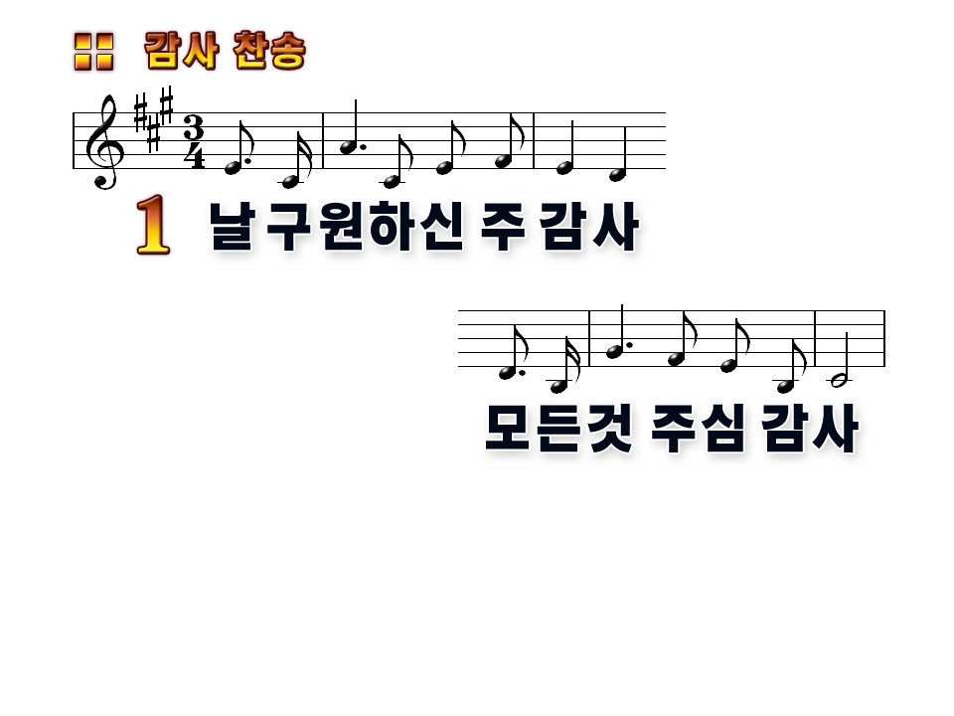
Thanks To God for my Redeemer,
Thanks for all Thou dost provide!

Slide 2
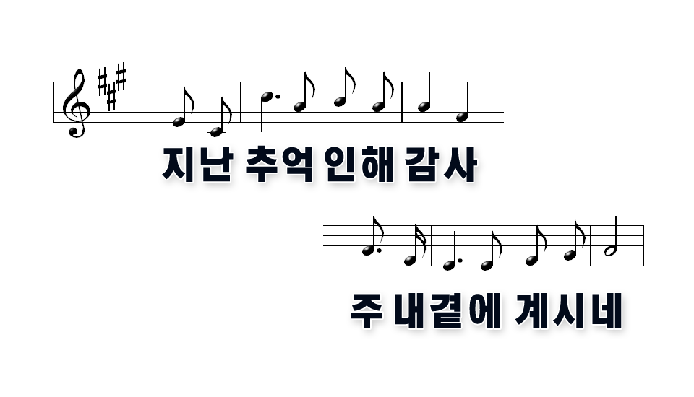
Thanks for times now but a memory, Thanks for Jesus by my side!

Slide 3
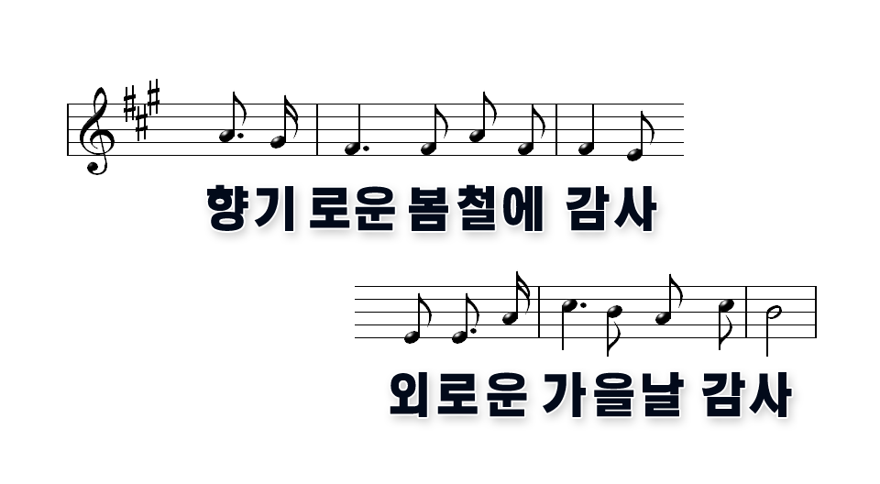
Thanks for pleasant, balmy springtime, Thanks for dark and stormy fall!

Slide 4
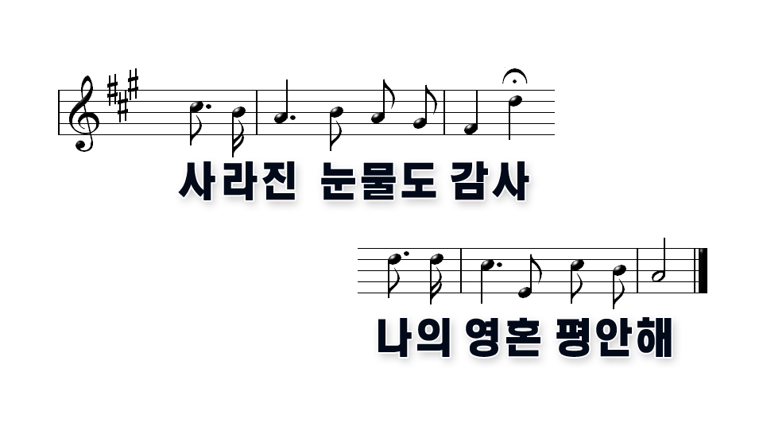
Thanks for Tears by now forgotten, Thanks for peace within my soul!

Slide 5
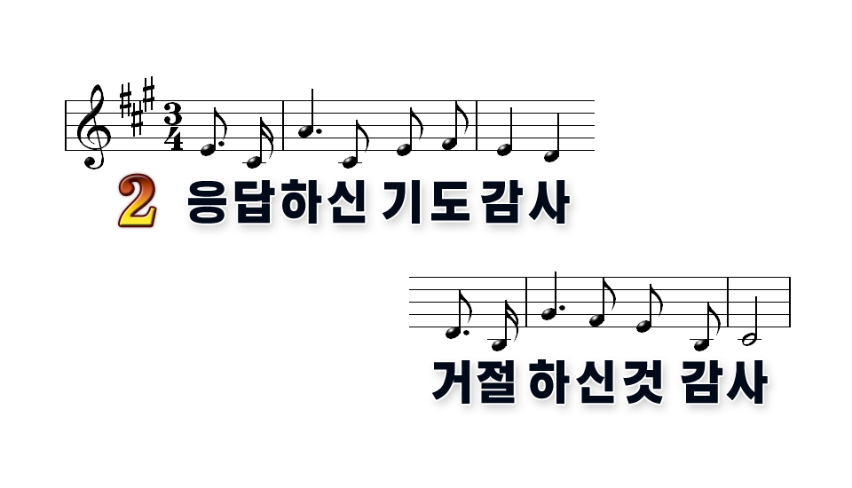
Thanks for prayers That Thou hast answered, Thanks for what Thou dost deny!

Slide 6

Thanks for storms That I have weathered, Thanks for all Thou dost supply!

Slide 7
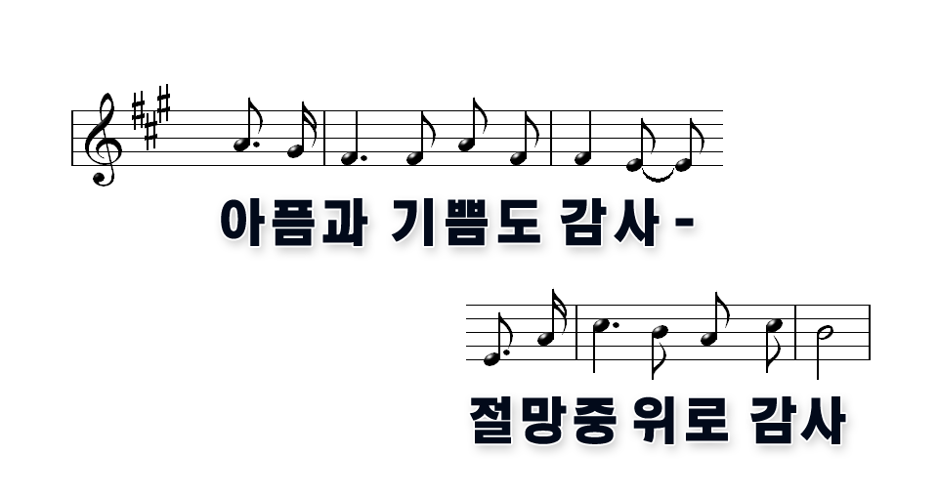
Thanks for pain, and Thanks for pleasure, Thanks for comfort in despair!

Slide 8

Thanks for grace That none can measure, Thanks for love beyond compare!

Slide 9
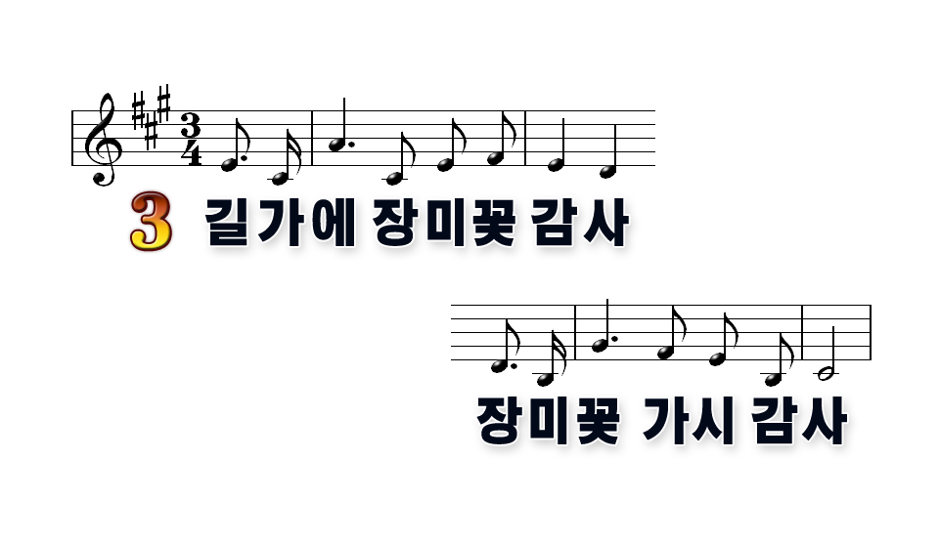
Thanks for roses by The wayside,
Thanks for thorns Their stems contain!

Slide 10
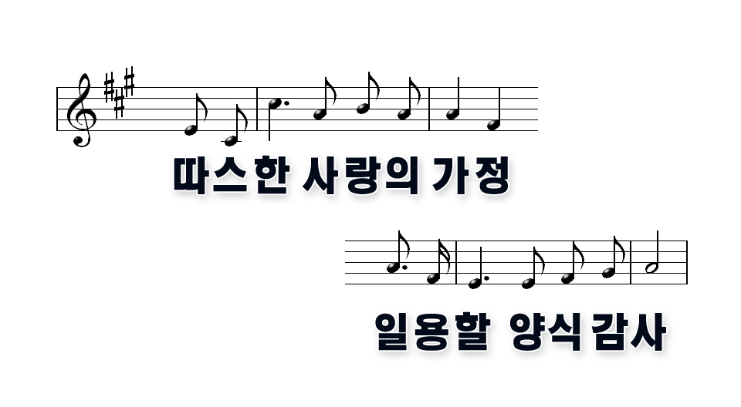
Thanks for home and Thanks for fireside, Thanks for hope, That sweet refrain!

Slide 11
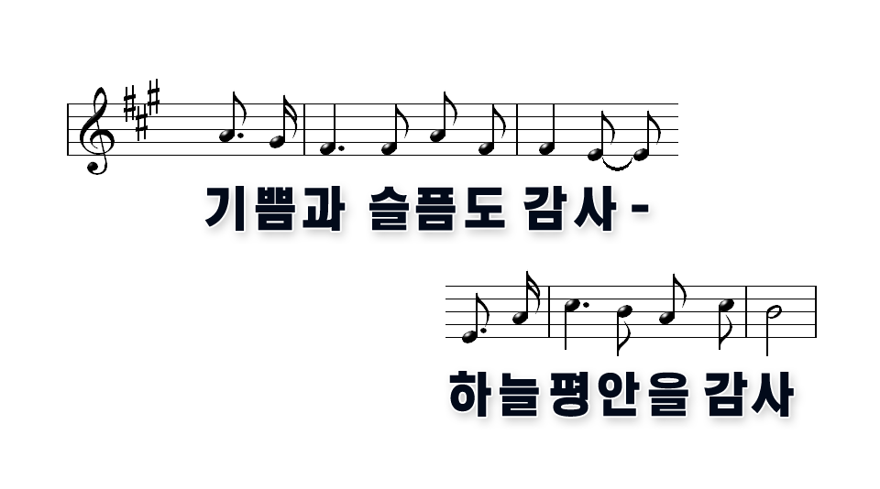
Thanks for joy and Thanks for sorrow, Thanks for heavenly peace with Thee!

Slide 12
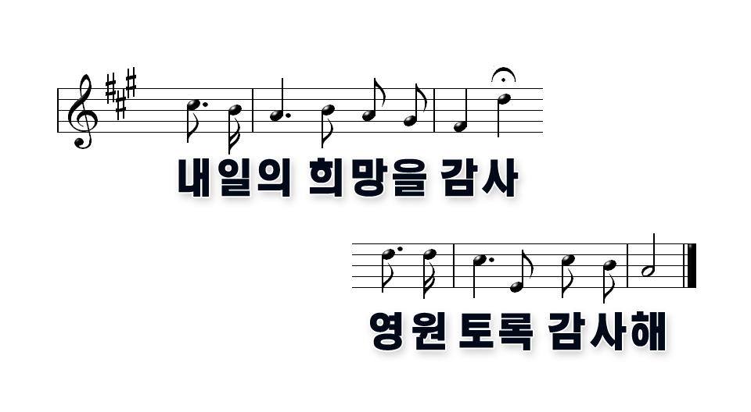
Thanks for hope in The Tomorrow, Thanks Through all eternity!

