Slide 1
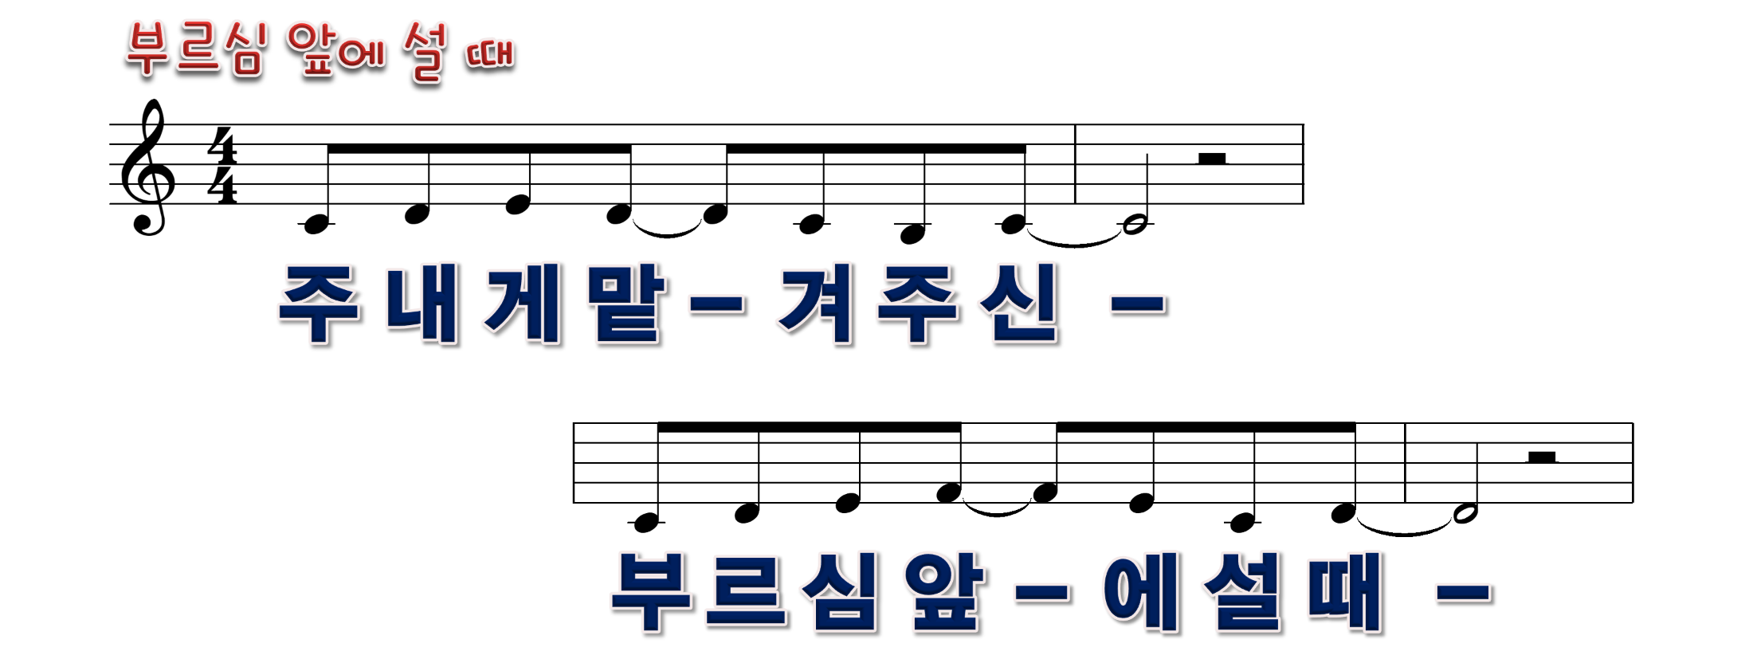
1/20

Slide 2
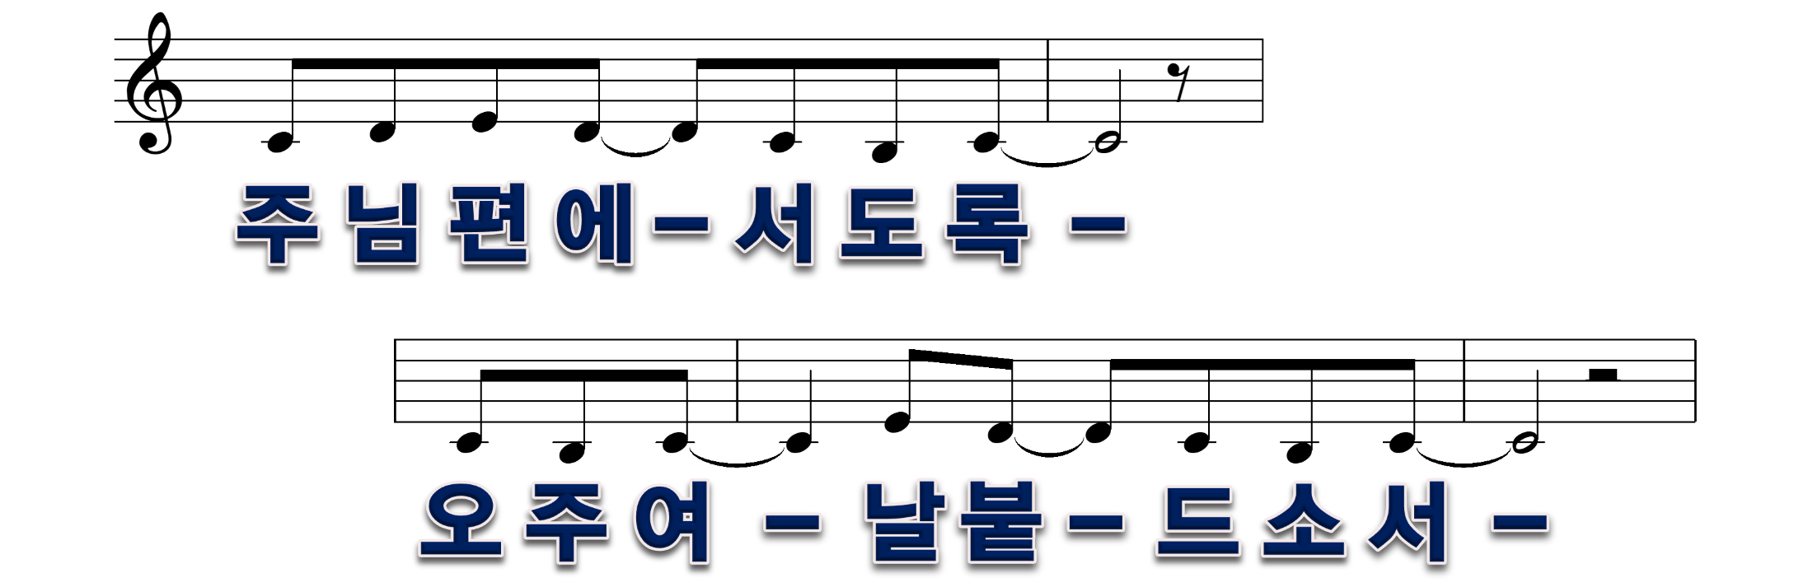
2/20

Slide 3
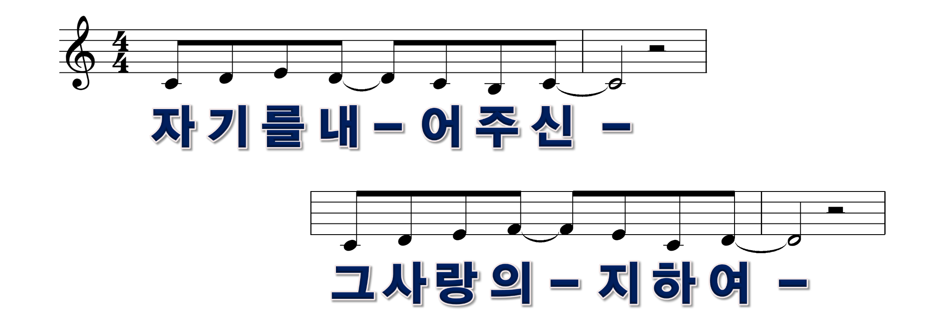
3/20

Slide 4
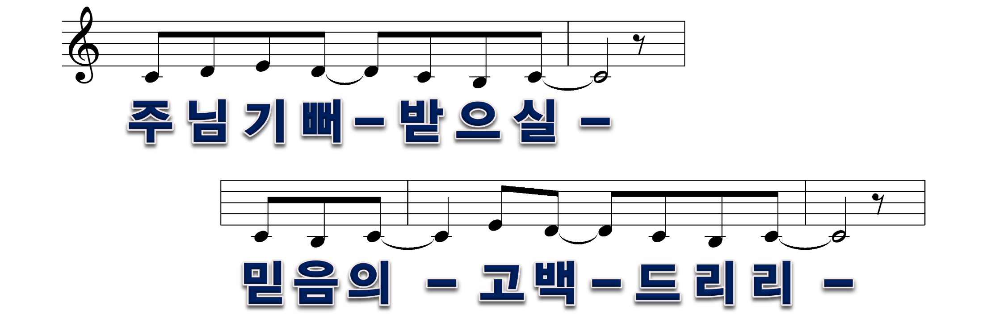
4/20

Slide 5
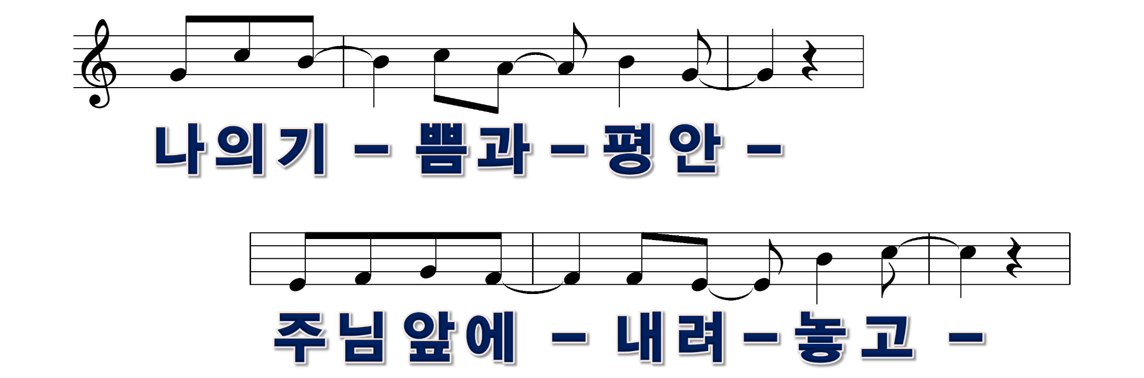
5/20

Slide 6
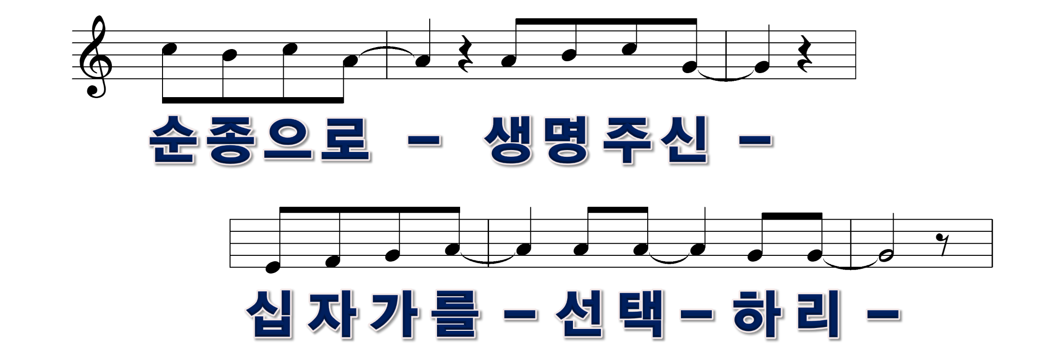
6/20

Slide 7
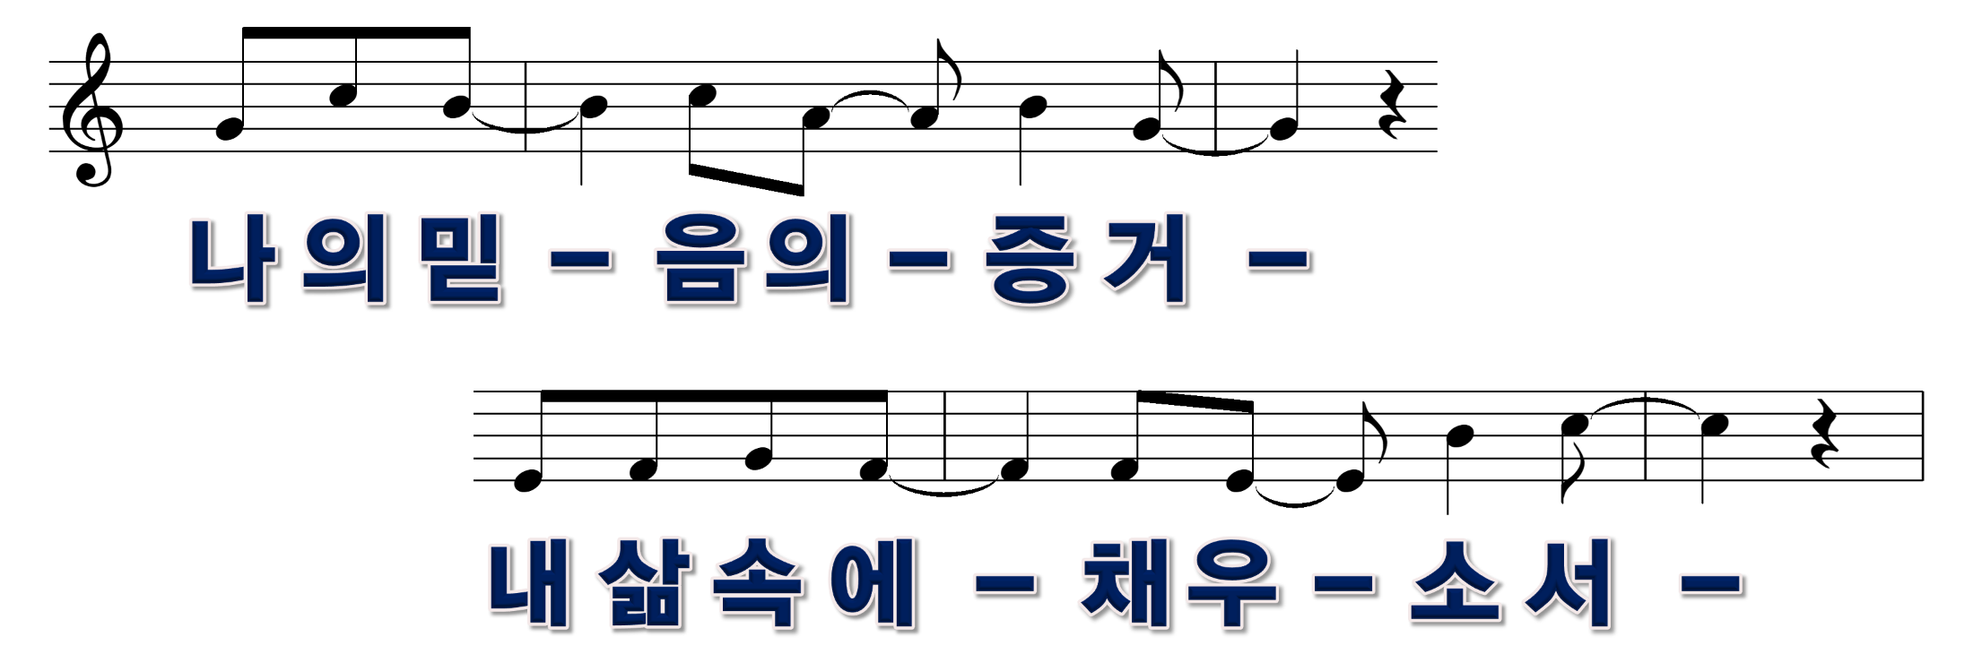
7/20

Slide 8

8/20

Slide 9

9/20

Slide 10
10/20

Slide 11
11/20

Slide 12
12/20

Slide 13
13/20

Slide 14
14/20

Slide 15
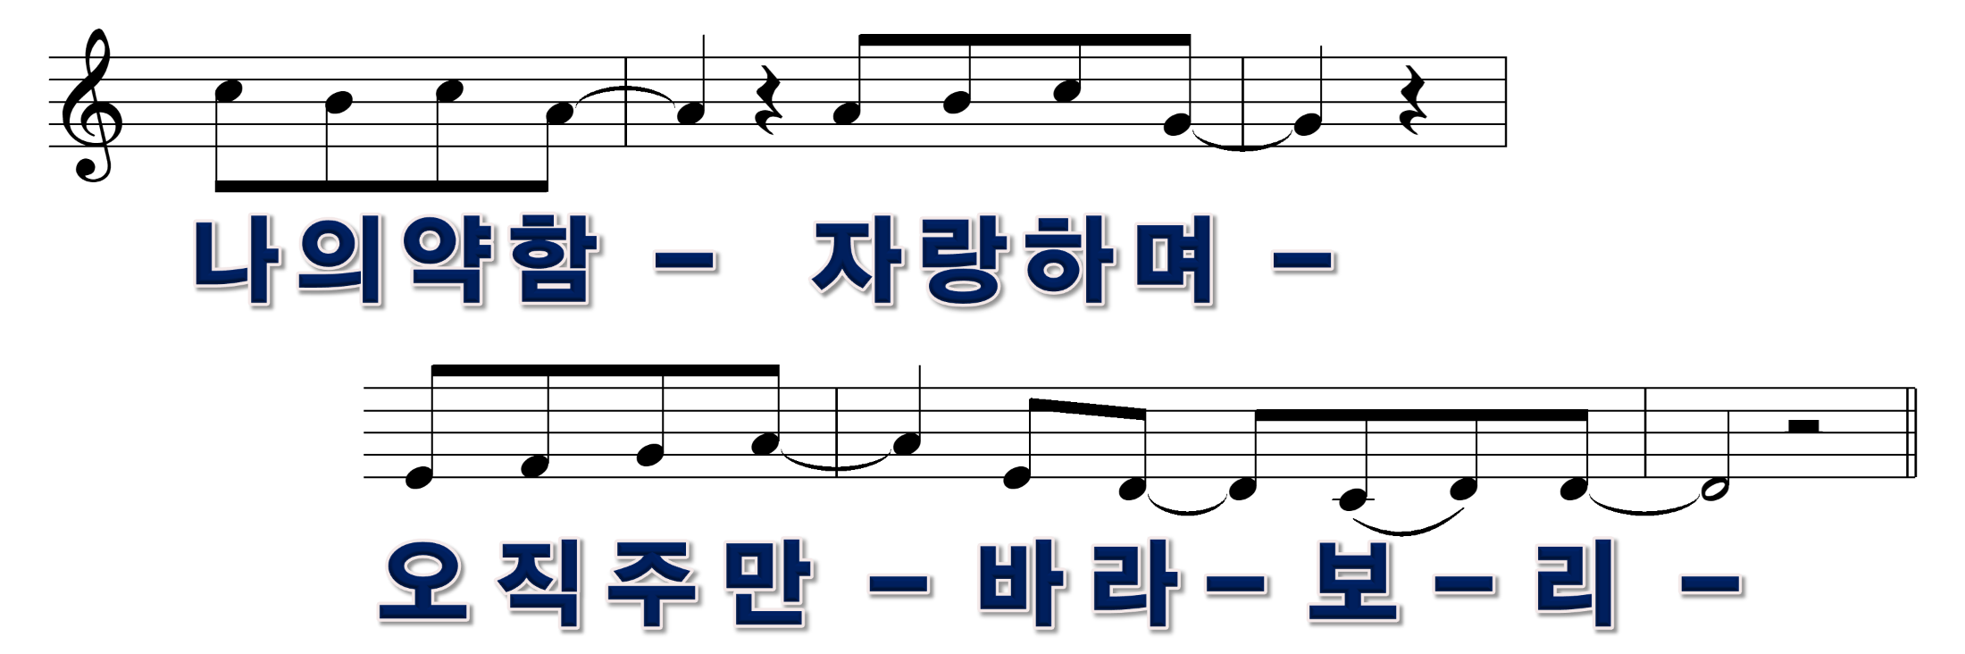
15/20

Slide 16
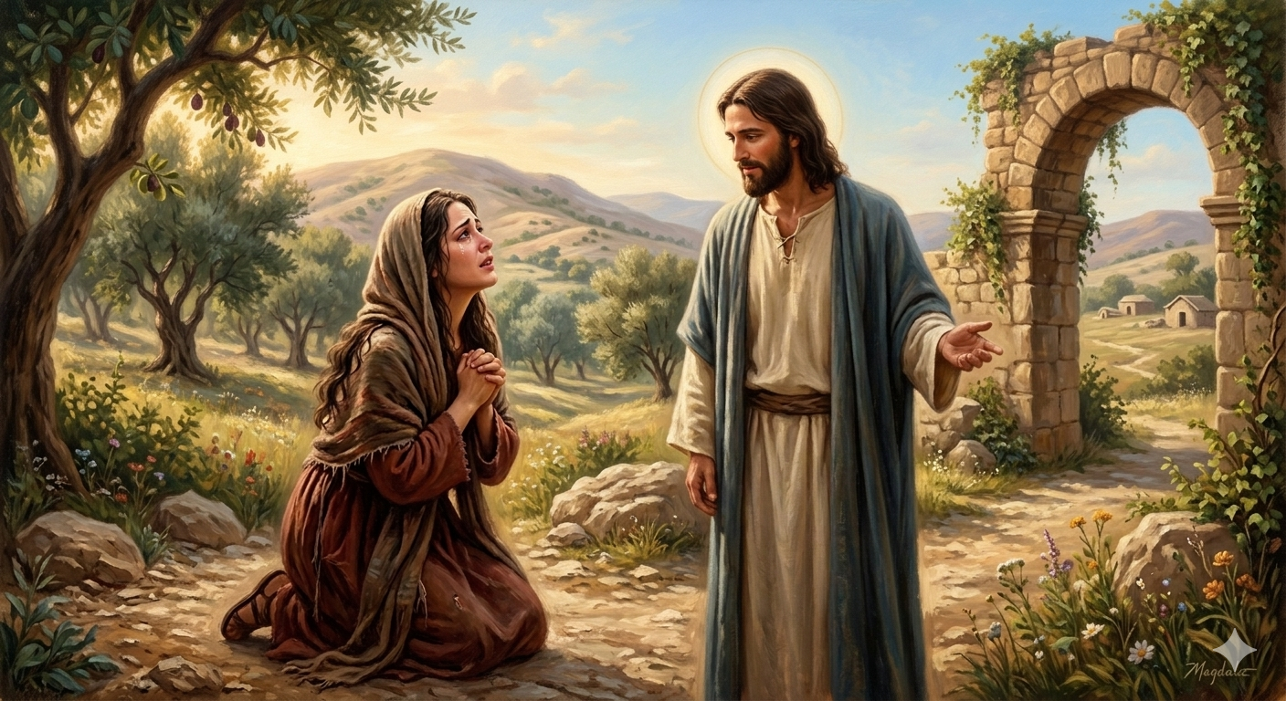
16/20

Slide 17
17/20

Slide 18
18/20

Slide 19
20/20

Slide 20
12/20

