Slide 1
FAST TCP : From Theory to Experiments
Sohn JongSoo
Intelligent Information System Lab.
mis026@korea.ac.kr

Slide 2
Index
Introduction
Motivation
Background theory
Equilibrium
Stability
FAST TCP
Parameter calculation
Experiments
Conclusion

Slide 3
Introduction
Congestion control algorithm
Size, speed, load, connectivity
Current TCP implementation
Performance bottleneck
Different congestion control algorithm for TCP
Called FAST TCP
Equation-based algorithm
Eliminating packet-level oscillations
Using queuing delay as the primary measure of congestion
Weighted proportioanl fairness in equilibrium
Does not penalize long flows, as the current congestions control algorithm

Slide 4
Motivation
High Energy and Nuclear Physics (HENP)
2,000 physicists, 150 universities, 30 countries
Require ability to analyze and share many terabyte-scale data collections
Key Challenge
Current congestion control algorithm of TCP does not scale to this regime

Slide 5
Background Theory
Congestion control consists of:
Source algorithm (TCP) that adapts sending rate (window) based on congestion feedback
Link algorithm (at router) that updates and feeds back a measure of congestion
Typically link algorithm is implicit and measure of congestion is loss probability or queueing delay

Slide 6
Background Theory (cont.)
Preliminary theory studies equilibrium and stability properties of the source-link algorithm pair
Source-link algorithm is TCP/AQM (active queue management)

Slide 7
Equilibrium
Interpret TCP/AQM as a distributed algorithm to solve a global optimization problem
Can be broken into two sub-problems
Source (maximize sum of all data rates)
Link (minimize congestion)

Slide 8
Equilibrium (cont.)
Source
Each source has a utility function, as a function of its data rate
Optimization problem is maximizing sum of all utility functions over their rates
Challenge is solving for optimal source rates in a distributed manner using only local information

Slide 9
Equilibrium (cont.)
Exploit Duality Theory
Associated with primal (source) utility maximization is dual (link congestion) minimization problem
Solving the dual problem is equivalent to solving the primal problem
Class of optimization algorithms that iteratively solve for both at once

Slide 10
Stability
Want to ensure equilibrium points are stable
When the network is perturbed out of equilibrium by random fluctuations, should drift back to new equilibrium point
Current TCP algorithms can become unstable as delay increases or network capacity increases

Slide 11
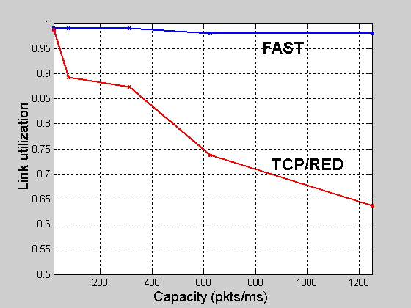
Lack of Scalability of TCP
ns-2 simulation
As capacity increases, link utilization of TCP/RED steadily drops
Main factor may be synchronization of TCP flows
capacity = 155Mbps, 622Mbps, 2.5Gbps, 5Gbps, 10Gbps;
100 ms round trip latency; 100 flows

Slide 12
FAST TCP
Implementation issues
Use both queueing delay and packet loss as congestion signals
Effectively deal with massive losses
Use pacing to reduce burstiness and massive losses
Converge rapidly to neighbourhood of equilibrium value after packet losses

Slide 13
FAST TCP - Implementation
Congestion window update
Weight = min(3/cwnd, 1/8)
α = the number of packets
each flow buffered
in the network

Slide 14
Calculating parameters (cont.)
α
Specifies total number of packets a single FAST connection tries to maintain in queues along its path
Can be used to tune the aggressiveness of the window update function

Slide 15
Calculating parameters
RTT and W_{old}
Timestamp every packet stored in retransmit queue and store W_{current}
On receipt of ACK, set RTT sample to difference in times. Also, set W_{old} to the stored window size of the ACK’ed packet
baseRTT is set to minimum observed RTT sample

Slide 16
Experiments - Infrastructure

Slide 17
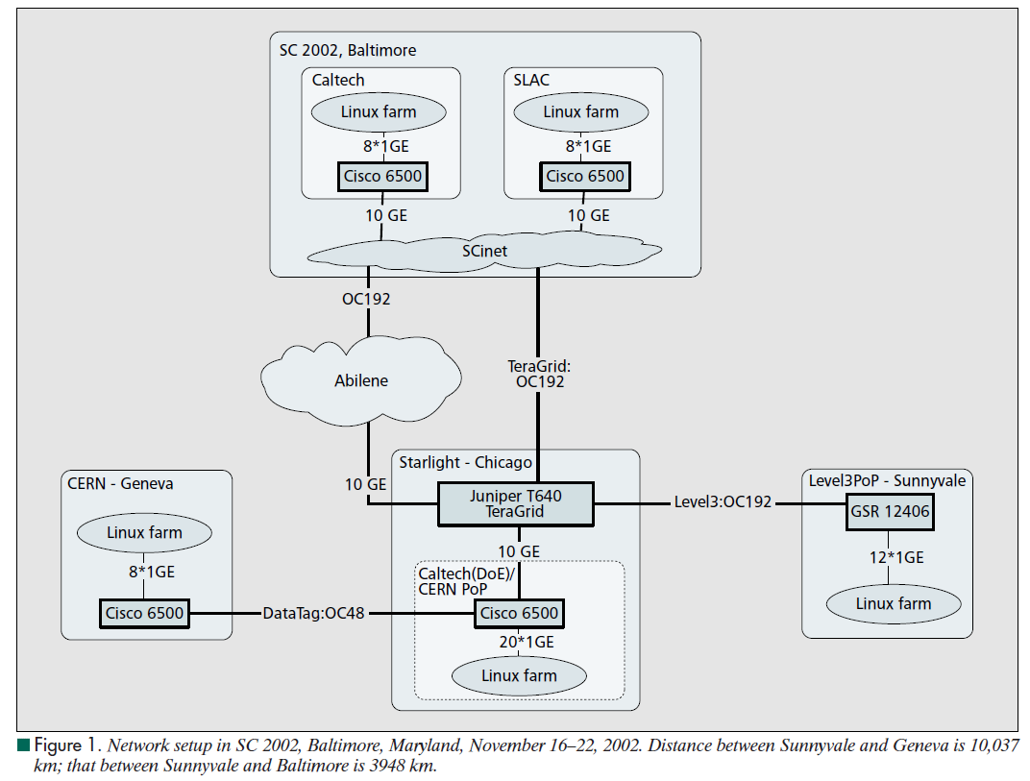
Infrastructure - Details
7, 9, 10 FAST flows
3,948 km
1, 2 Linux/FAST flows
10,037 km

Slide 18
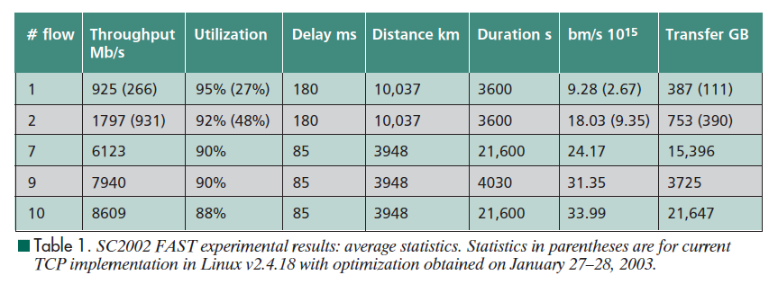
Throughput and Utilization
Statistics in parentheses are for current Linux TCP implementation
“bmps” = product of throughput and distance (bits-per-meter-per-second)

Slide 19
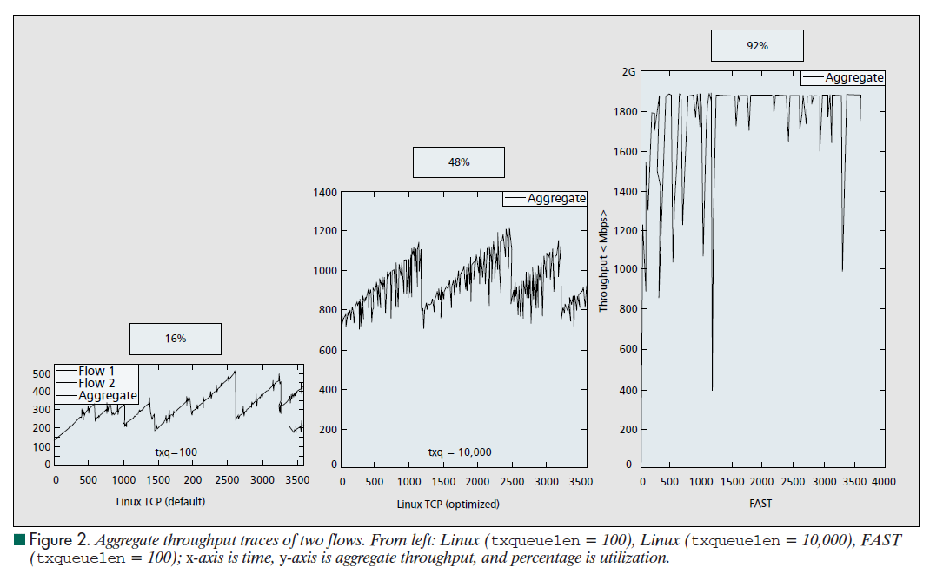
Average Utilization Traces

Slide 20
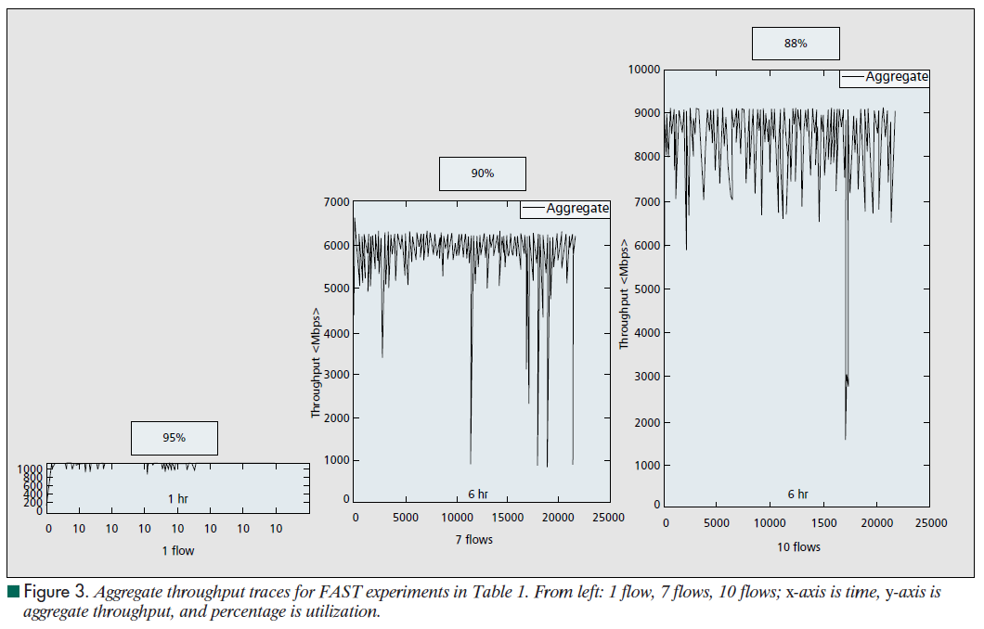
Traces (cont.)

Slide 21
Conclusions
Describing the development of FAST TCP
Background theory to actual implementation
High utilization
Without having to fill the buffer and incur large queuing delay
FAST TCP can converge rapidly
Yet stably

