Slide 1
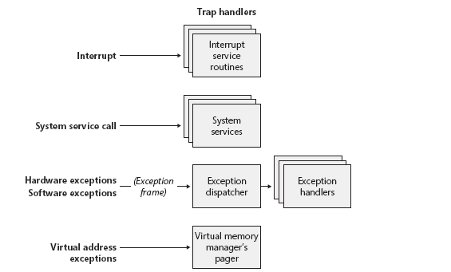
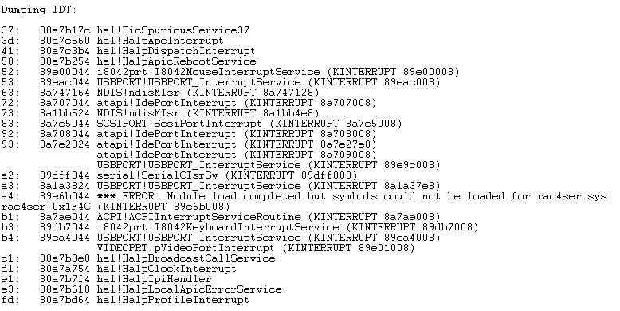
3. System Mechanisms
■ Trap Dispatching
- Trap : A Processor`s mechanism for capturing an executing thread an exception or an interrupt occurs and transferring control to
a fixed location in the OS.
- Trap handler : A function specific to a particular interrupt or exception.
- Interrupt : An asynchronous event (Not effect that processor us executing)
- Exception : A synchronous Condition
Processor : 현재 상태를 기록했다가 인터럽트 처리 후 재실행

Slide 2
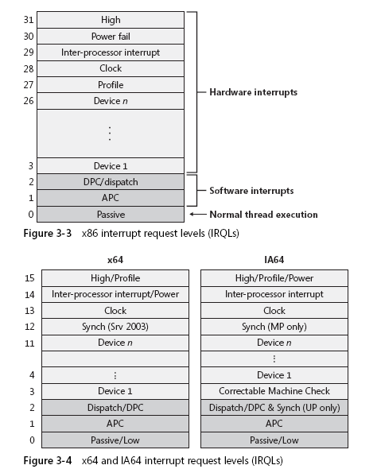
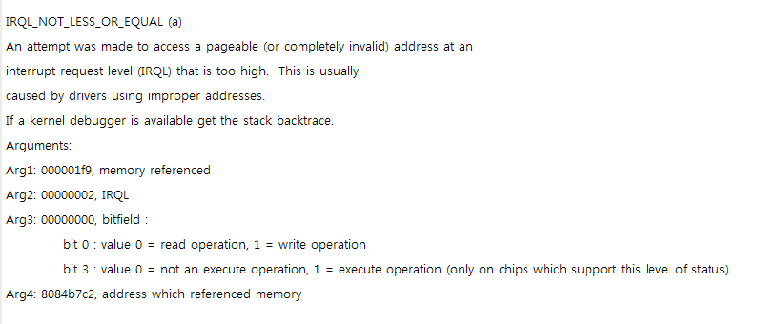
● H/W Interrupt Processing
- external I/O interrupts → interrupt controller → Interrupt # transfer to IRQ → IDT → transfers control to
interrupt dispatch routine.
1. x86 Interrupt Controllers
- PIC (Programmable Interrupt Controller – i8259A), APIC (Advanced PIC – i82489)
● S/W Interrupt Request Levels (IRQLs)
H/W
APC (Asynchronous Procedure Call)
DPC (Deferred Procedure Call)
High Level : System Crash
Power Fail
Inter-processor Interrupt : 다른 프로세서가 특정 Thread를
실행하도록 Dispatching, Shutdown, Crash
- Clock : Kernel의 날짜 유지, Thread에 대한 CPU 시간 측정 / 할당
Dispatch : S/W조절할 수 있는 가장 상위값
APC : 드라이버 사용 X,
S/W
Passive : User모드에서 실행되는 모든 Thread
● IRQL 설정 함수
- KeRaiseIrql() : 현재 값보다 상향으로 조절, 단순히 값만
- KeLowerIrql() : 현재 값보다 낮은쪽으로

Slide 3
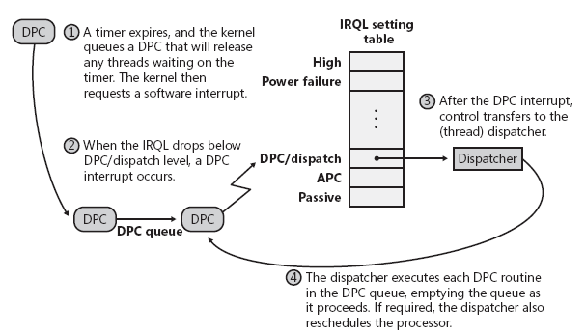
● DPC Interrupt (Dispatch or Deferred Procedure Call)
- Multiprocessor 상에서 동기화 : 병렬적인 Processor의 interrupt Routine
● APC Interrupt (Asynchronous Procedure Call)
- execute in the context of a particular thread and run at an IRQL less than DPC/dispatch level
- DPC 대기열과는 달리 APC 대기열에 스레드에 한정

